Slide 1
Committed to His Word
November 1

Slide 2
Video Introduction
View Video

Slide 3
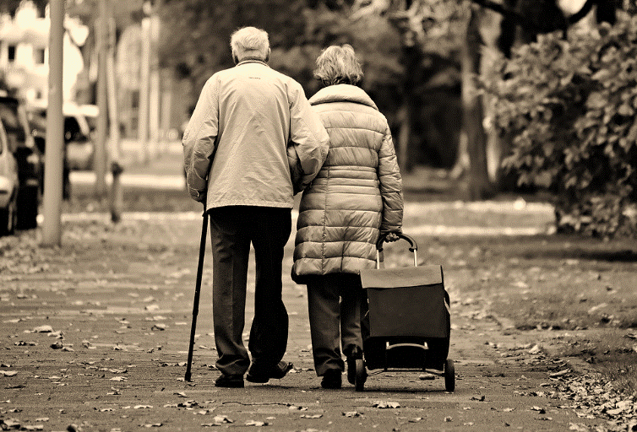
Think about it …
What advice would you include if you wrote a how-to book on growing older?
Many books exist on how to live.
One Book should be at the top of every person’s list.
God’s Word gives trustworthy guidance for all of life.

Slide 4
Listen for how to be blessed.
Psalm 119:1-4 (NIV) Blessed are they whose ways are blameless, who walk according to the law of the LORD. 2 Blessed are they who keep his statutes and seek him with all their heart. 3 They do nothing wrong; they walk in his ways. 4 You have laid down precepts that are to be fully obeyed.

Slide 5
Guiding Your Daily Walk
What is the path of blessedness presented in these verses? Who will be blessed by God?
What does God expect from us in relationship to His Word?
How do we seek God with our whole heart?

Slide 6
Guiding Your Daily Walk
How is the way the psalmist described the law of the Lord different from the way we typically think about law?
Why does it exhort us to seek Him with “all your heart”? Is obedience not enough?
Psalmist’s “Law” | Typical Concept of “Law”

Slide 7
Guiding Your Daily Walk
Consider this translation of verse 4. Psalm 119:4 (HCSB) You have commanded that Your precepts be diligently kept.
What does it mean to keep God’s precepts diligently? Let’s list some synonyms of the word “diligent.”

Slide 8
Guiding Your Daily Walk
If we are to keep God’s precepts, why must we be diligent?
How has God’s Word provided guidance for you?

Slide 9
Listen for more benefits of keeping God’s Word.
Psalm 119:5-8 (NIV) Oh, that my ways were steadfast in obeying your decrees! 6 Then I would not be put to shame when I consider all your commands. 7 I will praise you with an upright heart as I learn your righteous laws. 8 I will obey your decrees; do not utterly forsake me.

Slide 10
Leading You to Live Unashamed
Notice how the psalmist moves from the third person “those, their, they” to the second person “we”, to the first person “I.” What does this progression show you about the psalmist’s heart?
What does the psalmist desire?

Slide 11
Leading You to Live Unashamed
Consider Deuteronomy 31:8 (NIV) The LORD himself goes before you and will be with you; he will never leave you nor forsake you. Do not be afraid; do not be discouraged.
So why would the psalmist pray “do not utterly forsake me”?

Slide 12
Leading You to Live Unashamed
How can we avoid treating God’s Word like helpful hints rather than commands to be diligently kept? What specific steps can you take to increase the influence of God’s Word in your life?

Slide 13
Listen for why God’s Word is treasured.
Psalm 119:9-11 (NIV) How can a young man keep his way pure? By living according to your word. 10 I seek you with all my heart; do not let me stray from your commands. 11 I have hidden your word in my heart that I might not sin against you.

Slide 14
Keeping Us from Sin
What key question does the psalmist consider in beginning a new stanza?
What is the answer to the question? How has the psalmist guarded himself against sin?
How can treasuring God’s word resulted in changes in your life?

Slide 15
Keeping Us from Sin
Why do some believers today not treasure the Scriptures as they should?
What specific steps can you take to increase the influence of God’s Word in your life?

Slide 16
Application
Read.
If God’s Word has not been a part of your life, begin now.
Take time every day to read Scripture and meditate on what you read.
A good place to start is the Gospel of John.
Before you read, ask God to speak to you. He loves you and desperately wants to meet you in that time with Him.

Slide 17
Application
Store.
Consider practical ways to store up God’s Word in your heart.
For example, download an audio Bible and commit to listening to God’s word during your morning and evening commute.
Use an app like Scripture Memory Bible to help you memorize Scripture.
If you have children, use your dinner table as a time to teach your kids the Word of God.

Slide 18
Application
Teach.
Commit to helping others know God’s Word.
Multiply your group’s ministry by starting a new Bible study.
Reach out to those not currently in a group and let God use you to help them discover the rich guidance from His Word.

Slide 19
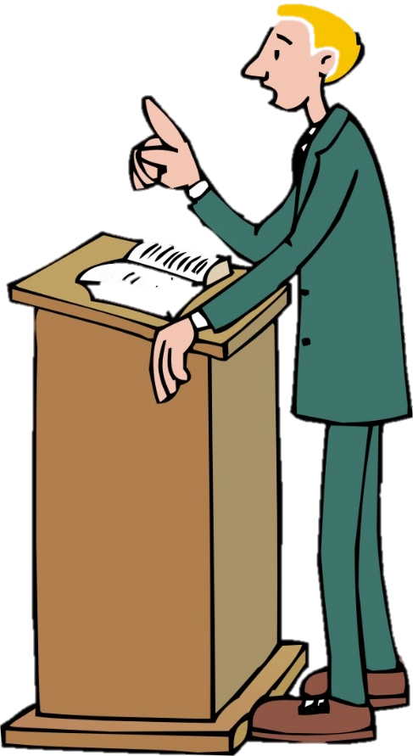
Family Activities
What about those other Family Activities?
Word has come to our offices that your pastor may be involved in the passing of a secret message to the United Neihuslands consulate. We need your help to decode it. Go to https://tinyurl.com/y4jx837v for help

Slide 20
Committed to His Word
November 2

