Slide 1
Committed to His Mission
November 29

Slide 2
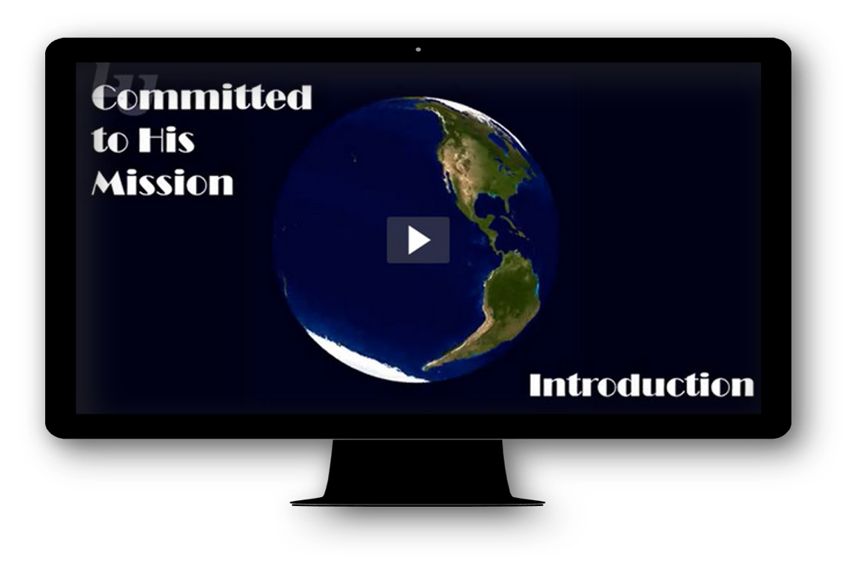
Video Introduction
View Video

Slide 3
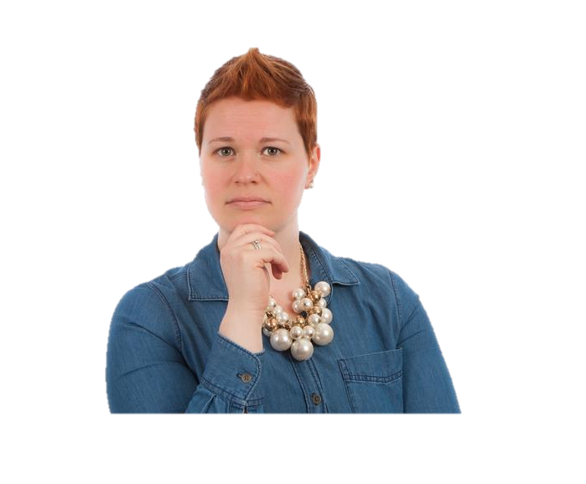
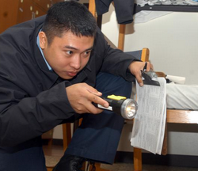
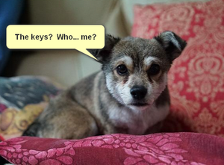
Admit it, now …
What’s your typical response when you lose something?
Our stuff seems to get lost easily.
Sometimes we know people who are lost … spiritually lost
God desires for all people be spiritually rescued, to hear and respond to the gospel.

Slide 4
Listen for what is necessary for salvation.
Romans 10:9-10 (NIV) That if you confess with your mouth, "Jesus is Lord," and believe in your heart that God raised him from the dead, you will be saved. 10 For it is with your heart that you believe and are justified, and it is with your mouth that you confess and are saved.

Slide 5
Confession and Belief in Christ
What two words did Paul use to convey being in right relationship with God through Christ?
What are the implications of confessing Jesus as Lord?
Explain why confession and believing are two parts of the same action, not two separate actions?

Slide 6
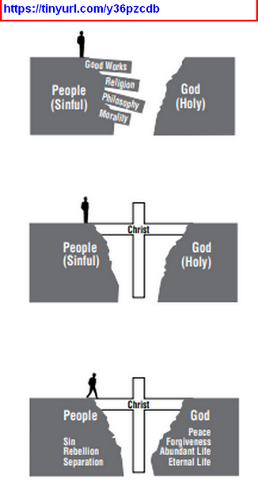
Confession and Belief in Christ
If you were called upon to tell what Jesus has done for you, what would you say?
From Steps to Peace with God
https://static.billygraham.org/sites/billygraham.org.uk/uploads/pro/2016/02/Printer-FriendlyStepstoPeacewithGod.pdf

Slide 7
Confession and Belief in Christ
Confessing “Jesus is Lord” is more important than believing in Jesus’ resurrection.
Agree or Disagree?
Agree | Disagree

Slide 8
Confession and Belief in Christ
Why do you think both confession and belief in the resurrection are necessary?
So if someone is watching us, how would they know that we confess Jesus as Lord?

Slide 9
Listen for who will be saved.
Romans 10:11-13 (NIV) As the Scripture says, "Anyone who trusts in him will never be put to shame." 12 For there is no difference between Jew and Gentile--the same Lord is Lord of all and richly blesses all who call on him, 13 for, "Everyone who calls on the name of the Lord will be saved."

Slide 10
Not Be Ashamed
According to these verses, who does God desire to be saved?
If God desires everyone to be saved, then what responsibility does that place on the individual in need of salvation?
What are the implications for us that the gospel message is for all people?

Slide 11
Not Be Ashamed
How do these verses both encourage and challenge you?
Racial or ethnic distinctions make no difference to God. Why do they sometimes still make a difference to us?
How can we overcome that kind of bias?
Encourage | Challenge

Slide 12
Listen for links of implication.
Romans 10:14-17 (NIV) How, then, can they call on the one they have not believed in? And how can they believe in the one of whom they have not heard? And how can they hear without someone preaching to them? 15 And how can they preach unless they are sent? As it is written, "How beautiful are the feet of those

Slide 13
Listen for links of implication.
who bring good news!" 16 But not all the Israelites accepted the good news. For Isaiah says, "Lord, who has believed our message?" 17 Consequently, faith comes from hearing the message, and the message is heard through the word of Christ.

Slide 14
Share the Message of Salvation
List the sequence of dependencies for someone to end up believing in Christ. Work your way from the end of the first sentence in verse 15 to the beginning of verse 14.

Slide 15
Share the Message of Salvation
What were the circumstances of your coming to faith. Who do you remember being significant in communicating the gospel to you?
What factors in this passage help to develop a sense of urgency for telling others about Jesus?

Slide 16
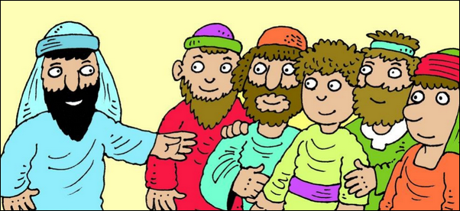
Share the Message of Salvation
How does Paul’s strategy for evangelism in these verses parallel the Great Commission ?
How can you be involved in communicating the gospel in places where you cannot go?
Go and make disciples of all nations, baptizing them in the name of the Father and of the Son and of the Holy Spirit, and teaching them to obey everything I have commanded you.

Slide 17
Application
Write.
Take time this week to write out your testimony.
Being committed to the mission of God to take the message of the gospel to those who haven’t heard it must begin with a clear understanding of your own story.
Write it down so that when you’re given the opportunity you can share it with clarity.

Slide 18
Application
Share.
This week share the gospel with someone.
Pray that the Holy Spirit would give you an opportunity and then look for that door to open.
When presents itself, simply share your story of how Jesus changed your life.
Invite them to call on the name of the Lord and be saved.

Slide 19
Application
Go.
Pray about being part of God’s mission around the world.
For some of you that might mean giving financially to missions.
For others that might mean actively supporting a missionary with your time, prayers, and support.
Still others might sense the call to go yourselves.
Pray that God will use you, and that you will have the courage to answer His call.

Slide 20
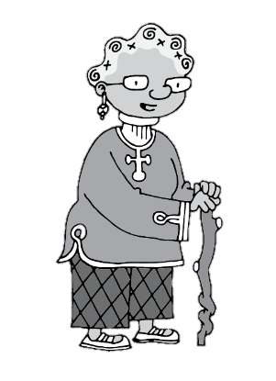
Family Activities
Well, that Fallen Phrases puzzle is not what’s in your handout. But it and other Family Activities are available at https://tinyurl.com/y6g54fax You’ll need to work on the Crossword. See how much you can do without looking at the Bible passage!

Slide 21
Committed to His Mission
November 29

