Slide 1
Committed to His Church
November 8

Slide 2

Video Introduction
View Video

Slide 3
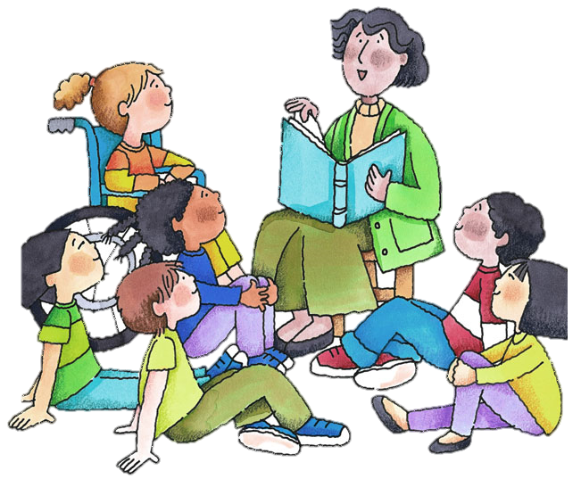
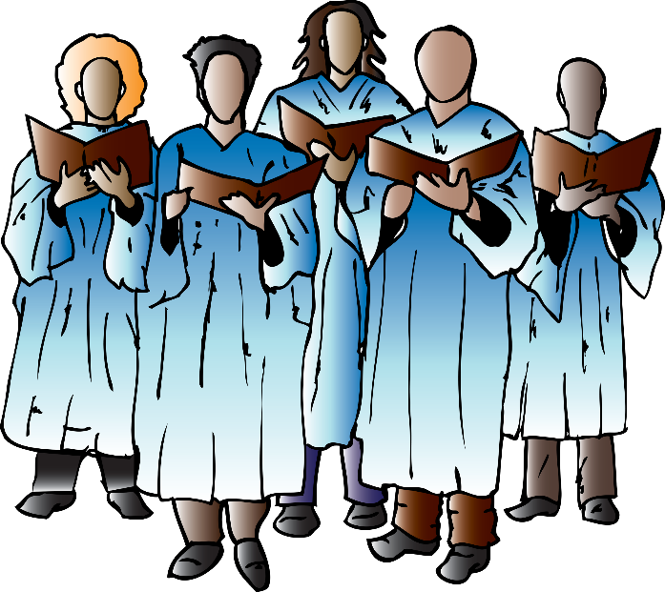

Remember when …
What are some of your first memories of church?
Regular attendance as a family required commitment.
  God calls us to commitment not just to the church but most importantly to Christ.
  And commitment to Christ includes a commitment to His Body, the Church.

Slide 4
Listen for a comparison to the human body.
Romans 12:3-5 (NIV) For by the grace given me I say to every one of you: Do not think of yourself more highly than you ought, but rather think of yourself with sober judgment, in accordance with the measure of faith God has given you.

Slide 5
Listen for a comparison to the human body.
Just as each of us has one body with many members, and these members do not all have the same function, 5 so in Christ we who are many form one body, and each member belongs to all the others.

Slide 6
One Body in Christ
According to Paul, how should Christians think about themselves?
Note the analogy he used to describe the diversity with unity that is essential to health. How did he apply that to being one body in Christ?
How does the analogy of the human body help us better understand how the church should work?

Slide 7
One Body in Christ
It’s more important to have an eye than an ear.
Agree or disagree?
⇨The point is, that both are equally important … Paul is saying no one believer is more important than the other … all are equally important.
Agree | Disagree

Slide 8
One Body in Christ
How should these concepts keep a person from feeling superior or inferior to other Christians?
What does it look like when a believer underestimates his or her value to the church?
How could that kind of thinking hinder spiritual health … both for the church and for the individual?

Slide 9
One Body in Christ
What should be our attitude about service to the church provided by fellow believers?

Slide 10
Listen for using Spiritual gifts in the church.
Romans 12:6-8 (NIV) We have different gifts, according to the grace given us. If a man's gift is prophesying, let him use it in proportion to his faith. 7 If it is serving, let him serve; if it is teaching, let him teach; 8 if it is encouraging, let

Slide 11
Listen for using Spiritual gifts in the church.
him encourage; if it is contributing to the needs of others, let him give generously; if it is leadership, let him govern diligently; if it is showing mercy, let him do it cheerfully.

Slide 12
Using Gifts to Support the Body
On what basis are persons gifted?
How should that affect our attitude toward the gifts we have, that others have, and the way we use them?
What are some words or phrases which Paul uses to tell us the attituded with which we should use a Spiritual gift.

Slide 13
Using Gifts to Support the Body
What obstacles often prevent us from using our gifts as God intended?
When have you seen the benefits of someone using his or her spiritual gifts in the church?

Slide 14
Listen for attributes that enhance the unity in the church.
Romans 12:9-16 (NIV) Love must be sincere. Hate what is evil; cling to what is good. 10 Be devoted to one another in brotherly love. Honor one another above yourselves. 11 Never be lacking in zeal, but keep your spiritual fervor, serving the Lord. 12 Be joyful in hope, patient in affliction, faithful in prayer. 13 Share with God's

Slide 15
Listen for attributes that enhance the unity in the church.
people who are in need. Practice hospitality. 14 Bless those who persecute you; bless and do not curse. 15 Rejoice with those who rejoice; mourn with those who mourn. 16 Live in harmony with one another. Do not be proud, but be willing to associate with people of low position. Do not be conceited.

Slide 16
Serving the Lord Together
What are some ways Paul identified for how love will manifest itself in relationship to others?
How might these actions contribute to the unity of the body?

Slide 17
Serving the Lord Together
Consider three of these commands. How might they be either the easiest or the hardest to obey?
⇨ We must be careful neither to take these commands for granted nor become cynical in attitude. They are all important to the growth of the Body of Christ, the Church.
Command | Easiest to Obey | Hardest to Obey
Hospitality
Joyful in hope
Pray for each other

Slide 18

Serving the Lord Together
What would your church look like if all members loved each other in the way described in these verses?

Slide 19
Application
Think.
  Think about the love of Christ for you.
  Consider all the ways Jesus has loved you and consider His call on your life to love His bride in the way He loves you.
  Ask yourself: “How should I live differently in light of God’s love for me?”

Slide 20
Application
Minister.
  Identify the spiritual gift(s) God has given you and get busy using it.
  Ask your pastor or others in your group how you might utilize your gift to minister, strengthen, and support your church.

Slide 21
Application
Motivate.
  As the body of Christ, we have a responsibility for each other.
  Maybe you know a fellow believer who is either not connected to a local church or is not using his or her spiritual gift.
  Lovingly confront and encourage the person to carry out his or her role in the body of Christ

Slide 22
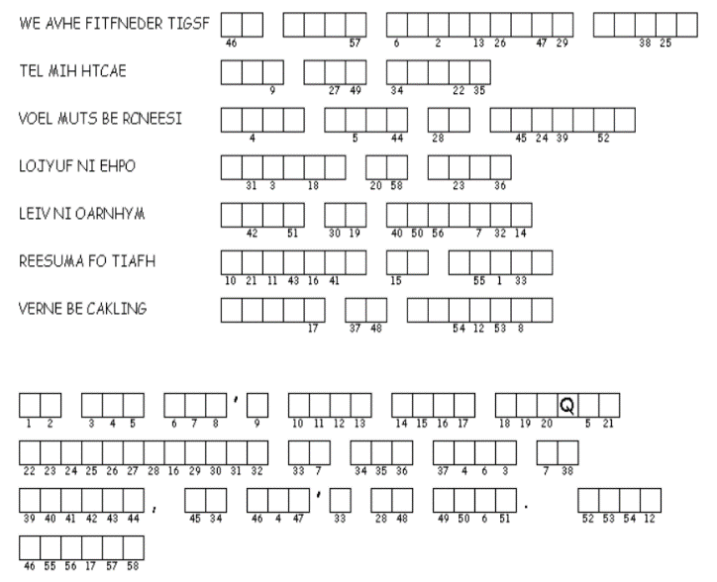

Family Activities
It is I … Spiros the Spy. This week’s Double Puzzle looks suspiciously like a message from Faba Wisauof, one of my operatives. Can you help us decode it? Maybe you have the gift of decoding. If you are suspicious, you might check other Family Activities at https://tinyurl.com/y2ohhwtf

Slide 23
Committed to His Church
November 8

