Slide 1
Christ’s Commitment to Us
October 18

Slide 2
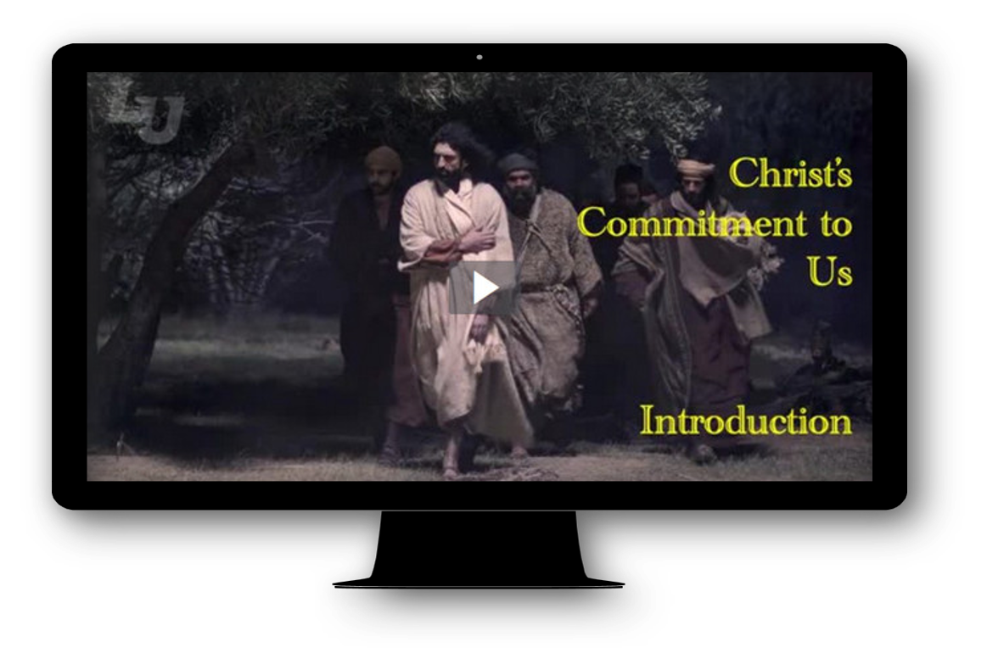
Video Introduction
View Video

Slide 3
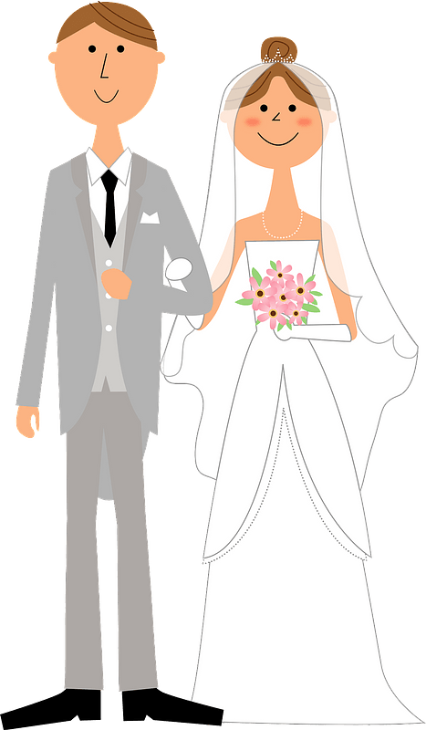


What do you remember?
What lessons about commitment were you taught growing up?
Consider Jesus’ commitment to us.
  There are times when we rebel against Him.
  Even then, Christ is fully committed to love us and bring us to God.

Slide 4

Listen for Jesus commitment.
Romans 5:6-8 (NIV) You see, at just the right time, when we were still powerless, Christ died for the ungodly. 7 Very rarely will anyone die for a righteous man, though for a good man someone might possibly dare to die. 8 But God demonstrates his own love for us in this: While we were still sinners, Christ died for us.

Slide 5
Committed to Die for Us
Paul said we were powerless, helpless. What feelings or kinds of situations do you associate with being powerless?
That was our condition, our situation when Christ died to provide our salvation
How does Paul explain the difference between human love and God’s love?

Slide 6
Committed to Die for Us
When might someone risk their life to protect someone who is important to them?
How does Christ’s sacrifice contrast to the heroic acts of normal people?
What does this imply about God’s love for us?

Slide 7
Committed to Die for Us
Jesus sacrificed his life for us when we were dirty, despicable sinners!!
How can this kind of love be reflected in our lives towards others around us?

Slide 8
Listen for how we are reconciled.
Romans 5:9-11 (NIV) Since we have now been justified by his blood, how much more shall we be saved from God's wrath through him! 10 For if, when we were God's enemies, we were reconciled to him through the death of his Son,

Slide 9
Listen for how we are reconciled.
how much more, having been reconciled, shall we be saved through his life! 11 Not only is this so, but we also rejoice in God through our Lord Jesus Christ, through whom we have now received reconciliation.

Slide 10
Committed to Reconcile Us to God
Because we are justified, from what shall we be saved?
What does it mean to be reconciled to God? How would you explain it to an unbeliever?
How is peace with God different from peace of mind?
Peace of Mind | Peace with God

Slide 11
Committed to Reconcile Us to God
Consider the present and future rescue from sin in our lives.
  We are saved from the penalty of sin because He died in our place
  We are saved from the power of sin in our lives, given a new life, a new power at work in our lives
  Eventually (in heaven) we will be rescued from the very presence of sin

Slide 12
Listen for contrasts, parallels.
Romans 5:12, 18 - 21 (NIV) Therefore, just as sin entered the world through one man, and death through sin, and in this way death came to all men, because all sinned-- …18 Consequently, just as the result of one trespass was condemnation for all men, so also the result of one act of righteousness was

Slide 13
Listen for contrasts, parallels.
justification that brings life for all men. 19 For just as through the disobedience of the one man the many were made sinners, so also through the obedience of the one man the many will be made righteous.20 The law was added so that

Slide 14
Listen for contrasts, parallels.
the trespass might increase. But where sin increased, grace increased all the more, 21 so that, just as sin reigned in death, so also grace might reign through righteousness to bring eternal life through Jesus Christ our Lord.

Slide 15
Committed to Give Us Eternal Life
What was the function of law in redemption?
What is the result of sin?
What is the benefit of grace?
How can God justly judge us for Adam’s sin?
How have you seen Adam’s sin continue to affect all humanity?

Slide 16
Committed to Give Us Eternal Life
What does it mean to you that where sin multiplied, grace multiplied even more?
What is the connection between Christ’s obedience and our righteousness?
How can knowing you are forgiven and righteous before God through Jesus Christ affect your attitudes and actions.

Slide 17
Application
Pray.
  If you never have accepted Jesus Christ as your Lord and Savior, do so now.
  Find someone you know who is a committed Christian and ask him or her to walk you through the steps of trusting in Christ as your Lord and Savior.
  You can also read the inside front cover of this book for help.

Slide 18
Application
List.
  Pray and reflect on Christ’s commitment to you.
  Ask yourself: “How am I living in light of Jesus’ great commitment to me?”
  Write down some ways you can live differently because of His great gift to you.

Slide 19
Application
Share.
  Share the love and commitment of Christ with someone this week who has never heard it.
  Pray that God would bring to your mind a name of someone who needs to hear the good news of the gospel.
  Make it a priority to share that good news with them.

Slide 20
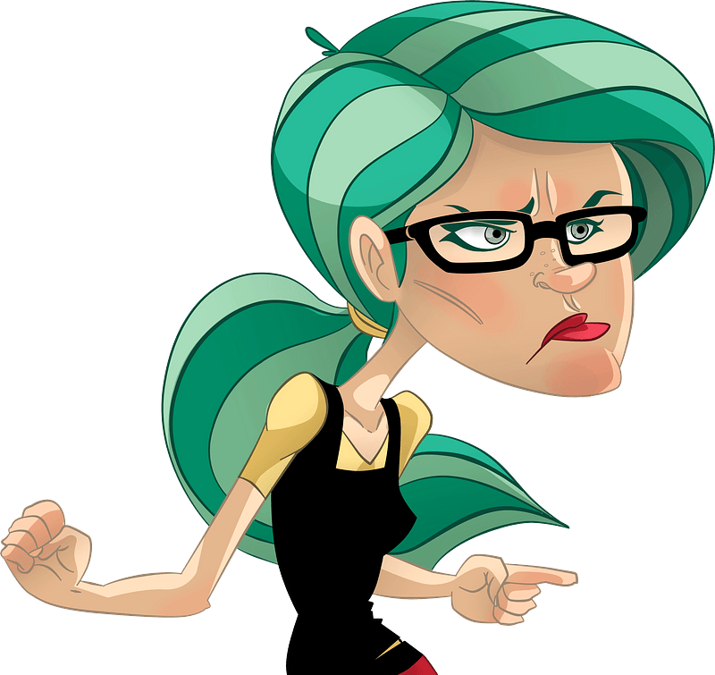
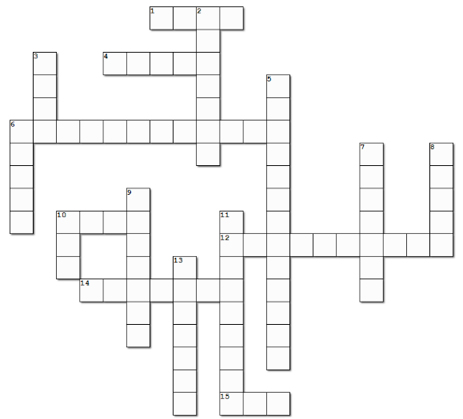
Family Activities
Well, it’s about time the Crossword Puzzle shows up. Everyone in our class likes it best … just sayin’ … But if you like your “Double Puzzle” that’s your alternative this week. And you really should look at what else is there … it’s good stuff. Go to
https://tinyurl.com/y3yuv8xv

Slide 21
Christ’s Commitment to Us
October 18

