Slide 1
Characterized by Love
June 6

Slide 2
Video Introduction
View Video

Slide 3
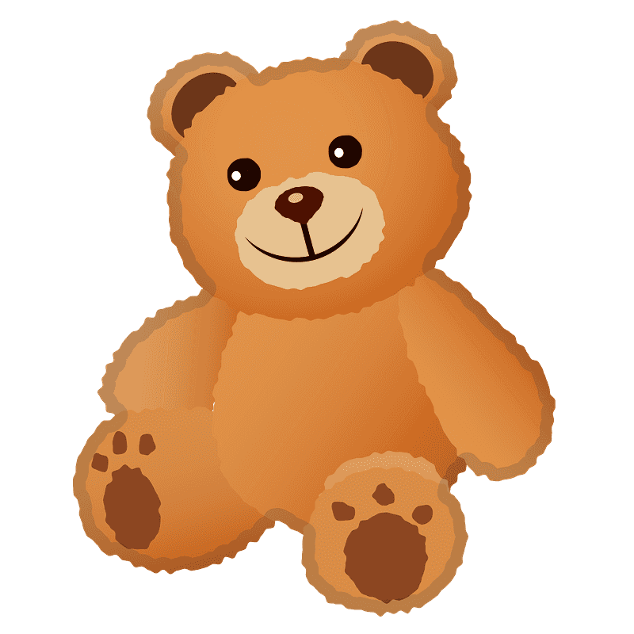
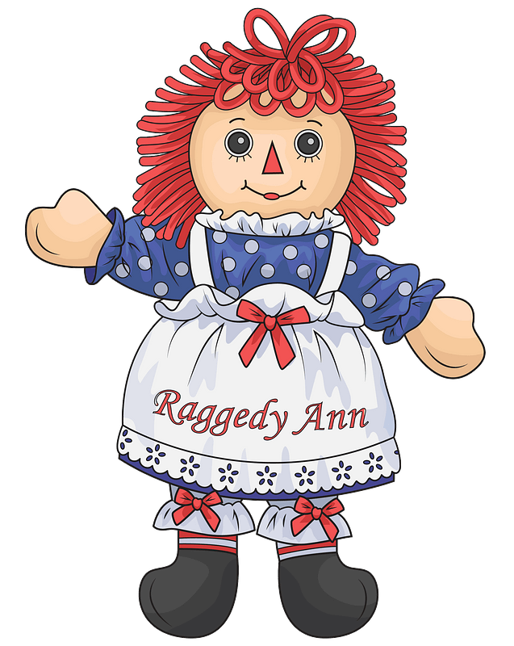
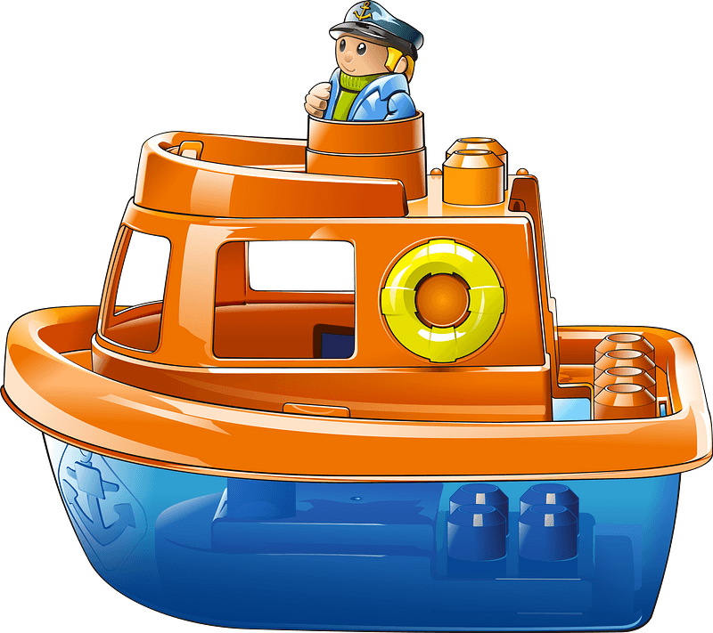
Admit it, now …
What is something you remember loving dearly as a child that you eventually outgrew?
Our fondness for children’s personal items wanes with maturity.
Our love for our Savior must not fade away over time.
When we ground everything we do in love for Christ we will keep our relationship to Him alive.

Slide 4
Listen for good deeds done.
Revelation 2:1-3 (NIV) "To the angel of the church in Ephesus write: These are the words of him who holds the seven stars in his right hand and walks among the seven golden lampstands: 2 I know your deeds, your hard work and your

Slide 5
Listen for good deeds done.
perseverance. I know that you cannot tolerate wicked men, that you have tested those who claim to be apostles but are not, and have found them false. 3 You have persevered and have endured hardships for my name, and have not grown weary.

Slide 6
Be Known for Your Good Works
To whom is this message given?
What two assurances come from the way in which the Lord identified Himself?
For what was the church at Ephesus to be commended?
Where is your church succeeding based on these verses? What are some of the ministries you are known for?

Slide 7
Be Known for Your Good Works
What things do people do that say that show or demonstrate who or what is most important in their lives?
How would you compare and contrast doing things for Jesus and spending time with Jesus?
They are similar … | They are different …

Slide 8
Listen for a criticism.
Revelation 2:4-6 (NIV) Yet I hold this against you: You have forsaken your first love. 5 Remember the height from which you have fallen! Repent and do the things you did at first. If you do not repent, I will come to you and remove your lampstand from its place. 6 But you have this in your favor: You hate the practices of the Nicolaitans, which I also hate

Slide 9
Love for Christ Motivates Good Works
What does verse 4 reveal about the Lord’s knowledge of His church?
What expectation of the Lord is implied by His pointing out their deficiency?
If a church is doing good and right, why does a drift from love need to be a concern?

Slide 10
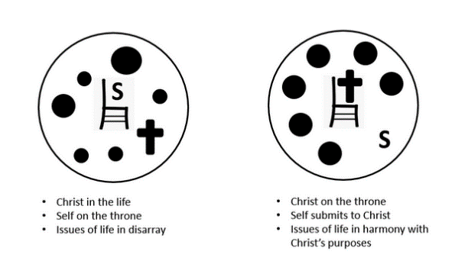
Love for Christ Motivates Good Works
How did the church at Ephesus need to change? What three steps were they to take to return to the fervency that had once characterized their service to the Lord?
What does it mean to repent? What does it look like for a person who is already a Christian to repent?

Slide 11
Listen for Jesus promise.
Revelation 2:7 (NIV) He who has an ear, let him hear what the Spirit says to the churches. To him who overcomes, I will give the right to eat from the tree of life, which is in the paradise of God.

Slide 12
One Day Dwell with Christ Forever
What does Jesus promise to those who hear and heed His Word?
What prior Biblical event and place do the symbols in this verse bring to mind?
What practices have helped you hear and follow the Holy Spirit? How can we keep our commitment to Christ from waning over time?

Slide 13
One Day Dwell with Christ Forever
How do we train ourselves to listen to what the Holy Spirit says throughout the day?
What are some costs and benefits when it comes to listening to the Spirit’s communications to us?
Costs | Benefits

Slide 14
Application
Listen.
Take some time each day to spend alone with God.
Read Scripture, and as you read, ask God to help you hear what the Spirit is saying.
Resolve to obey and act on what you read.

Slide 15
Application
Love.
Make a list of ways God has revealed His love to you.
Pray and express your love to Him in return.
Ask God to help you love Him in return and to keep that love in the forefront of everything you do.

Slide 16
Application
Return.
Throughout the COVID-19 pandemic, many believers got out of the habit of attending a worship service or Bible study group.
With a mindset of “return to your first love,” graciously encourage others to come back to sharing life with the body of Christ through worship and group study.

Slide 17
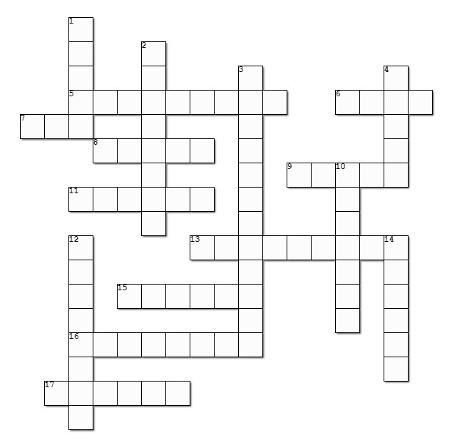
Family Activities
Just because the puzzle makes you cross, doesn’t mean you can’t do the Cross-Word puzzle!
Help is available at https://tinyurl.com/86a6fn6h
And you can find a variety of other Family Friendly Activities

Slide 18
Characterized by Love
June 6

