Slide 1
Can I Walk Away from My Salvation?
July 20

Slide 2

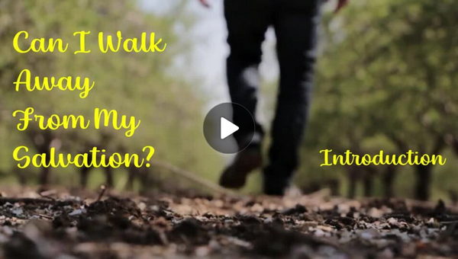
Video Introduction
View Video

Slide 3
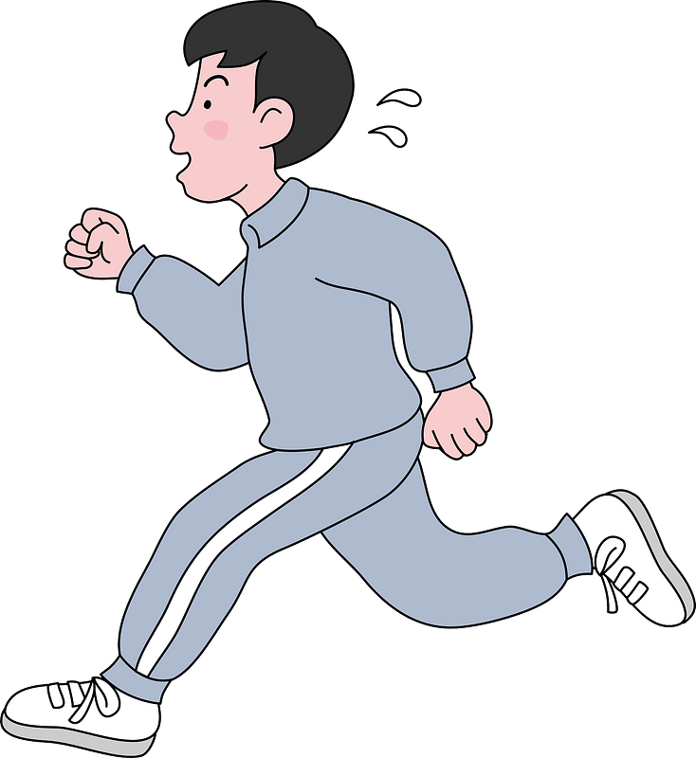

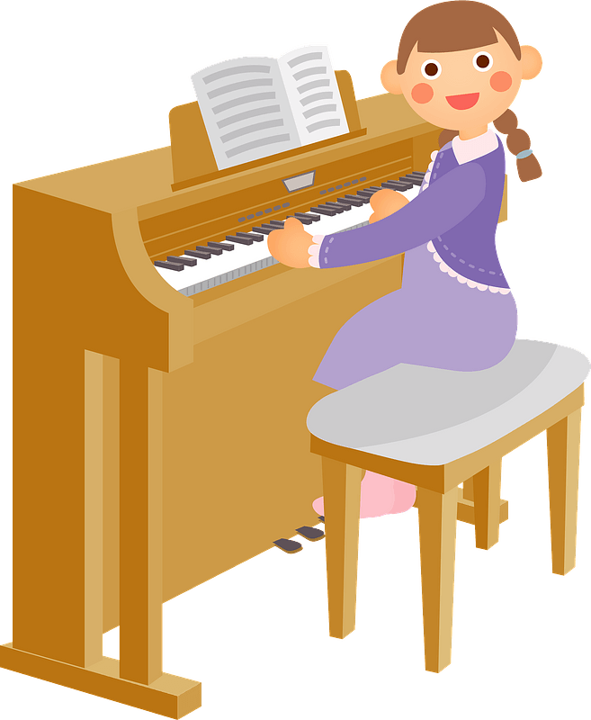
What was the occasion …
What is something you are glad you never quit? You persevered.
Perseverance can be a spiritual attribute.
A true relationship with Christ is seen in our perseverance.

Slide 4
Listen for how to grow.
Hebrews 6:1-3 (NIV) Therefore let us leave the elementary teachings about Christ and go on to maturity, not laying again the foundation of repentance from acts that lead to death, and of faith in God, 2 instruction about baptisms, the laying on of hands, the resurrection of the dead, and eternal judgment. 3 And God permitting, we will do so.

Slide 5
Growing Faith
Chapter 6 begins with a further challenge to maturity. What kinds of things are included here in our spiritual foundation?
Consider training you have received in some subject or skill. Maybe you also received advanced training. What does the advance training allow you to accomplish what you could not do when you only knew the basics?

Slide 6
Growing Faith
What is involved in the need for human effort in growing and maturing as a believer?
What indicates that human effort alone is not sufficient, and that spiritual growth is a work of God?

Slide 7
Listen for an agricultural example.
Hebrews 6:4-8 (NIV) It is impossible for those who have once been enlightened, who have tasted the heavenly gift, who have shared in the Holy Spirit, 5 who have tasted the goodness of the word of God and the powers of the coming age, 6 if they fall away, to be brought back to repentance, because to their loss they

Slide 8
Listen for an agricultural example.
are crucifying the Son of God all over again and subjecting him to public disgrace. 7 Land that drinks in the rain often falling on it and that produces a crop useful to those for whom it is farmed receives the blessing of God. 8 But land that produces thorns and thistles is worthless and is in danger of being cursed. In the end it will be burned.

Slide 9
Grounded in the Saving Work of Christ
What do believers who fail to mature and faithfully serve, bring upon the Lord, especially before those who are unbelievers?
How does it disgrace Christ when a person lapses back into his or her old way of life?
In what way can a Christian become useless to God?

Slide 10
Grounded in the Saving Work of Christ
Verse 7 uses the concept of crops to describe genuine faith. What happens to ground that receives the rain as it falls?
If the “rain” for our spiritual lives is God’s Truth, what is the “crop” that God intends would result.

Slide 11
Diligently Walking in Christ
How do you feel when someone gives you positive reinforcement like “Way to go!” or “Good job!” or “Nice effort, well done!” ?
We’ve heard challenge and correction, now listen for commendation and encouragement.

Slide 12
Listen for commendation, and encouragement.
Hebrews 6:9-12 (NIV) Even though we speak like this, dear friends, we are confident of better things in your case--things that accompany salvation. 10 God is not unjust; he will not forget your work and the love you have shown him as you have helped his

Slide 13
Listen for commendation, and encouragement.
people and continue to help them. 11 We want each of you to show this same diligence to the very end, in order to make your hope sure. 12 We do not want you to become lazy, but to imitate those who through faith and patience inherit what has been promised.

Slide 14
Diligently Walking in Christ
According to the passage, what does God remember?
What does it show when we help other believers.
In what ways are we to keep on showing diligence and perseverance?

Slide 15
Diligently Walking in Christ
Consider mentors you’ve had. How did they demonstrate faith and patience?
Perseverance demonstrates valid faith
Not a requirement for salvation
True saving faith will persevere
Faith Demonstrated | Patience Demonstrated

Slide 16
Application
Study.
Study the Bible and do what it says.
Remember, just learning more facts will not change your behavior.
Get busy putting the Bible into practice.
This journey is not for the faint of heart, but take courage!
God will sustain you as you strive to grow in your relationship with Him.

Slide 17
Application
Serve.
Become more than a passive church member; join a community and begin serving others.
This will include a formal leadership or service role, but that is not required.
Just find some needs among fellow Christians and meet them.

Slide 18
Application
Encourage.
You may know another believer who is struggling with his or her own faith.
Walk alongside this person and call him or her to persevere and walk with you as you both seek to walk with Christ.

Slide 19
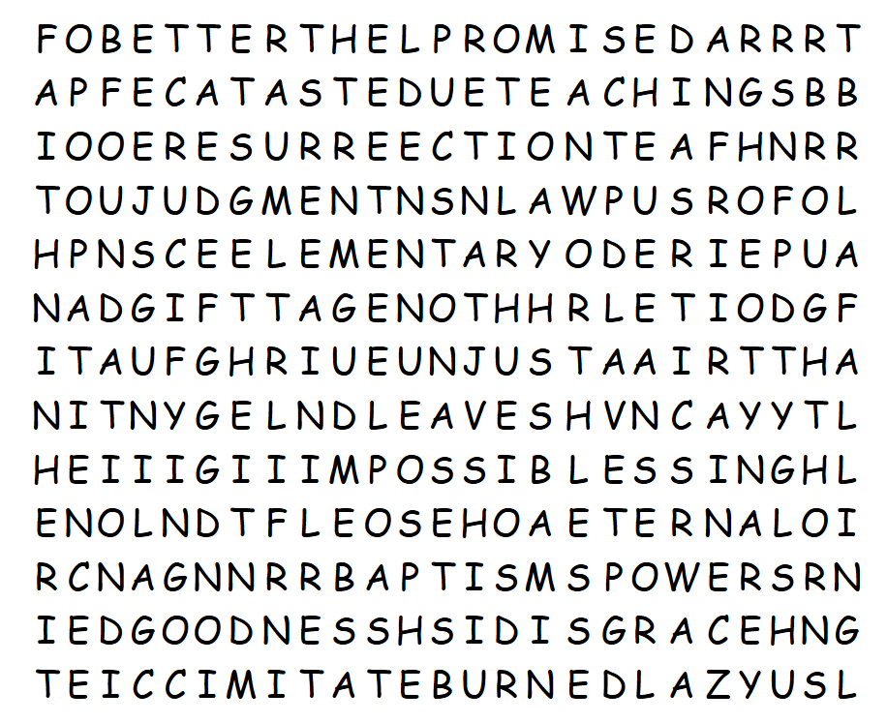

Family Activities
I can’t bear for you to lose to that other class. I have PROMISED for you to do BETTER when you look at the top row (hint, hint). Don’t tell them, but help is available at https://tinyurl.com/ycxtunf3 You should tell them to go ahead and try the crossword, instead, or maybe the color page.

Slide 20
Can I Walk Away from My Salvation?
NO !

