Slide 1
Can I Lose
My Salvation?
July 13

Slide 2

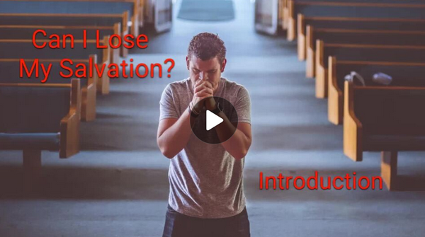
Video Introduction

Slide 3


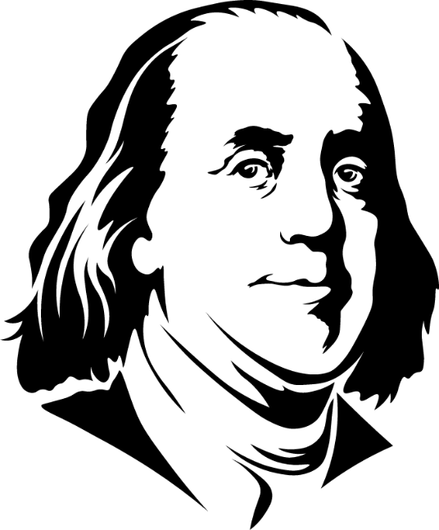
Remember these?
What are some words of wisdom relating to security?
Our lesson today considers security from God.
  God keeps His children securely in His hands.
A stich in time …
Trust, but …

Slide 4
Listen for a contrast.
John 10:7-11 (NIV) Therefore Jesus said again, "I tell you the truth, I am the gate for the sheep. 8 All who ever came before me were thieves and robbers, but the sheep did not listen to them. 9 I am the gate; whoever enters through me will be

Slide 5
Listen for a contrast.
saved. He will come in and go out, and find pasture. 10 The thief comes only to steal and kill and destroy; I have come that they may have life, and have it to the full. 11 "I am the good shepherd. The good shepherd lays down his life for the sheep.

Slide 6
Salvation and Abundant Life Promised
Jesus said He was the “gate” for the sheep. How could the shepherd be the “gate” for the sheep?
What is the significance or purpose of a door or a gate?
Note also the significance of Jesus statement, “I am the gate” and not a gate. Why is this important?

Slide 7
Salvation and Abundant Life Promised
What did Jesus say would be the result of entering through Him?
How did Jesus contrast His coming with the coming of a thief?
What are some common “thieves and robbers” in our lives? How have you seen the enemy steal, kill, and destroy in our culture?

Slide 8
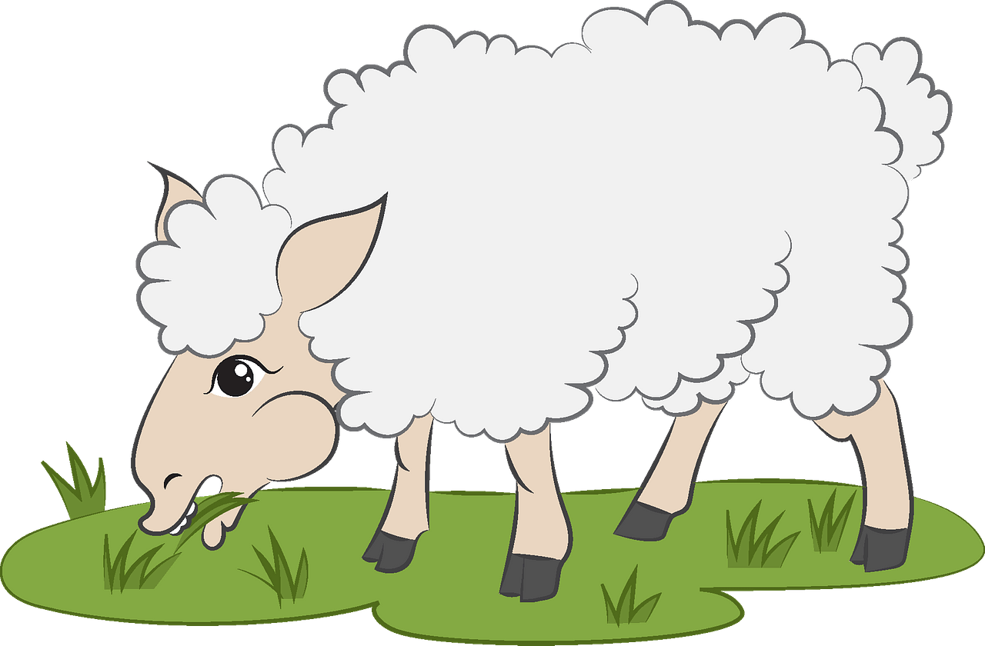
Salvation and Abundant Life Promised
Jesus said His sheep would “find pasture.” What do you think that means? How does that fit in with the “abundant life” or “life to the full” that Jesus promised?

Slide 9
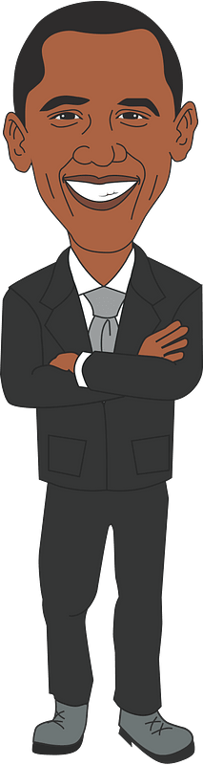
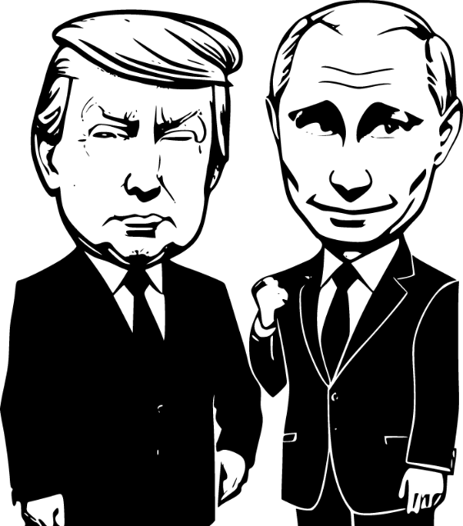
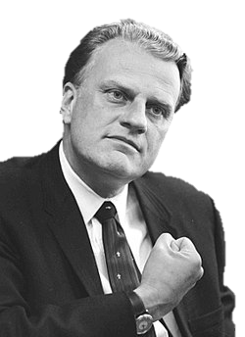
Who do you know?
Consider the following names …
Donald Trump
Billy Graham Do you know these people?
Vladimir Putin
Barak Obama

Slide 10

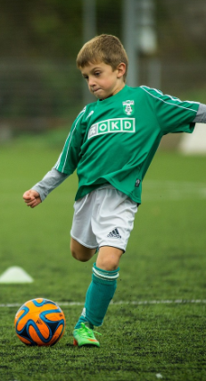
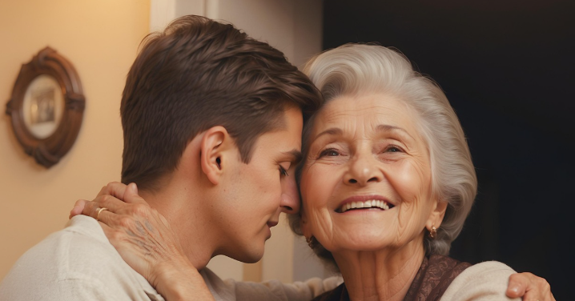
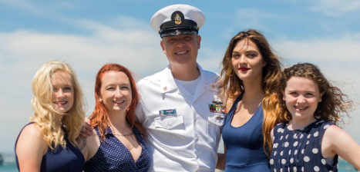
Who do you know?
Show us some pictures from your phones … how well do you know these people?

Slide 11
Consider how well the shepherd knows his sheep
John 10:14-18 (NIV) "I am the good shepherd; I know my sheep and my sheep know me-- 15 just as the Father knows me and I know the Father--and I lay down my life for the sheep. 16 I have other sheep that are not of this sheep pen. I must bring them also. They too will listen to my voice, and there shall

Slide 12
Consider how well the shepherd knows his sheep
be one flock and one shepherd. 17 The reason my Father loves me is that I lay down my life--only to take it up again. 18 No one takes it from me, but I lay it down of my own accord. I have authority to lay it down and authority to take it up again. This command I received from my Father."

Slide 13
Jesus Laid Down His Life
What type of relationship did Jesus say He had with His sheep?
We are Jesus “sheep” – how does He know us well?
How does the relationship of knowing each other develop between the sheep and the good shepherd?

Slide 14
Jesus Laid Down His Life
How does this relate to our relationship with Jesus Christ?
What is meant by the “other sheep” and the “one flock”?

Slide 15
Listen for blessings.
John 10:27-30 (NIV) My sheep listen to my voice; I know them, and they follow me. 28 I give them eternal life, and they shall never perish; no one can snatch them out of my hand. 29 My Father, who has given them to me, is greater than all; no one can snatch them out of my Father's hand. 30 I and the Father are one."

Slide 16
In the Hands of God
What blessing does the Good Shepherd give to those who follow Him?
What makes Christians question their security in Christ?
Jesus says no one can snatch His sheep out of His hand (v. 28). Then He says no one can snatch them out of the Father’s hand (v. 29). Why do you think He emphasizes both His and the Father’s protection?

Slide 17
In the Hands of God
How might someone mistakenly base their assurance of salvation on feelings or performance rather than on God’s promises in this passage?
What is our role in accessing and benefiting from Jesus’ protection?

Slide 18
Trust and Obey
When we walk with the Lord in the light of His Word
What a glory He sheds on our way!
While we do His good will, He abides with us still
And with all who will trust and obey
Trust and obey, for there's no other way
To be happy in Jesus, but to trust and obey

Slide 19
Application
Trust Christ.
  Eternal security begins with looking to Christ for salvation.
  Talk to your Bible study leader or a trusted Christian about placing your faith and trust in Christ.

Slide 20
Application
Memorize Scripture.
  Memorize John 10:27-30 and meditate on God’s promises.
  Anytime you doubt your salvation, clasp a small object in your hands and rehearse God’s promises either in your thoughts or aloud.
  Thank God you are more secure in Him than the object you are tightly squeezing.

Slide 21
Application
Embrace God’s truth.
  Reject emotional foundations for your faith and base what you think and do on instructions from the Bible.
  When a particular issue (like death or disease) makes you afraid, discover what the Bible says on that subject and make your decisions based on truth instead of feelings.

Slide 22
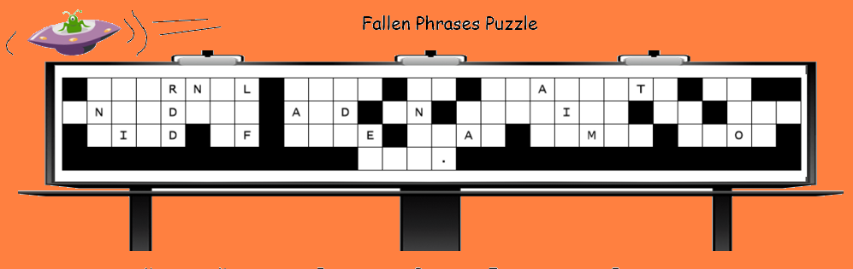
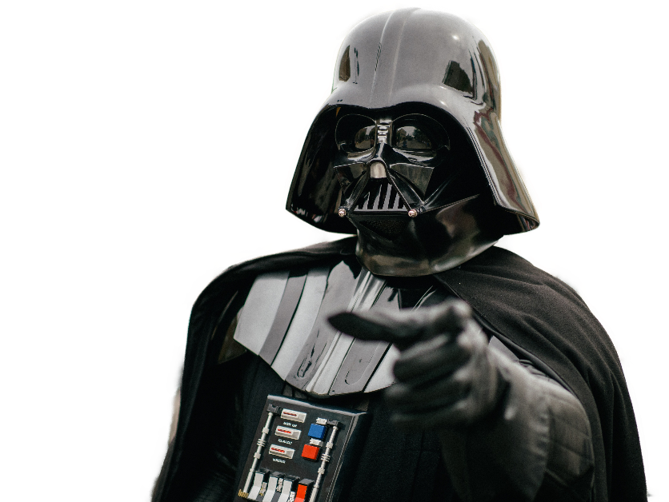
Family Activities
Your church sign has been damaged... by an alien from the Dicroageor system. This will not go unpunished. We need your assistance to put it back as it should be. Help (and the crossword) are available at https://tinyurl.com/2e2ey2c8

Slide 23
Can I Lose
My Salvation?
July 13

