Slide 1
Calling Out Sin
June 28

Slide 2

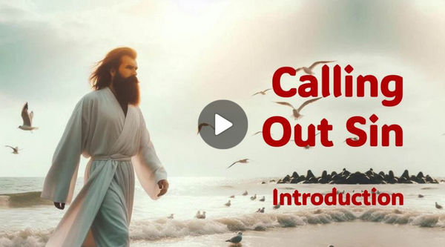
Video Introduction
View Video

Slide 3






Be honest … admit it, now …
What kind of social media “click bait” do you find it hard to resist?
Amusement Park Rides are Dangerous!
You Are Slicing Bell Peppers Wrong!
YouTube
Police
Pursuit

Slide 4
Be honest … admit it, now …
What kind of social media “click bait” do you find it hard to resist?
It’s easy to point out bad things … especially when we’re telling people what is sinful.
  We should point out sin for what it is.
  At the same time we should point people to Jesus who rescues from sin.

Slide 5
Listen for Inside vs. Outside
Luke 11:37-41 (NIV) When Jesus had finished speaking, a Pharisee invited him to eat with him; so he went in and reclined at the table. 38 But the Pharisee, noticing that Jesus did not first wash before the meal, was surprised. 39 Then the Lord said to him, "Now then,

Slide 6
Listen for Inside vs. Outside
you Pharisees clean the outside of the cup and dish, but inside you are full of greed and wickedness. 40 You foolish people! Did not the one who made the outside make the inside also? 41 But give what is inside [the dish] to the poor, and everything will be clean for you.

Slide 7
What’s Inside Matters
Consider the Pharisee host’s observance about Jesus that troubled him.
  Saw that Jesus did not wash before the meal
  This was not an hygienic exhortation to
  “Wash your hands” before the meal
  Had to do with ceremonial washing
  A “good” Jewish person did this prior to the meal to show spiritual cleanliness

Slide 8
What’s Inside Matters
Describe Jesus’ comments concerning this external ritual. What contrast does Jesus make between the outside and the inside?
"Now then, you Pharisees clean the outside of the cup and dish, but inside you are full of greed and wickedness. You foolish people! Did not the one who made the outside make the inside also?

Slide 9
What’s Inside Matters
Why do you think people often focus more on outward appearances than inward character? Why is it easier to manage appearances than to deal with heart issues?
What kinds of "outward cleanliness" might Christians emphasize today?

Slide 10
What’s Inside Matters
Which is more dangerous: obvious sinful behavior or hidden sinful attitudes? Why?
Obvious Sinful Behavior | Hidden Sinful Attitudes

Slide 11
What’s Inside Matters
When helping another believer deal with sin, how can we avoid focusing only on external behavior?
How does the gospel provide the solution to the problem Jesus identifies here?

Slide 12
Listen for multiple “Woe” accusations
Luke 11:42-46 (NIV) "Woe to you Pharisees, because you give God a tenth of your mint, rue and all other kinds of garden herbs, but you neglect justice and the love of God. You should have practiced the latter without leaving the former undone. 43 "Woe to

Slide 13
Listen for multiple “Woe” accusations
Pharisees, because you love the most important seats in the synagogues and greetings in the marketplaces. 44 "Woe to you, because you are like unmarked graves, which men walk over without knowing it." 45 One of the experts in

Slide 14
Listen for multiple “Woe” accusations
the law answered him, "Teacher, when you say these things, you insult us also." 46 Jesus replied, "And you experts in the law, woe to you, because you load people down with burdens they can hardly carry, and you yourselves will not lift one finger to help them.

Slide 15
Don’t Just Be Religious
What are woe statements to the Pharisees? List them.
Why does Jesus condemn the desire for prominent seats and public recognition?
What religious activities can someone perform without truly loving God?

Slide 16
Don’t Just Be Religious
What is the difference between practicing religion and having a relationship with God?
Practicing Religion | Relationship with God

Slide 17

Don’t Just Be Religious
Why do justice and the love of God matter more than meticulous rule-keeping?

Slide 18
Listen for a warning.
Luke 12:1-3 (NIV) Meanwhile, when a crowd of many thousands had gathered, so that they were trampling on one another, Jesus began to speak first to his disciples, saying: "Be on your guard against the yeast of the Pharisees, which is hypocrisy.

Slide 19
Listen for a warning.
There is nothing concealed that will not be disclosed, or hidden that will not be made known. 3 What you have said in the dark will be heard in the daylight, and what you have whispered in the ear in the inner rooms will be proclaimed from the roofs.

Slide 20
God Knows
Consider Jesus’ warning to the disciples.
  Be on guard against the “yeast of the Pharisees”
  Don’t be a hypocrite
Why is hypocrisy such a serious sin?

Slide 21
God Knows
Let’s list or write some of our own proverbs or truisms based on verses 2 & 3
There is nothing concealed that will not be disclosed, or hidden that will not be made known. What you have said in the dark will be heard in the daylight, and what you have whispered in the ear in the inner rooms will be proclaimed from the roofs.

Slide 22

God Knows
What areas of one’s failures (sin) are people most tempted to keep hidden?
How can we guard against being hypocritical?

Slide 23
Application
Confess.
  Before we call out the sins of others, we must admit our own sin.
  Confess your sins to the Lord.
  Make confession of sin part of your daily devotion.

Slide 24
Application
Assess.
  Who do you know needs forgiveness and salvation?
  Begin praying for their salvation and for the opportunity to point them to Jesus.

Slide 25
Application
Express.
  Using your phone, record yourself calling out your sin.
  Listen to your tone of voice, look for compassion and care in the words you say.
  Correct any obstacle that might hinder a positive response.

Slide 26

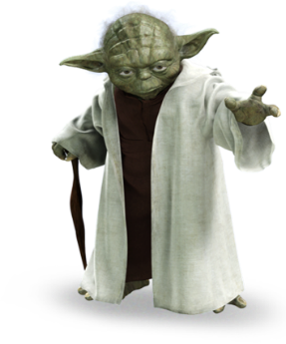
Family Discussion
The code, easy it is. Decode, you must!
Help, you can get at https://tinyurl.com/3srvedu3

Slide 27
Calling Out Sin
June 28

