Slide 1
Cain and Abel
Family Responsibility
October 13

Slide 2

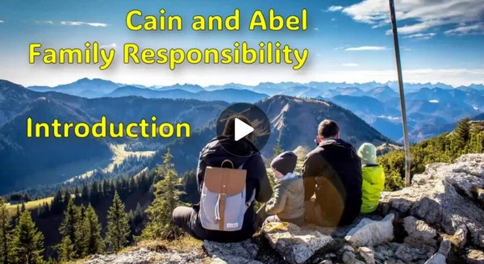
Video Introduction
View Video

Slide 3
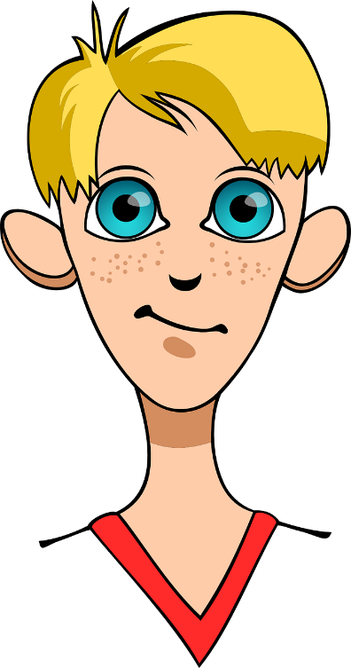

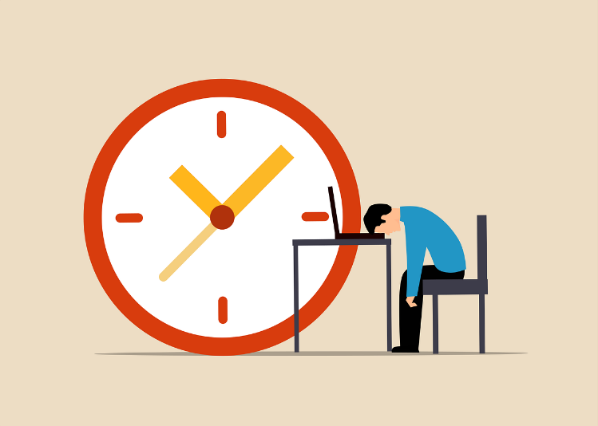
Be honest now …
What is something that makes you unique compared to the rest of your family?
Even though some of those differences can be difficult to navigate sometimes, it need not be a source of conflict.
  We are family and we get along pretty well most of the time.
  God expects us to look after our family members.

Slide 4

Listen for differences
Genesis 4:1-2 (NIV) Adam lay with his wife Eve, and she became pregnant and gave birth to Cain. She said, "With the help of the LORD I have brought forth a man." 2 Later she gave birth to his brother Abel. Now Abel kept flocks, and Cain worked the soil.

Slide 5
Different Individuals
Who were the two sons Eve birthed and how were they different?
Though different, why were they equal in contribution to the family’s well-being?
What are some ways work contributes to our overall well-being?

Slide 6
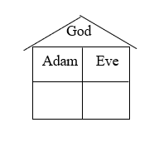
Different Individuals
Consider:
The family is God's design and God's plan.
Note the four relationships demonstrated in these two verses?
  Husband/Wife
  Human/God
  Parent/Child
  Sibling/Sibling

Slide 7
Different Individuals
What are some obstacles to healthy family life in our culture?
How has your family influenced your life?
⇨ A right relationship with God is the foundation of all human relationships

Slide 8
Listen for a contrast of offerings.
Genesis 4:3-7 (NIV) In the course of time Cain brought some of the fruits of the soil as an offering to the LORD. 4 But Abel brought fat portions from some of the firstborn of his flock. The LORD looked with favor on Abel and his offering, 5 but on Cain and his offering he did not look with favor. So Cain was

Slide 9
Listen for a contrast of offerings.
very angry, and his face was downcast. 6 Then the LORD said to Cain, "Why are you angry? Why is your face downcast? 7 If you do what is right, will you not be accepted? But if you do not do what is right, sin is crouching at your door; it desires to have you, but you must master it."

Slide 10
Different Offerings
What were the differences between Cain’s and Abel’s sacrifices?
What are some possible reasons that the offerings were received differently by God?
Cain | Abel

Slide 11
Different Offerings
Consider Hebrews 11:4 By faith Abel offered God a better sacrifice than Cain did. By faith he was commended as a righteous man, when God spoke well of his offerings. And by faith he still speaks, even though he is dead.
Abel was a man of faith …
  God knew that Cain was not acting in faith, maybe only out of duty

Slide 12
Different Offerings
What is the relationship between faith and genuine worship?
How does Abel continue to influence us?
How does our influence as people of faith live long past us and affect those who follow us?

Slide 13
Listen for a curse pronounced.
Genesis 4:8-12 (NIV) Now Cain said to his brother Abel, "Let's go out to the field." And while they were in the field, Cain attacked his brother Abel and killed him. 9 Then the LORD said to Cain, "Where is your brother Abel?" "I don't know," he replied. "Am I my brother's keeper?" 10 The LORD said, "What have you done?

Slide 14
Listen for a curse pronounced.
Listen! Your brother's blood cries out to me from the ground. 11 Now you are under a curse and driven from the ground, which opened its mouth to receive your brother's blood from your hand. 12 When you work the ground, it will no longer yield its crops for you. You will be a restless wanderer on the earth."

Slide 15
Different Destiny
What did Cain do to Abel?
How did he literally try to cover up his deed and how did he attempt to hide it from God?
What consequences befell Cain for his crime?

Slide 16
Different Destiny
What do we learn from this passage about God’s expectations for us to be our brother’s keeper?
What kinds of responsibilities do we have for our family members?

Slide 17
Application
Make worship real.
  Worship is more than hymns, songs, and preaching during Sunday services.
  Take time this week to worship God as a part of your daily quiet time.

Slide 18
Application
Deal with relational pain.
  Take time to reflect on relationships in your family where you have experienced hurt feelings.
  Ask the Holy Spirit to be your counselor in these matters.

Slide 19
Application
Deal with anger.
  Begin the process of identifying your anger.
  Proceed with the process of forgiving those who have hurt you.

Slide 20

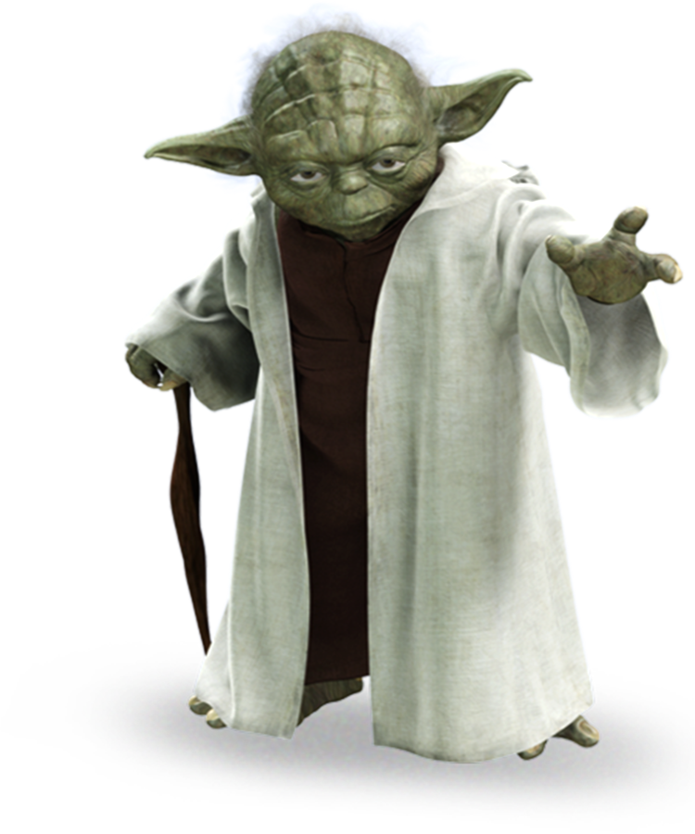
Family Activities
A coded message you have. Depending on you, we are. Try not, do or do not … there is no “try”. Help and more Family Activities from your solar system are available at https://tinyurl.com/yz3eehs7

Slide 21
Cain and Abel
Family Responsibility
October 13

