Slide 1
Built on Christ
April 14

Slide 2
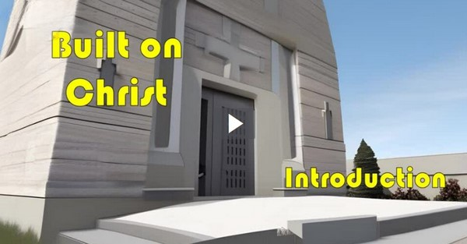
Video Introduction
View Video

Slide 3
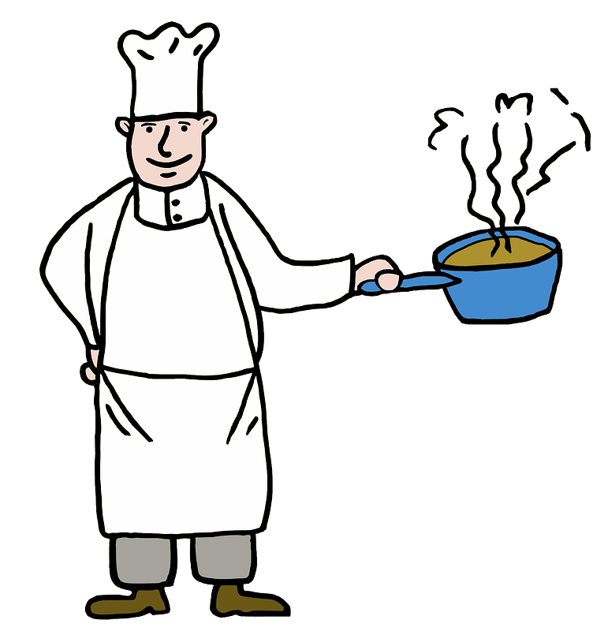
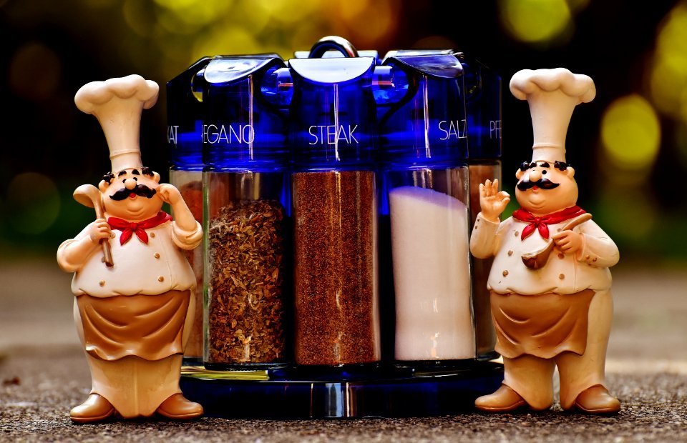
You’re the chef …
What is a recipe you hate for people to mess with the ingredients and prevent it from tasting authentic?
Consider the single element of our faith that makes it authentic.
The person of Jesus Christ makes our faith true and authentic in all aspects.

Slide 4
Listen for a rejection.
1 Peter 2:1-5 (NIV) Therefore, rid yourselves of all malice and all deceit, hypocrisy, envy, and slander of every kind. 2 Like newborn babies, crave pure spiritual milk, so that by it you may grow up in your salvation, 3 now that you have tasted that the

Slide 5
Listen for a rejection.
Lord is good. 4 As you come to him, the living Stone--rejected by men but chosen by God and precious to him-- 5 you also, like living stones, are being built into a spiritual house to be a holy priesthood, offering spiritual sacrifices acceptable to God through Jesus Christ.

Slide 6
Trust and Obey Christ
Note the practices persons born into Christ are to lay aside.
Malice – wickedness, depravity
Guile – deceit, trickery against others
Envies – desire for what belongs to another
Evil speaking – slander, defamation

Slide 7
Trust and Obey Christ
Peter contrasts these to receiving pure spiritual milk for spiritual growth and maturity. What would be the source of this “pure spiritual milk”?
Why is Jesus referred to as a living stone?

Slide 8
Trust and Obey Christ
Note the roles in which believers function for God.
Living stones
Built into a spiritual house
For a holy priesthood
Offer spiritual sacrifices acceptable to God through Jesus

Slide 9
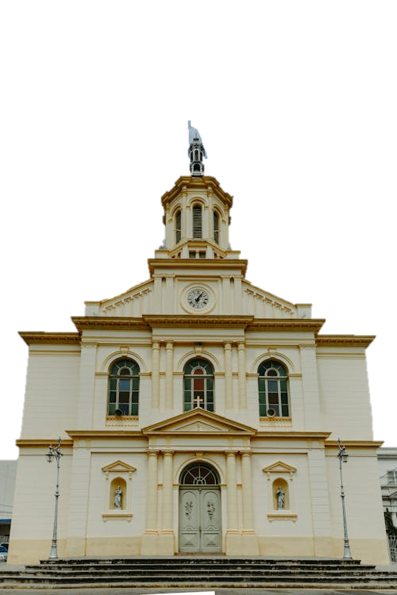
Trust and Obey Christ
What are different kinds or shapes of stones used in constructing a beautiful building, a cathedral, for instance?

Slide 10
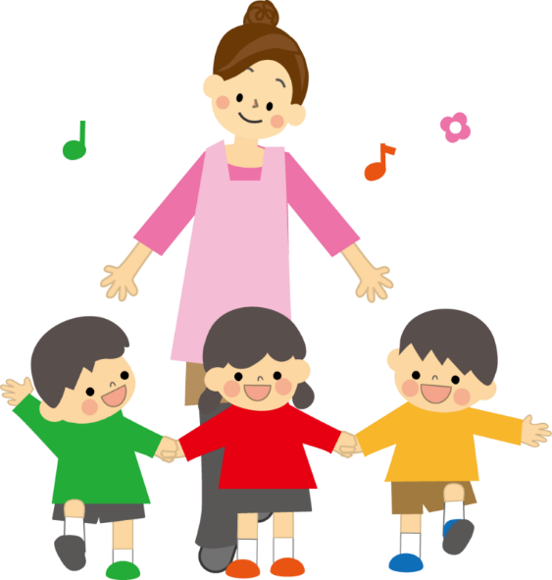
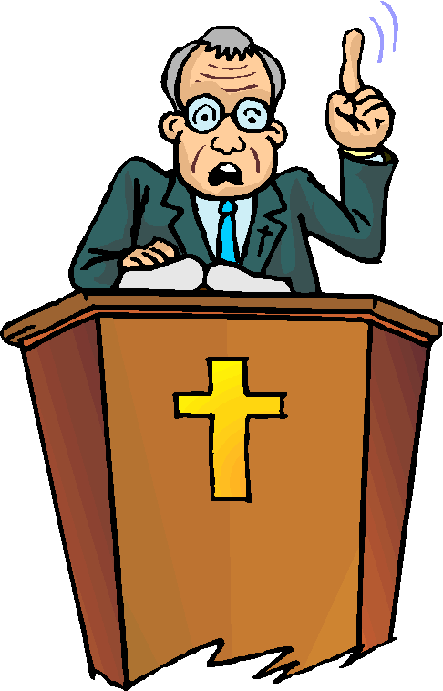
Trust and Obey Christ
If we are “stones” which form the “building” of the church, what are different kinds of “stones” needed for God’s church – both the local congregation and the church universal?

Slide 11
Listen for who is the “stone”.
1 Peter 2:6-8 (NIV) For in Scripture it says: "See, I lay a stone in Zion, a chosen and precious cornerstone, and the one who trusts in him will never be put to shame." 7 Now to you who believe, this stone is precious. But to those who

Slide 12
Listen for who is the “stone”.
do not believe, "The stone the builders rejected has become the capstone, 8 and, "A stone that causes men to stumble and a rock that makes them fall." They stumble because they disobey the message--which is also what they were destined for.

Slide 13
Foundation of the Church
What will happen to those who trust in the "Cornerstone", those who build their lives on Him?
How did Isaiah 28:16 (quoted by Jesus) describe the “stone”?
How was Christ treated differently by believers and unbelievers?
Believers | Unbelievers

Slide 14
Foundation of the Church
In what ways do people stumble over Jesus and His message today?

Slide 15
Foundation of the Church
In verse 6 Jesus quoted Isaiah 28:16. Consider these facts about what Isaiah said.
Zion was a name for the city of Jerusalem.
In the ancient world, the greatest care was taken in
Selecting, preparing, and
Setting in perfect position, the primary foundation stone of a temple building.
The stones in a temple structure “depend” on the cornerstone for direction and support.

Slide 16
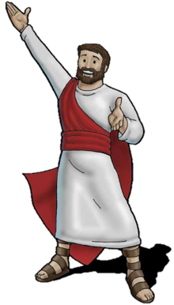
Foundation of the Church
So, for what things do we depend on Jesus ?

Slide 17
Listen for Jesus as the center.
1 Peter 2:9-12 (NIV) But you are a chosen people, a royal priesthood, a holy nation, a people belonging to God, that you may declare the praises of him who called you out of darkness into his wonderful light. 10 Once you were not a people, but now you are the people of God; once you had not received mercy, but now you have

Slide 18
Listen for Jesus as the center.
received mercy. 11 Dear friends, I urge you, as aliens and strangers in the world, to abstain from sinful desires, which war against your soul. 12 Live such good lives among the pagans that, though they accuse you of doing wrong, they may see your good deeds and glorify God on the day he visits us.

Slide 19
Proclaim Christ, Glorify the Lord
Note the four images Peter used to describe what those who believe in Christ have become.
A chosen race
A royal priesthood
A holy nation
A people for His possession

Slide 20
Proclaim Christ, Glorify the Lord
Contrast the past and present condition of believers.
Past Condition | Present Condition

Slide 21
Proclaim Christ, Glorify the Lord
For what purpose were they called?
What changed about their lives?
How has God changed your life?

Slide 22
Application
Pray.
Once a week, pray for your church leaders.
Pray they will have wisdom to guide the church to center on Jesus.

Slide 23
Application
Eliminate.
Identify one action or attitude you will eliminate from your life to move toward holiness.
Trust God’s strength and wisdom to do so.

Slide 24
Application
Participate.
Volunteer to serve in a ministry role where you can influence your church.
Work to make Jesus the main thing in its mission

Slide 25
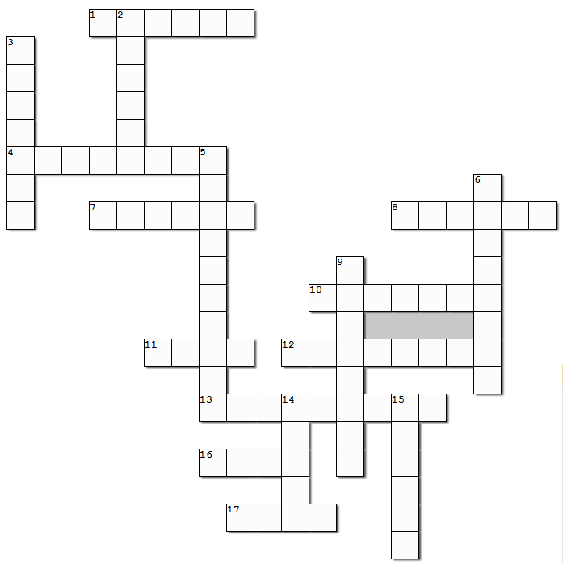
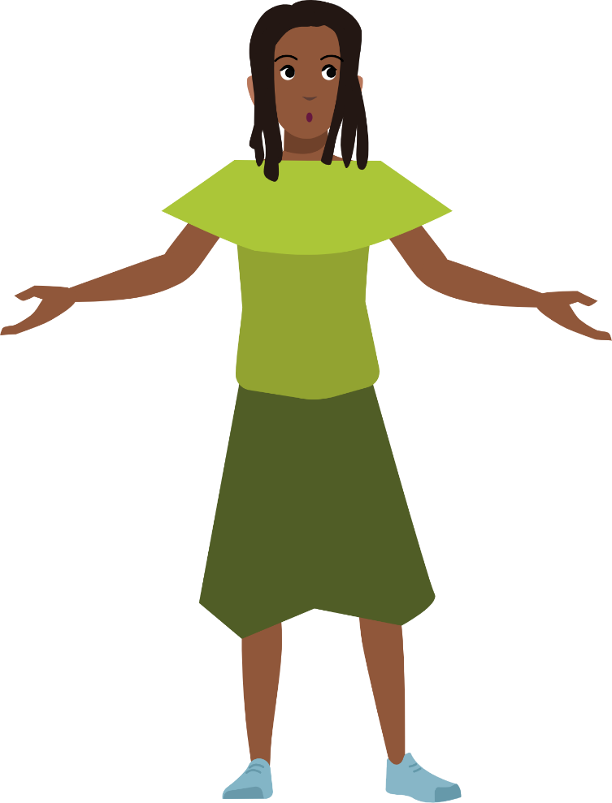
Family Activities
It’s about time the crossword comes back! Five weeks … humph! Well, all you must do is remember the clues and words are taken from 1 Peter 2:1 – 12 (NIV). Oh yes, for you people in the back row, you’ll want to use the help and also find the color page link at https://tinyurl.com/3shcfey9

Slide 26
Built on Christ
April 14

