Slide 1
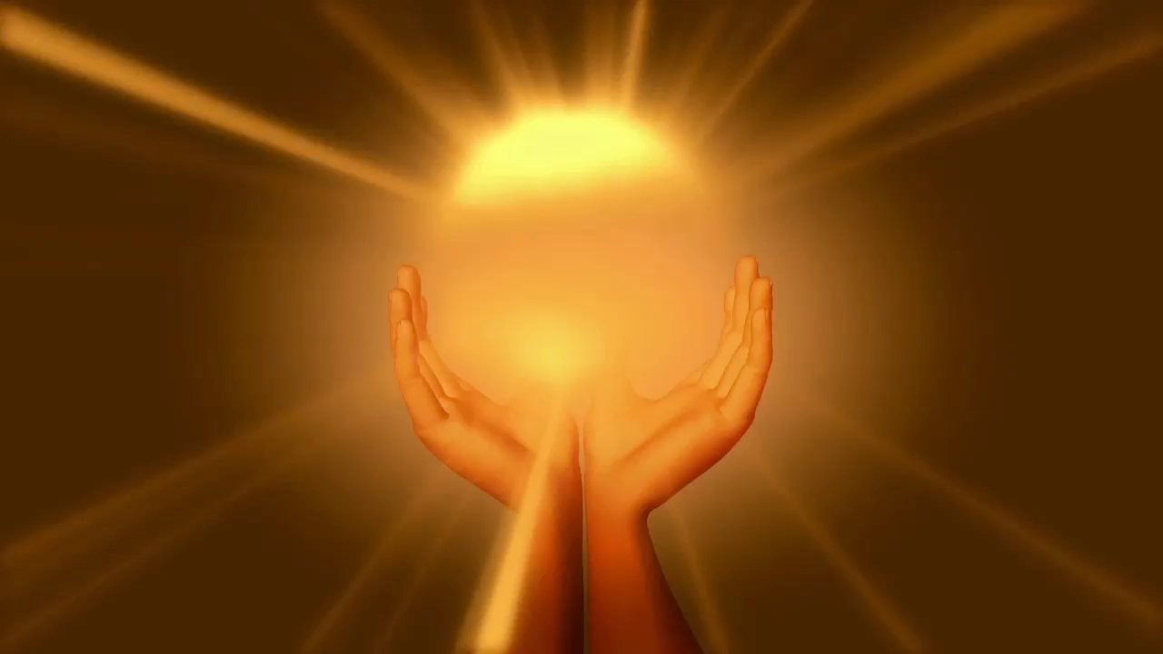
Embedded PowerPoint Video
Born Again by the Spirit
Introduction
By PresenterMedia.com

Slide 2

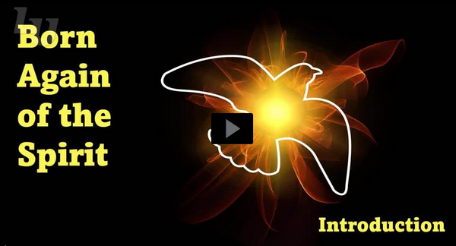
Video Introduction
View Video

Slide 3
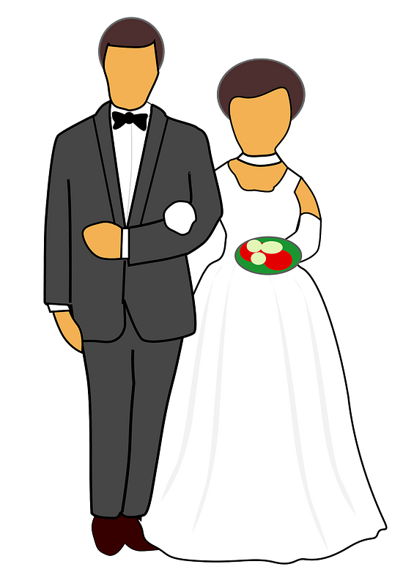

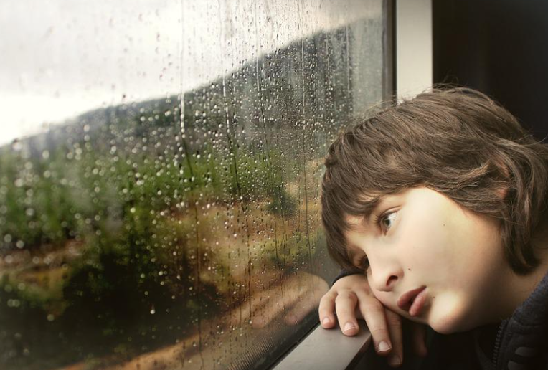
Can’t forget this one …
When have you had big plans only to have them unexpectedly change?
An old Jewish proverb says, “We make plans and God laughs.”
  When we place our trust in Jesus, God’s Holy Spirit brings us into a new life
God’s plans shape and mold us into His plans.

Slide 4
Listen for a surprising reply.
John 3:1-3 (NIV) Now there was a man of the Pharisees named Nicodemus, a member of the Jewish ruling council. 2 He came to Jesus at night and said, "Rabbi, we know you are a teacher who has come from God.

Slide 5

Listen for a surprising reply.
For no one could perform the miraculous signs you are doing if God were not with him." 3 In reply Jesus declared, "I tell you the truth, no one can see the kingdom of God unless he is born again."

Slide 6
Enter the Kingdom of God
Facts about Nicodemus
  A pharisee
  Member of the Jewish ruling council
  Came to Jesus at night
a man of the Pharisees named Nicodemus, a member of the Jewish ruling council. He came to Jesus at night

Slide 7
Enter the Kingdom of God
What might be some reasons that he came to Jesus at night?
At least on surface level, whom did he acknowledge Jesus to be? List the attributes he stated about Jesus.
Rabbi, we know you are a teacher who has come from God. For no one could perform the miraculous signs you are doing if God were not with him

Slide 8
Enter the Kingdom of God
Rather than respond to Nicodemus’s compliments, note the assertions Jesus made.
  Speaks to the issue of the kingdom/rule of God
  Says you cannot experience the kingdom of God, the rule of God without being “born again”
Why do you think He ignored the compliments and made His statements about “born again”?

Slide 9
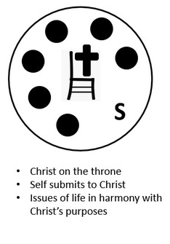
Enter the Kingdom of God
Why would such a statement be a challenge to Nicodemus’ thinking, and indeed, that of all Pharisees?
What are some spiritual
truths that you struggle
to understand?

Slide 10
Listen for further explanation about “born again”.
John 3:4-8 (NIV) "How can a man be born when he is old?" Nicodemus asked. "Surely he cannot enter a second time into his mother's womb to be born!" 5 Jesus answered, "I tell you the truth, no one can enter the kingdom of God unless he is born of water and the Spirit. 6 Flesh gives birth to

Slide 11
Listen for further explanation about “born again”.
flesh, but the Spirit gives birth to spirit. 7 You should not be surprised at my saying, 'You must be born again.' 8 The wind blows wherever it pleases. You hear its sound, but you cannot tell where it comes from or where it is going. So it is with everyone born of the Spirit."

Slide 12
New Birth by the Spirit
The wind blows wherever it pleases. You hear its sound, but you cannot tell where it comes from or where it is going.
What are options for understanding that a man be born of water and of the Spirit? What did Jesus mean?
Note the illustration from nature used to convey a spiritual truth … He compares the concept of God’s Spirit to the wind. What are some characteristics of wind listed by the passage?

Slide 13
New Birth by the Spirit
How do these characteristics of wind describe the work of the Holy Spirit?
Why do you think the Holy Spirit is a more effective means of changing a person’s life than methods such as counselling, support groups, hypnotism or will power?

Slide 14
Listen for a reference to an Old Testament story.
John 3:14-17 (NIV) Just as Moses lifted up the snake in the desert, so the Son of Man must be lifted up, 15 that everyone who believes in him may have eternal life. 16 "For God so loved the world that he gave his one and only

Slide 15
Listen for a reference to an Old Testament story.
Son, that whoever believes in him shall not perish but have eternal life. 17 For God did not send his Son into the world to condemn the world, but to save the world through him.

Slide 16
Trust in Jesus for A New Birth
Recall the “snake event” in Numbers 21:4 – 9.
  The people suffering from snake bites had merely to look at the snake image on the pole
  John here says that this was a symbolic event that looked forward to Jesus being “lifted up” on a cross
⇨Note that in both situations, it was God’s purpose to save … not to condemn

Slide 17
Trust in Jesus for A New Birth
How does the historical illustration support Jesus’s message to Nicodemus?
Why do you think John 3:16 is one of the favorite verses of the Bible?
  From the Amplified Bible. “For God so [greatly] loved and dearly prized the world, that He [even] gave His [One and] only begotten Son, so that whoever believes and trusts in Him [as Savior] shall not perish, but have eternal life.”

Slide 18
Trust in Jesus for A New Birth
The key phrase in this verse that describes our response to what God has made possible in Jesus is “believes and trusts in Him.” Consider the meaning of that phrase
  Receive personally what Jesus said as “truth for me”
  Believe what God says – about my spiritual need, about His solution to the problem
  Believe in His love, His power, His authority to whom I surrender

Slide 19
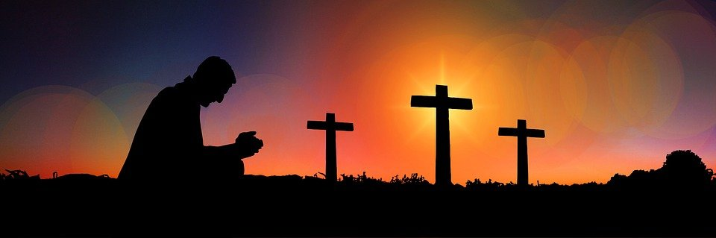
Trust in Jesus for A New Birth
How has trusting Jesus changed your life?

Slide 20
Application
Think.
  Evaluate yourself and your relationship with God by asking this simple question: Am I trying to earn God’s favor and salvation?
  If necessary, explore the meaning of grace.

Slide 21
Application
Decide.
  If you’ve concluded that you’ve tried to earn salvation, make the decision today to trust in Jesus and the Holy Spirit’s power to forgive and save you.
  Tell Jesus that you surrender your life to Him and trust Him as Lord and Savior.

Slide 22
Application
Act.
  Speak to a trusted believer or a pastor about your decision.
  Join a local body of believers so you can live out your faith biblically.

Slide 23

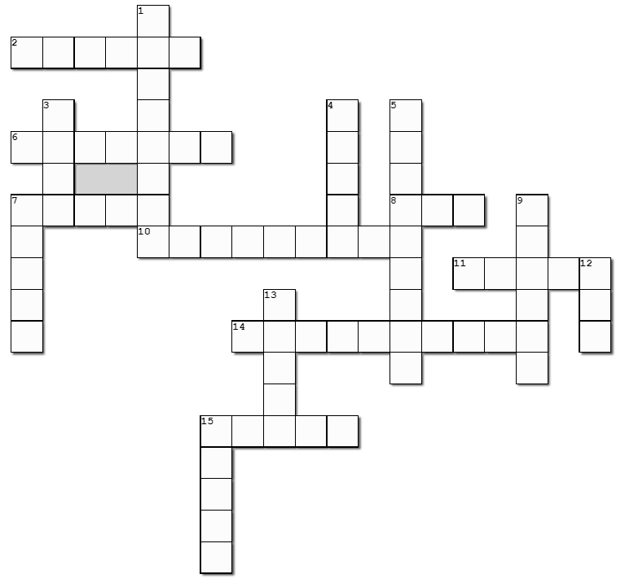


Family Activities
Color Page
https://tinyurl.com/yw6he5t5
Crossword
Fix the Story
Family Discussion Video

Slide 24
Embedded PowerPoint Video
Born Again by the Spirit
Introduction
By PresenterMedia.com

