Slide 1
Baruch
August 25

Slide 2
Video Introduction
View Video

Slide 3
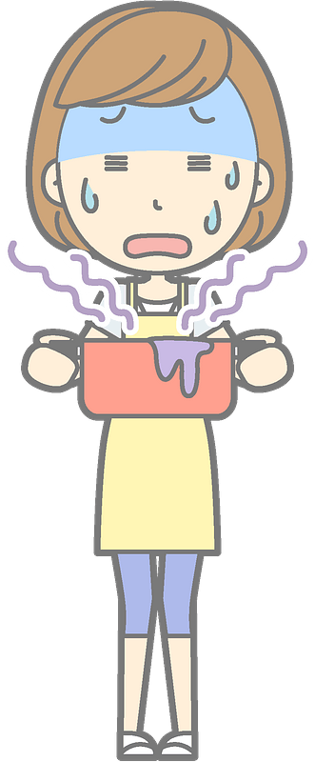
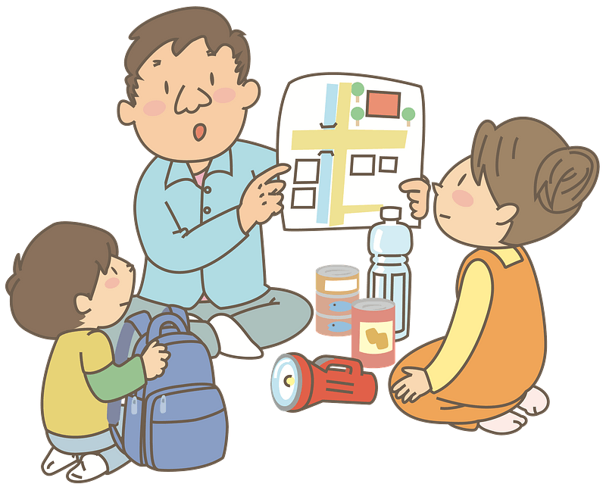
Remember that time …
What assigned duty have you been given that has required courage and/or stick-to-itive-ness?
In spite of feeling inadequate or fearful …
Be assured that God will reward your faithful service.

Slide 4
Listen for an assignment.
Jeremiah 36:4-8 (NIV) So Jeremiah called Baruch son of Neriah, and while Jeremiah dictated all the words the LORD had spoken to him, Baruch wrote them on the scroll. 5 Then Jeremiah told Baruch, "I am restricted; I cannot go to the LORD's temple.

Slide 5
Listen for an assignment.
So you go to the house of the LORD on a day of fasting and read to the people from the scroll the words of the LORD that you wrote as I dictated. Read them to all the people of Judah who come in from their towns. 7 Perhaps they will bring their petition before

Slide 6
Listen for an assignment.
the LORD, and each will turn from his wicked ways, for the anger and wrath pronounced against this people by the LORD are great." 8 Baruch son of Neriah did everything Jeremiah the prophet told him to do; at the LORD's temple he read the words of the LORD from the scroll

Slide 7
Faithfully Serve
Along with being his scribe, what did Jeremiah ask of Baruch and why?
What was the message to be delivered and why was it important?
How does a public pronouncement of a written document add weight to a message someone wants to deliver?

Slide 8
Faithfully Serve
With what has God tasked us with the Word He has given to us?
Baruch did what the prophet told him to do. What does it look like for us to serve God faithfully?
How can the church enlist believers to be more involved in the Great Commission?

Slide 9
Listen for credit given.
Jeremiah 36:16-18 (NIV) When they heard all these words, they looked at each other in fear and said to Baruch, "We must report all these words to the king." 17 Then they asked Baruch, "Tell us, how did you come to

Slide 10
Listen for credit given.
write all this? Did Jeremiah dictate it?" 18 "Yes," Baruch replied, "he dictated all these words to me, and I wrote them in ink on the scroll."

Slide 11
Give Credit where Due
Baruch presented Jeremiah’s warnings and exhortations to the people gathered for a fast day. What was their response?
Why might they have asked Baruch how the scroll came about?
When God’s message is communicated today, what are some of the different responses?

Slide 12
Give Credit where Due
Baruch gave the credit to Jeremiah. What are some practical ways we can give credit to others?
In what ways might Baruch's courage and dedication in this passage inspire or challenge contemporary believers in their own roles in communicating important truths or messages?

Slide 13
Listen for discouragement.
Jeremiah 45:1-5 (NIV) This is what Jeremiah the prophet told Baruch son of Neriah in the fourth year of Jehoiakim son of Josiah king of Judah, after Baruch had written on a scroll the words Jeremiah was then dictating: 2 "This is what the LORD, the God of

Slide 14
Listen for discouragement.
Israel, says to you, Baruch: 3 You said, 'Woe to me! The LORD has added sorrow to my pain; I am worn out with groaning and find no rest.'" 4 [The LORD said,] "Say this to him: 'This is what the LORD says: I will overthrow what I have

Slide 15
Listen for discouragement.
built and uproot what I have planted, throughout the land. 5 Should you then seek great things for yourself? Seek them not. For I will bring disaster on all people, declares the LORD, but wherever you go I will let you escape with your life.'"

Slide 16
God Rewards Service
What was going on with Baruch? List the descriptions of his distress.
What kinds of things make us feel “worn out with groaning” or not be able to find rest?
Why are some people willing to attribute their misfortune to God’s indifference or powerlessness rather than to their own sins?

Slide 17
God Rewards Service
Note God’s response.
Why are you seeking great things for yourself?
Don’t let that kind of success be your goal.
You and many others will experience judgment of disaster.
But whatever happens, I will make a way of escape for you.

Slide 18
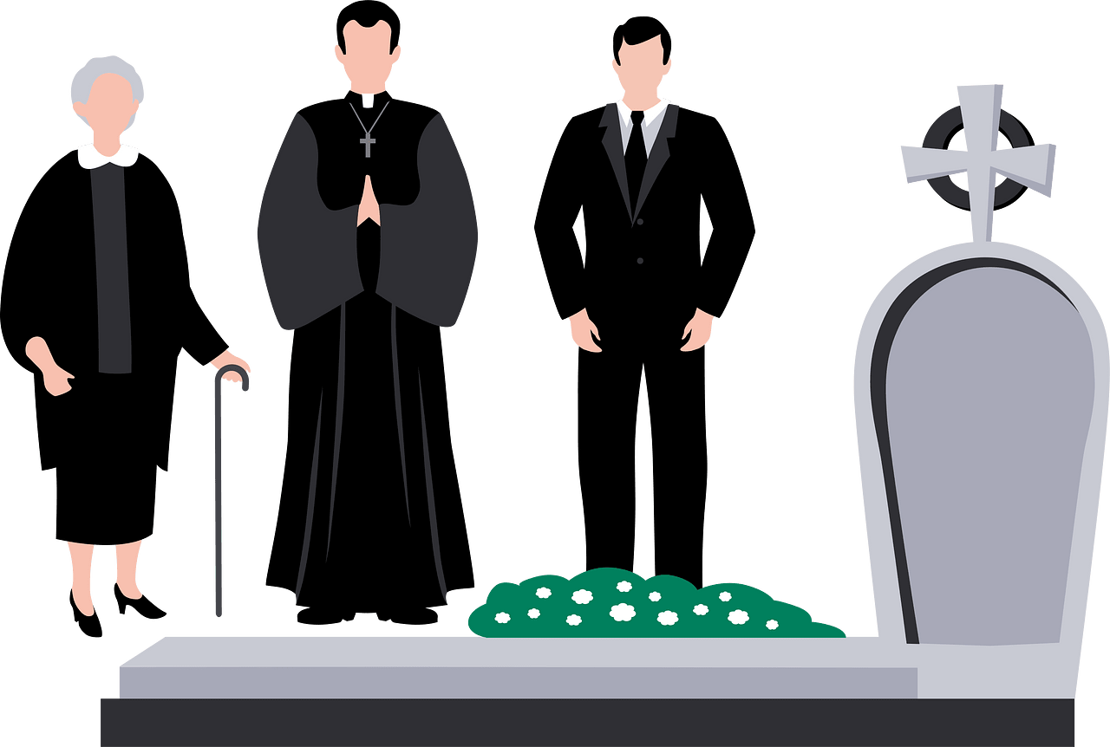
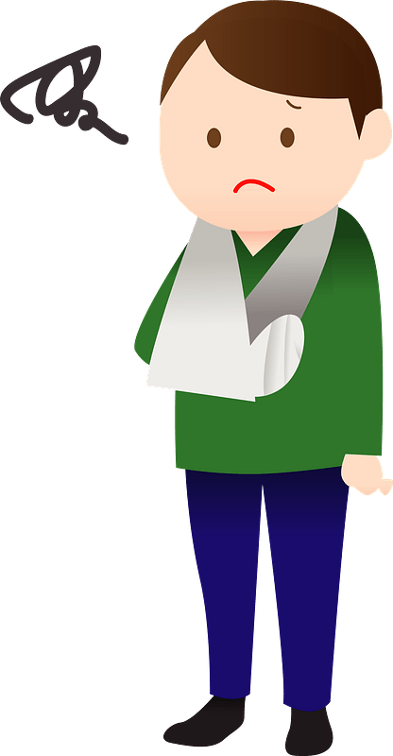
God Rewards Service
How can you experience God’s blessing, even in the midst of difficult times?

Slide 19
Application
Ask God for help.
Thank God for the privilege of getting to serve Him.
Ask Him to help you do so with excellence, in a way that brings glory to Him and good to others.

Slide 20
Application
Repeat the message.
Like Baruch, start writing down the message by journaling your devotions or taking notes on your pastor’s sermon. Then repost the message online.
Share the link to worship on your social media if possible.
Text your notes to your family.
Let’s digitally repeat the message of the gospel of Jesus Christ.

Slide 21
Application
Become a teacher.
Shadow a teacher and ask to be trained as a substitute Sunday School or small group teacher/facilitator.
We can multiply by reproducing our leaders.

Slide 22
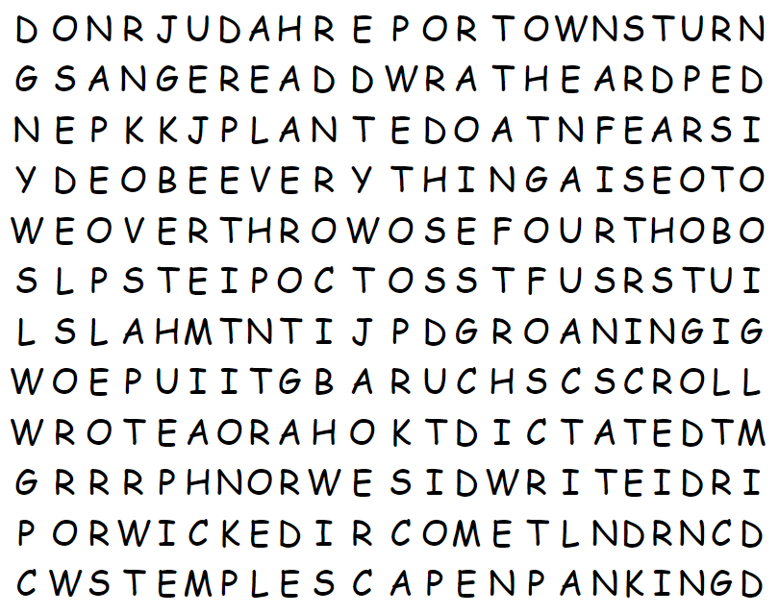
Family Activities
What is a “BEEVERY”? That’s not on the list of words. You’ll need to help me find those words that come from your Bible passage. There’s rumors about an inter-class challenge. I heard you can get help at https://tinyurl.com/2s39a5um

Slide 23
Baruch
August 25

