Slide 1
Barnabas and Paul
July 2

Slide 2


Video Introduction
View Video

Slide 3


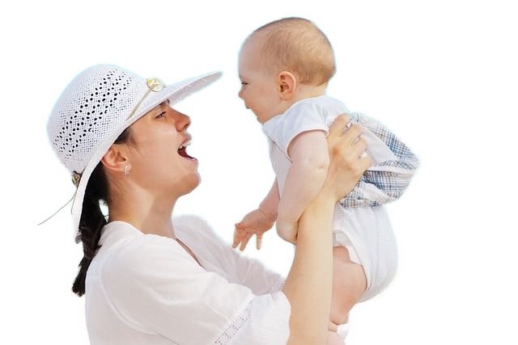
Remember that person?
How have you seen someone grow as a person over time?
Today we look at the progression in the mentoring relationship between Barnabas and Paul.
  We realize that mentoring relationships to change over time

Slide 4
Listen for someone needing acceptance.
Acts 9:26-28 (NIV) When he came to Jerusalem, he tried to join the disciples, but they were all afraid of him, not believing that he really was a disciple. 27 But Barnabas took him and brought him to the apostles. He told them how Saul on his journey

Slide 5

Listen for someone needing acceptance.
had seen the Lord and that the Lord had spoken to him, and how in Damascus he had preached fearlessly in the name of Jesus. 28 So Saul stayed with them and moved about freely in Jerusalem, speaking boldly in the name of the Lord.

Slide 6
Encourage A New Believer
What is the setting in which Saul came to Jerusalem after his conversion?
What emotions or feelings may he have felt at their rejection?
What difference did Barnabas make to Saul personally and to the fellowship in general?

Slide 7
Encourage A New Believer
What did Barnabas risk in standing up for Saul?
What might we risk by investing in others? What risks do you take when you put yourself on the line for an outsider?
What would be the benefits of investing in Saul if he turned out to be genuine?

Slide 8
Encourage A New Believer
Saul/Paul became one of the world’s premier missionaries. How would history be different if Barnabas had not taken the risk to involve Saul?
How could a person like Barnabas help heal wounds in a church group?

Slide 9
Listen for Barnabas’ travels.
Acts 11:21-26 (NIV) The Lord's hand was with them, and a great number of people [in Antioch] believed and turned to the Lord. 24 News of this reached the ears of the church at Jerusalem, and they sent Barnabas to Antioch. 23 When he arrived and saw the evidence of the grace of God,

Slide 10
Listen for Barnabas’ travels.
he was glad and encouraged them all to remain true to the Lord with all their hearts. 24 He was a good man, full of the Holy Spirit and faith, and a great number of people were brought to the Lord. 25 Then Barnabas went to

Slide 11
Listen for Barnabas’ travels.
Tarsus to look for Saul, 26 and when he found him, he brought him to Antioch. So for a whole year Barnabas and Saul met with the church and taught great numbers of people. The disciples were called Christians first at Antioch.

Slide 12
Encourage Others to Serve
What was taking place in Antioch that caught the attention of the church in Jerusalem?
What was Barnabas’ assessment of what he saw?
What words and phrases in these verses support the choice of Barnabas as the right person to go to Antioch?

Slide 13
Encourage Others to Serve
As we noted, Barnabas was an encourager. How is encouragement like a set of jumper cables?
Why do you think Barnabas went looking for Saul (it had been about 10 years since their acquaintance in Jerusalem)?

Slide 14
Encourage Others to Serve
What was the primary scope of their ministry together in Antioch?
How can we actively encourage God’s larger work in our church?

Slide 15
Listen for the reason for a disagreement.
Acts 15:36-40 (NIV) Some time later Paul said to Barnabas, "Let us go back and visit the brothers in all the towns where we preached the word of the Lord and see how they are doing." 37 Barnabas wanted to take John, also called Mark, with them, 38 but Paul did not think it wise to take him,

Slide 16
Listen for the reason for a disagreement.
because he had deserted them in Pamphylia and had not continued with them in the work. 39 They had such a sharp disagreement that they parted company. Barnabas took Mark and sailed for Cyprus, 40 but Paul chose Silas and left, commended by the brothers to the grace of the Lord.

Slide 17
Follow God’s Given Paths
What did Paul suggest to Barnabas?
Why didn’t Paul want Mark to accompany the apostles on their trip?
What did the apostles do about their difference of opinion?

Slide 18
Follow God’s Given Paths
How do you think the disagreement between Paul and Barnabas impacted their relationship and their ministry?
How can disagreements be beneficial in some cases?

Slide 19
Application
Reconcile
  Prayerfully evaluate your relationships to determine anyone with whom you are at odds.
  Ask God to open a way for you to reconcile with that person.

Slide 20
Application
Consider.
  Take time to evaluate your relationship with the person you are mentoring or are being mentored by.
  What areas might become a source of friction?
  What steps are needed to avoid conflict?
  Prayerfully consider taking those steps.

Slide 21
Application
Divide.
  Speak with the other person in your mentoring relationship about a plan to multiply your relationship with each of you choosing someone else to mentor.
  Thus, two will become four and you will double your impact for Christ!

Slide 22



Family Activities
While I’m on assignment in xxxxxxxx (sorry, cannot say where), we need your help to decode this message. Use the key given on your handouts. Help is available at https://tinyurl.com/mpcea45f Also, the crossword is available for you ladies in the back row.

Slide 23
Barnabas and Paul
July 2

