Slide 1
Avoiding a Critical Spirit
May 28

Slide 2


Video Introduction
View Video

Slide 3
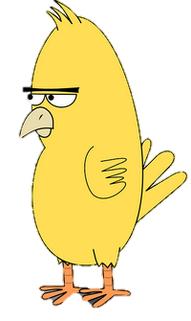


Think about it …
What comes to mind when you hear the word “critic”?
A critical spirit damages our lives.
  Today we look at two Old Testament characters who criticized their leader.
  We see that we must guard our hearts against criticizing others.

Slide 4
Listen for who is complaining.
Numbers 12:1-3 (NIV) Miriam and Aaron began to talk against Moses because of his Cushite wife, for he had married a Cushite. 2 "Has the LORD spoken only through Moses?" they asked. "Hasn't he also spoken through us?" And the LORD heard this. 3 (Now Moses was a very humble man, more humble than anyone else on the face of the earth.)

Slide 5
God Sets the Standard
We see it was Moses’ brother and sister who were criticizing him. Why would that be surprising?
What was the issue of the conflict?
What kind of man was Moses?
What do you think caused Miriam to lose focus at this point in the sequence of events?

Slide 6
God Sets the Standard
What drives us to be critical of others? What kinds of situations can tempt us to criticize others?
Consider what could be the most ominous statement in these verses. “And the Lord heard them.” Why would that be ominous?
We noted Moses’ humility. How would this help him (and us) deal with disappointments and opposition?

Slide 7
Listen for God’s response.
Numbers 12:4-9 (NIV) At once the LORD said to Moses, Aaron and Miriam, "Come out to the Tent of Meeting, all three of you." So the three of them came out. 5 Then the LORD came down in a pillar of cloud; he stood at the entrance to the Tent and summoned Aaron and Miriam. When both of them stepped forward, 6 he said,

Slide 8
Listen for God’s response.
"Listen to my words: "When a prophet of the LORD is among you, I reveal myself to him in visions, I speak to him in dreams. 7 But this is not true of my servant Moses; he is faithful in all my house. 8 With him

Slide 9
Listen for God’s response.
I speak face to face, clearly and not in riddles; he sees the form of the LORD. Why then were you not afraid to speak against my servant Moses?" 9 The anger of the LORD burned against them, and he left them.

Slide 10
Criticism: Questioning God
What suggests the Lord was deeply concerned by the comments about Moses?
How was Moses different from other prophets?
What penetrating, convicting question did God ask Miriam and Aaron?

Slide 11
Criticism: Questioning God
How can criticism of God’s leaders impact us and our church?
What price do we pay for having a critical spirit?
What can we do to change the behavior of being critical and instead be encouraging to others?

Slide 12
Listen for judgment and restoration.
Numbers 12:10-15 (NIV) When the cloud lifted from above the Tent, there stood Miriam--leprous, like snow. Aaron turned toward her and saw that she had leprosy; 11 and he said to Moses, "Please, my lord, do not hold against us the sin we have so foolishly committed. 12 Do not let her be like a stillborn infant coming from its

Slide 13
Listen for judgment and restoration.
mother's womb with its flesh half eaten away." 13 So Moses cried out to the LORD, "O God, please heal her!" 14 The LORD replied to Moses, "If her father had spit in her face, would she not have been in disgrace for seven days? Confine her outside the camp for seven days; after that she can be brought back."

Slide 14
Confess and Return
What judgment came upon Miriam?
What was Aaron’s confession?
How does Miriam’s sentence suggest the restorative grace of God exercised in His discipline on those who sin?

Slide 15
Confess and Return
Consider our responsibility when we criticize hurtfully or get criticized in a hurtful manner.
When You Criticize | When Others Criticize You
Be quick to confess (agree with God that it is sin) Repent – resolve to cease and desist Pursue forgiveness – from the injured party and from God | Don’t hold it against them Be willing to forgive Pray for them Act in ways that will restore relationships

Slide 16
Application
Be honest with yourself.
  Evaluate your own heart for complaints against others.
  Ask God to reveal where you might be comparing yourself to others.
  The first step is to see yourself as God sees you.

Slide 17
Application
Encourage someone else.
  When your heart is prone to criticize, choose instead to find someone to encourage.
  Intentionally let that person know how he or she blesses you.

Slide 18
Application
Confess your criticism to another.
  Have you been critical of someone in unhealthy ways?
  The Lord may be convicting you to ask that person for forgiveness and seek to walk in steps of reconciliation.

Slide 19
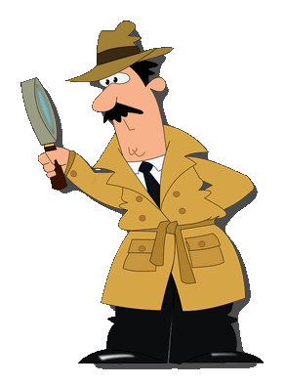
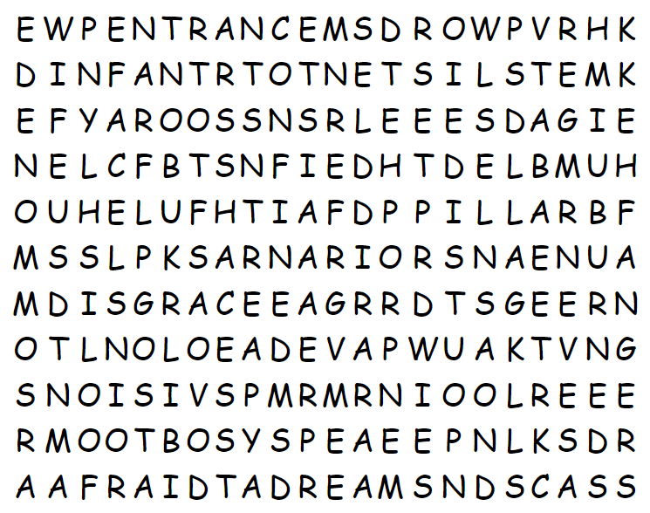
Family Activities
“YAROOSS” … This must be something for Spiros the Spy. Although it could also be something from the Word Search Lady. I’ll bet there’s a list of words hidden in this grid of letters. I suppose it might be a message. To be sure, check out this website.
https://tinyurl.com/4vhypvua There’s other good Family Activities there, also.

Slide 20
Avoiding a Critical Spirit
May 28

