Slide 1
Authentic Joy
September 30

Slide 2
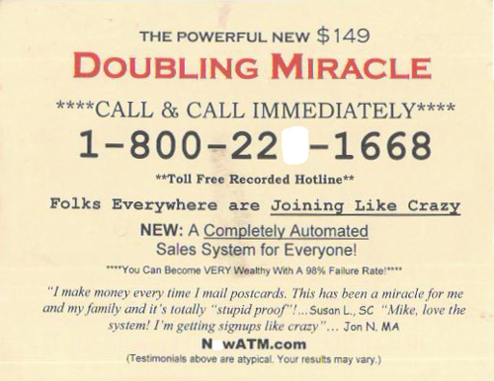
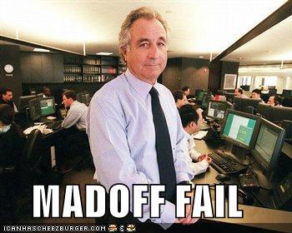
Think about it …
What’s the best forgery, fake, or fraud you’ve seen or heard about?
Consider how people fake friendliness and joy when we meet each other … smile, shake hands, murmur polite words, etc.
However, genuine joy calls for something deeper.
Today we look at how authentic joy flows from a relationship with Jesus.

Slide 3
Listen for faith, love, and hope.
1 Thessalonians 1:1-3 (NIV) Paul, Silas and Timothy, To the church of the Thessalonians in God the Father and the Lord Jesus Christ: Grace and peace to you. 2 We always thank God for all of you, mentioning you in our prayers.

Slide 4
Listen for faith, love, and hope.
We continually remember before our God and Father your work produced by faith, your labor prompted by love, and your endurance inspired by hope in our Lord Jesus Christ.

Slide 5
Driven by Faith, Love, and Hope
Who is the letter from and to whom was it written?
Through what acts did Paul constantly affirm the Thessalonians?
What did Paul remember about the Thessalonians?
Work” and “labor” sort of go together. How are they produced and prompted by faith and love?

Slide 6
Driven by Faith, Love, and Hope
What kind of “hope” are we talking about here?
How do you think the Thessalonians’ hope was visible for others to see? How can our hope be demonstrated before others?

Slide 7
Listen for how Paul ministered.
1 Thessalonians 1:4-6 (NIV) For we know, brothers loved by God, that he has chosen you, 5 because our gospel came to you not simply with words, but also with power, with the Holy Spirit and with deep conviction. You know how we

Slide 8
Listen for how Paul ministered.
lived among you for your sake. 6 You became imitators of us and of the Lord; in spite of severe suffering, you welcomed the message with the joy given by the Holy Spirit.

Slide 9
Joy Flows from Salvation
How had Paul presented the gospel to this audience?
How had the Thessalonians responded to the gospel message?
What statements show a vital connection between the preaching of the gospel and living out the gospel as important to an effective witness?

Slide 10
Joy Flows from Salvation
Why or how is it possible to have joy in the midst of the pressures that accompany living for Jesus in an unfriendly world?
What are some ways our lives can reflect the joy of the gospel?
When have you seen the power of the gospel displayed in someone’s life?

Slide 11
Joy Flows from Salvation
How does demonstrating joy in difficult circumstances make a difference in the kingdom?
What is the difference between presenting the gospel with power and deep conviction, and presenting the gospel without it?
Without power and conviction. | With power and conviction

Slide 12
Listen for model believers.
1 Thessalonians 1:7-10 (NIV) And so you became a model to all the believers in Macedonia and Achaia. 8 The Lord's message rang out from you not only in Macedonia and Achaia--your faith in God has become known everywhere. Therefore we do not need

Slide 13
Listen for model believers.
to say anything about it, 9 for they themselves report what kind of reception you gave us. They tell how you turned to God from idols to serve the living and true God, 10 and to wait for his Son from heaven, whom he raised from the dead--Jesus, who rescues us from the coming wrath.

Slide 14
Love and Joy Lived as An Example
For what else did Paul commend the Thessalonians?
What intentional actions did they take in response to the hearing of the gospel?
What major elements of the gospel does Paul allude to in these verses?

Slide 15
Love and Joy Lived as An Example
Paul noted that his readers had given up idols to trust in Jesus. What kind of idols must we turn from?
What obstacles should we overcome to be able to live with a sense of love and joy?

Slide 16
Application Video
View Video

Slide 17
Application
Thank someone.
Who is one person in your life who lives with authentic joy?
Write a note and thank that person for his or her example.

Slide 18
Application
Grow in joy.
Take a hard look at the three suggestions for growing your joy
Authentic joy does not wax and wane with circumstances
Authentic joy is more solid and stable than the rising of the sun.
Authentic joy is not found in immediate gratification but by pushing past it
Write these on index cards and place them in spots where you will see them on a daily basis.

Slide 19
Application
Journal your thanks.
Because joy is linked with gratitude, begin a “thankful” journal.
Each day for the next month write down something you are thankful for and watch your joy begin to grow.

Slide 20
Family Activities
Breaking news … You and your kids can benefit from the Family Activities website. This week’s cool stuff is at
https://tinyurl.com/y834or72

Slide 21
Authentic Joy
September 30

