Slide 1
Are Miracles Relevant?
October 22

Slide 2

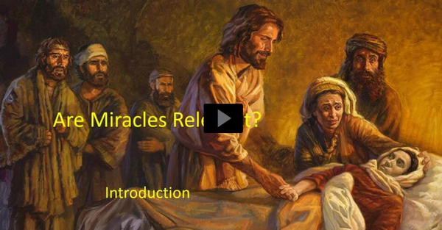
Video Introduction
View Video

Slide 3
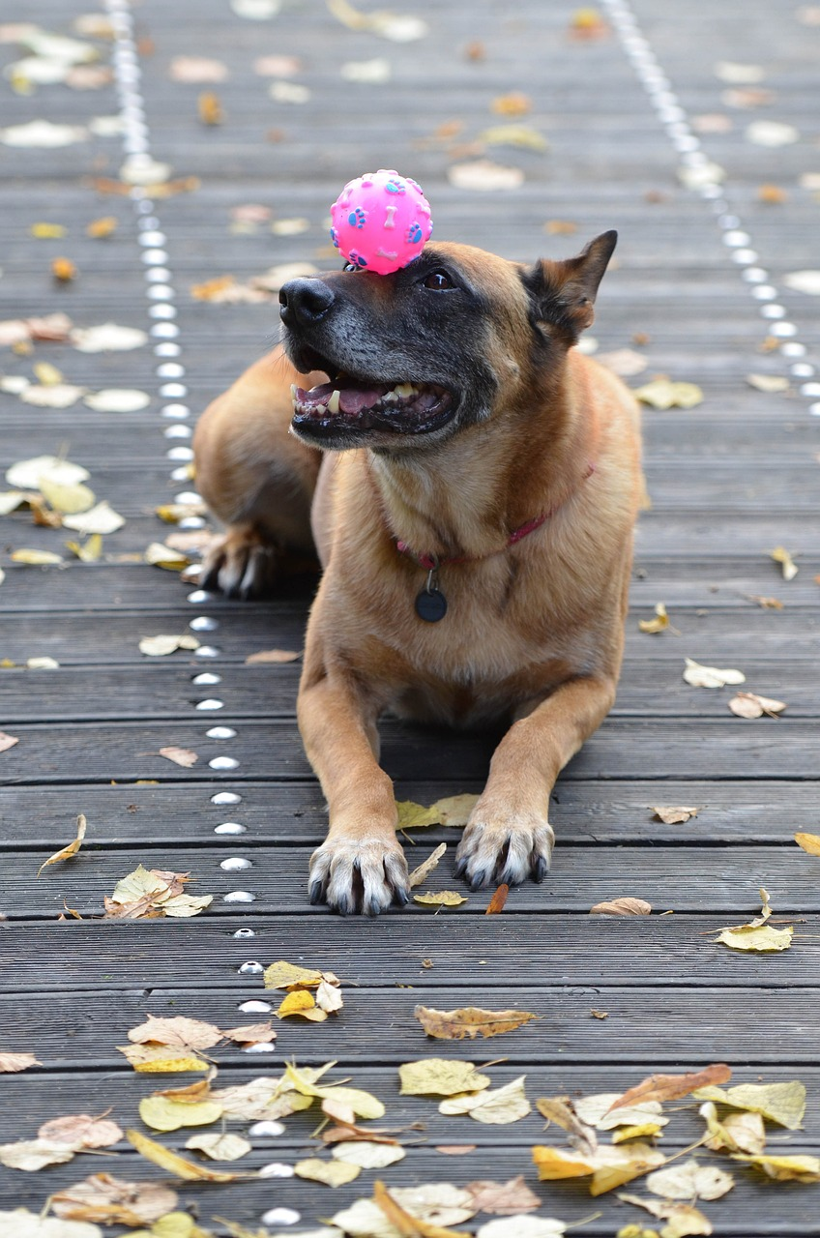
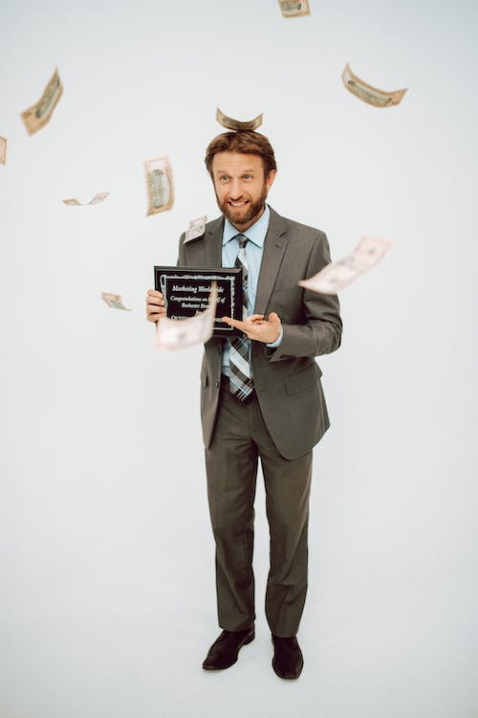
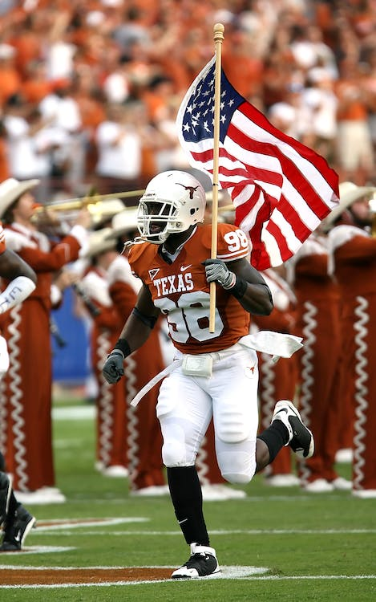
Think about it …
What is one of your favorite stories to tell about something hard to believe?
Sometimes God does something in our lives that is hard to believe.
  Miracles we read of in the Gospels, point to Jesus as God’s chosen Messiah.

Slide 4
Listen for evidence of doubt.
John 10:22-26 (NIV) Then came the Feast of Dedication at Jerusalem. It was winter, 23 and Jesus was in the temple area walking in Solomon's Colonnade. 24 The Jews gathered around him, saying, "How long will you keep

Slide 5

Listen for evidence of doubt.
us in suspense? If you are the Christ, tell us plainly." 25 Jesus answered, "I did tell you, but you do not believe. The miracles I do in my Father's name speak for me, 26 but you do not believe because you are not my sheep.

Slide 6
Miracles Point to the Messiah
Note the setting for these verses and to whom is Jesus talking.
  During the Feast of Dedication – celebration of the rebuilding of the Temple
  It was winter
  Jesus is in the temple area, Solomon’s colonnade
  Speaking to Jewish leaders

Slide 7
Miracles Point to the Messiah
What was the question posed to Jesus; what did the Jews want to know?
How did Jesus answer them? What two ways had Jesus sought to reveal who He was?
Why did they reject Him?
What can we learn about Jesus by looking at His miracles?

Slide 8
Miracles Point to the Messiah
Why do some people find Jesus's miracles hard to believe?
Jesus said these Jewish leaders were “not my sheep.” What is true about those who are the “sheep” of Jesus?
How can you learn to better hear Jesus’ voice and be one of Jesus’ “sheep”?

Slide 9
Listen for a question of clarity.
John 14:8-11 (NIV) 8 Philip said, "Lord, show us the Father and that will be enough for us." 9 Jesus answered: "Don't you know me, Philip, even after I have been among you such a long time? Anyone who has seen

Slide 10
Listen for a question of clarity.
me has seen the Father. How can you say, 'Show us the Father'? 10 Don't you believe that I am in the Father, and that the Father is in me? The words I say to you are not just my own. Rather, it is the

Slide 11
Listen for a question of clarity.
Father, living in me, who is doing his work. 11 Believe me when I say that I am in the Father and the Father is in me; or at least believe on the evidence of the miracles themselves.

Slide 12
Miracles Point to Jesus’ Divinity
Note the setting for these verses.
  Disciples are gathered together
  Jesus is explaining why he will be leaving them
  Mentions going to the Father
  Phillip asks “Show us the Father”

Slide 13
Miracles Point to Jesus’ Divinity
Why did Jesus seem surprised Philip felt a need for such a request?
What kinds of things had Philip already seen that demonstrated the Father at work through Jesus?

Slide 14
Miracles Point to Jesus’ Divinity
What obstacles prevent many from accepting the truth of who Jesus is?
Jesus appealed to His miracles as proof of His oneness with the Father. Why, how are they proof?

Slide 15
Listen for an amazing promise.
John 14:12-14 (NIV) I tell you the truth, anyone who has faith in me will do what I have been doing. He will do even greater things than these, because I am going to the Father. 13 And I will do whatever you ask in my name, so that the Son may bring glory to the Father. 14 You may ask me for anything in my name, and I will do it.

Slide 16
Jesus Continues to Work Miraculously
What is the unusual promise of Jesus in verse 12?
Consider how/why we will do even greater works.
  Because He was going to the Father.
  Jesus as a human was limited by time and space
  When the Holy Spirit came, He would be omnipresent
  God’s power now dwells in every believer
  It will still be God’s power at work, doing miracles

Slide 17
Jesus Continues to Work Miraculously
Jesus states that He will do whatever we ask. What are the qualifying statements concerning the effectiveness of our praying and Jesus’s work through us?

Slide 18
Jesus Continues to Work Miraculously
Consider the “name it and claim it” prayer philosophy sometimes based on this verse
  Motivated by greed
  “You too can drive a BMW if you have enough faith”
  “You’ll never be sick again if you have enough faith”
  “Words are said to have power, thus if you need something, simply speak it into existence (just like God created the earth).”
This philosophy wants to make God “dance” to our attempts to manipulate the spiritual laws of the universe

Slide 19
Jesus Continues to Work Miraculously
So, what does it mean to pray “in Jesus’ name”?
Assuming one has a relationship with Jesus, what might be examples of prayers where we are acting as Jesus’ representative and asking for God’s will?

Slide 20
Application
Confront doubt.
  If you struggle with believing miracles are possible, consider what your doubts might say about your belief in God.
  Be willing to trust that the all-powerful God is capable of doing the miraculous and things we cannot explain.

Slide 21
Application
Embrace the miracle in your life.
  The greatest miracle God performs is the spiritual transformation He carries out through Christ in the lives of those who put their faith in Him.
  Trust Christ and let Him work the miracle of making you a new person.

Slide 22
Application
Share the miracle.
  Let people see the miraculous work God has done in your life and be prepared to share that miracle with them.
  “But in your hearts regard Christ the Lord as holy, ready at any time to give a defense to anyone who asks you for a reason for the hope that is in you” (1 Pet. 3:15).

Slide 23
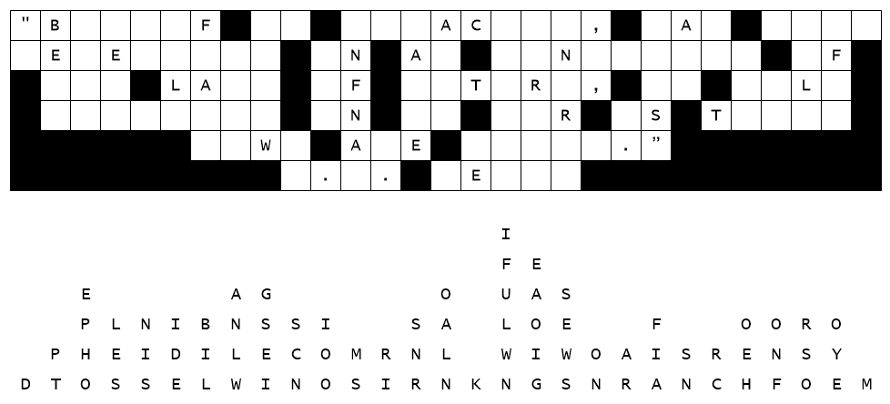

Family Activities
They claim an earthquake did this. Letters fell straight down. Start with single letter columns. Then work on two and three letter words. Here’s a hint, MIRACLES appears somewhere in the message. For help and to find the color page, go to https://tinyurl.com/ysmnjhd5

Slide 24
Are Miracles Relevant?
October 22

