Slide 1
Act with Courage
August 4

Slide 2
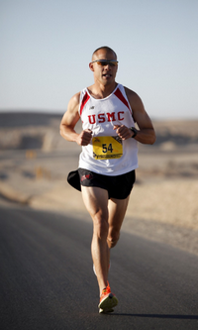
Consider …
Who comes to mind when you think of persistence?
In some ways, we’re all required to demonstrate persistence.
In our lives we will face struggles and problems.
Persistent problems call for persistent courage.

Slide 3
Listen for warning and encouragement.
2 Chronicles 15:1-7 (NIV) The Spirit of God came upon Azariah son of Oded. 2 He went out to meet Asa and said to him, "Listen to me, Asa and all Judah and Benjamin. The LORD is with you when you are with him. If you seek him, he will be found by you, but if you forsake him, he will forsake you. 3 For a long time Israel was without the true God,

Slide 4
Listen for warning and encouragement.
without a priest to teach and without the law. 4 But in their distress they turned to the LORD, the God of Israel, and sought him, and he was found by them. 5 In those days it was not safe to travel about, for all the inhabitants of the lands were in great turmoil.

Slide 5
Listen for warning and encouragement.
One nation was being crushed by another and one city by another, because God was troubling them with every kind of distress. 7 But as for you, be strong and do not give up, for your work will be rewarded."

Slide 6
Courage in Following God
Who did the Lord raise up to deliver a word to Asa and his army even as they returned to Jerusalem following the victory over Zerah?
What life lesson might we learn from the fact that we virtually know nothing about Azariah?
What was at the heart of Azariah’s prophetic message to Asa and the people? What were his main points?

Slide 7
Courage in Following God
How did Azariah illustrate the basic warning?
What had been the result of abandoning the Lord? What was it like in Israel when they did not worship the true God?
What personal message of encouragement did Azariah have for Asa?
What does it mean to have a close relationship with God, to “seek Him”?

Slide 8
Courage in Following God
How can we be receptive to what God’s messengers want to say to us?
Why is it important to stay in regular contact with Christian leaders who can teach us God’s Word and pray with us?

Slide 9
Courage in Following God
Following the Lord becomes easier as you grow older.
I’m not so sure, in some ways it becomes harder as you get older.
What do you think?
Easier when Older | Harder when Older

Slide 10
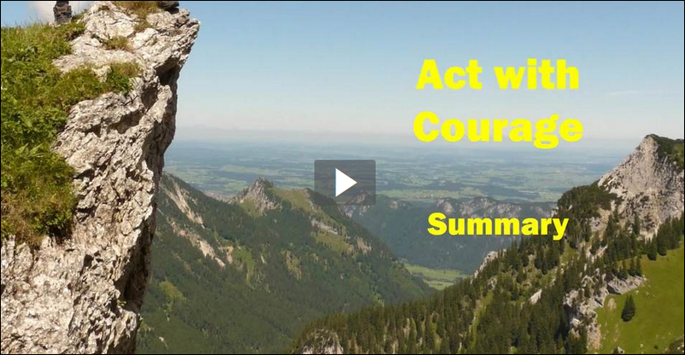
Mid Lesson Summary Video
View Video

Slide 11
Listen for Asa’s response to the message.
2 Chronicles 15:8-9 (NIV) When Asa heard these words and the prophecy of Azariah son of Oded the prophet, he took courage. He removed the detestable idols from the whole land of Judah and Benjamin and from the towns he had captured in the hills of Ephraim. He repaired the altar of the LORD that was in front of the portico of the

Slide 12
Listen for Asa’s response to the message.
LORD's temple. 9 Then he assembled all Judah and Benjamin and the people from Ephraim, Manasseh and Simeon who had settled among them, for large numbers had come over to him from Israel when they saw that the LORD his God was with him.

Slide 13
Encouraging Others to Follow God
What indicates Asa took Azariah’s message to heart? What actions did Asa take to ensure the worship of the Lord?
Why might Asa have called for a great assembly of Judah and Benjamin, including others who resided with them?
What is the value of making a public commitment to seek the Lord?

Slide 14
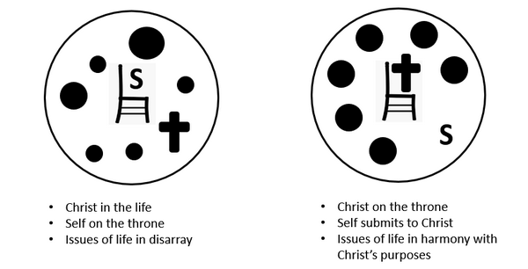
Encouraging Others to Follow God
What is the difference between serving the Lord wholeheartedly and giving God just part of our life?

Slide 15
Encouraging Others to Follow God
Where do followers of Jesus have opportunities to demonstrate courage in today’s world?

Slide 16
Encouraging Others to Follow God
Maintain spiritual courage. Restore it after a moment of weakness or a time of failure.
Consider the practice of “Spiritual Breathing”
Exhale – express confession, repentance to the Lord
Inhale – receive by faith God’s forgiveness, receive God’s strength to face the next temptation in His power

Slide 17
Application
Pray.
Ask God to show you what things have become distractions in your life and are keeping you from seeking Him with a deeper passion.
Confess those things and resolve to seek God with your whole life.

Slide 18
Application
Memorize.
Commit 2 Chronicles 15:7 to memory. “But as for you, be strong and do not give up, for your work will be rewarded.”
Let that verse come to mind when problems persist.

Slide 19
Application
Encourage.
Be an “Azariah” in someone’s life.
Step in with a word of challenge or encouragement.
As they face their problems, walk alongside them and remind them of the presence of Christ in their lives.

Slide 20
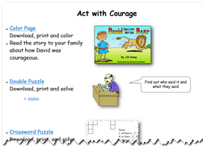
Family Activities
Double your pleasure … Double your fun … do the Double Puzzle.
And check out other fun things on the Family Activities Web Site https://tinyurl.com/y5lttaed

Slide 21
Act with Courage
August 4

