Slide 1
Accept
May 31

Slide 2
Video Introduction
View Video

Slide 3
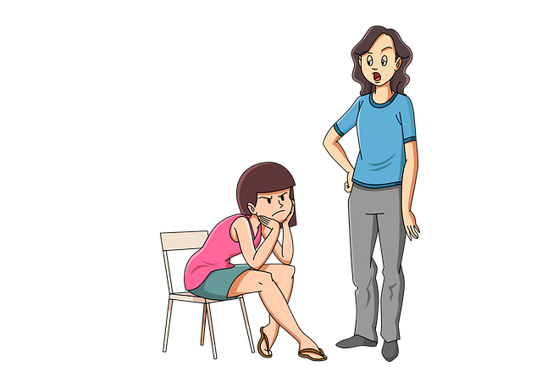
Think About It …
How do you decide what is not worth arguing about?
Today we look at Paul’s teaching on agreeing to disagree
Don’t let differences of opinion damage your relationships.

Slide 4
Listen for how to treat each other.
Romans 14:1-4 (NIV) Accept him whose faith is weak, without passing judgment on disputable matters. 2 One man's faith allows him to eat everything, but another man, whose faith is weak, eats only vegetables. 3 The man who eats everything must not look down on him who does not,

Slide 5
Listen for how to treat each other.
and the man who does not eat everything must not condemn the man who does, for God has accepted him. 4 Who are you to judge someone else's servant? To his own master he stands or falls. And he will stand, for the Lord is able to make him stand.

Slide 6
Accept People with Different Opinions
How should a fellow believer who is weak in the faith be treated?
On what basis should believers accept one another?
How should we show love for brothers and sisters who are immature in faith?
What issues did Paul believe were not worth fighting over?

Slide 7
Accept People with Different Opinions
What life-style rules and issues do Christians argue about today?
Why is it so tempting to pick apart the opinions of others?
How can we learn more about what causes believers to do, say, or believe certain things?

Slide 8
Listen for a warning from Paul.
Romans 14:13-15 (NIV) Therefore let us stop passing judgment on one another. Instead, make up your mind not to put any stumbling block or obstacle in your brother's way. 14 As one who is in the Lord Jesus, I am fully convinced that no food is unclean in itself

Slide 9
Listen for a warning from Paul.
But if anyone regards something as unclean, then for him it is unclean. 15 If your brother is distressed because of what you eat, you are no longer acting in love. Do not by your eating destroy your brother for whom Christ died.

Slide 10
Don’t Cause Another Person to Stumble
What responsibility does the mature believer have toward the spiritually weaker brother?
What if the weaker believer is distressed, offended and outraged by your expression of your freedom? What should be your response?
What reasons did Paul give to support his instructions that the strong have responsibility toward the weak?

Slide 11
Don’t Cause Another Person to Stumble
How do you balance enjoying your freedom and avoiding stumbling blocks?
How can Christians share a spirit of unity despite having different views on certain practices?

Slide 12
Listen for how to build up one another.
Romans 14:16-19 (NIV) Do not allow what you consider good to be spoken of as evil. 17 For the kingdom of God is not a matter of eating and drinking, but of righteousness, peace and joy in the Holy Spirit, 18 because anyone who serves Christ in this way is pleasing to God and approved by men. 19 Let us therefore make every effort to do what leads to peace and to mutual edification.

Slide 13
Build Up Fellow Believers
What kind of situation might result in good being spoken of as evil?
What three attributes of the kingdom did Paul cite? What is the true focus of the kingdom of God?
What should pursuing peace look like in our church?

Slide 14
Build Up Fellow Believers
What are some specific ways we can pursue peace with those with whom we have differences of opinion? How can Christians share a spirit of unity despite having different views on certain practices?
What would working “for mutual edification” look like in our church?

Slide 15
Application
Extend grace.
If someone has offended you because their actions go against your convictions, forgive.
Do not hold these actions over their heads.

Slide 16
Application
Let go.
You may feel perfectly free in Christ to participate in some activities, but others do not.
Let go of your freedom to engage in the activity in order to respect and serve the other person.

Slide 17
Application
Agree to disagree.
Meet with someone with whom you have a difference of opinion.
t might help if you each communicated why you hold to a certain conviction; in the end, however, you may still choose to agree to disagree.
Maintain love and respect for the other person in spite of the difference

Slide 18
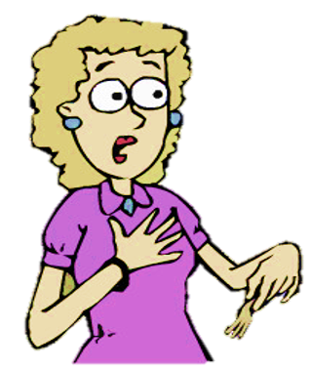
Family Activities
Oh my goodness … a coded message. And from the local Srislandsmark secret operative. You’ll need to decrypt it immediately. Help is available at https://tinyurl.com/yce5rydo There’s other unclassified activities there also.

Slide 19
Accept
May 31

