Slide 1
Abram and Lot: Family Rights
October 20

Slide 2
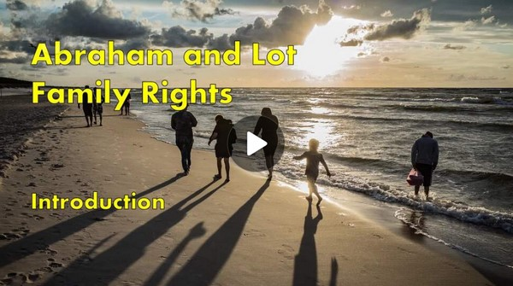
Video Introduction
View Video

Slide 3
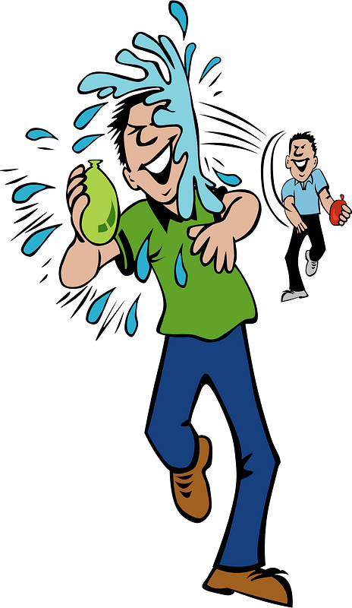
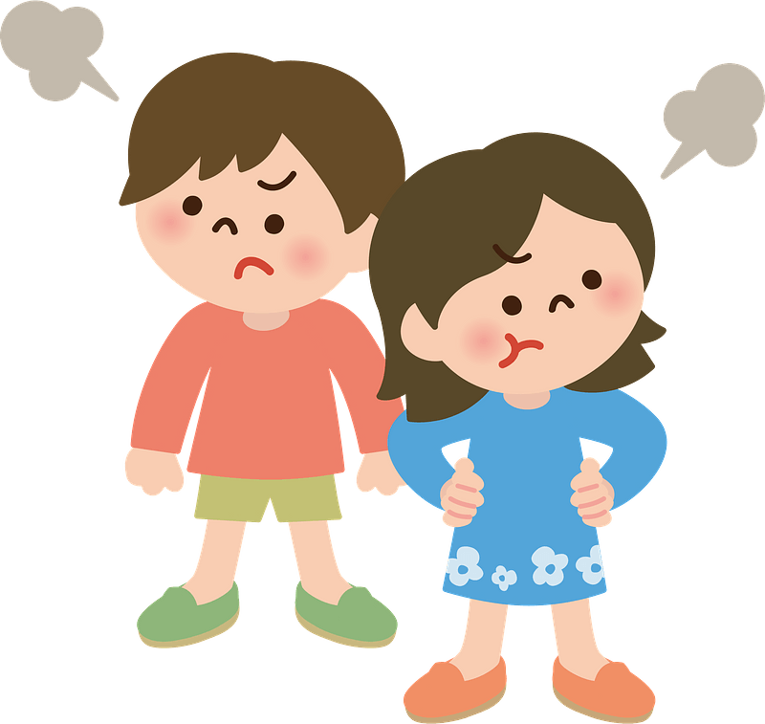
Admit it now …
What was something that you and your siblings argued about or complained about each other when you were growing up as kids?
Unfortunately, squabbles (family or otherwise) can extend into our adult years as well.
Believers have a better course of action when it comes to self-preservation and personal relationships.
Trust God when challenged over your rights or possessions.

Slide 4
Listen for the source of conflict.
Genesis 13:5-8 (NIV) Now Lot, who was moving about with Abram, also had flocks and herds and tents. 6 But the land could not support them while they stayed together, for their possessions were so great that they were not able to stay together. 7 And quarreling

Slide 5
Listen for the source of conflict.
arose between Abram's herdsmen and the herdsmen of Lot. The Canaanites and Perizzites were also living in the land at that time. 8 So Abram said to Lot, "Let's not have any quarreling between you and me, or between your herdsmen and mine, for we are brothers.

Slide 6
Identify the Source of Conflict
What were some of the details of the strife that developed?
How did the reference to the presence of the Canaanites and Perizzites contribute to the problem?
What are some things that make conflict worse in our culture?

Slide 7
Identify the Source of Conflict
What are some ways that people today deal with conflict?
What are some early steps we can take to avoid or reduce conflict?
Why is it important to be ready to handle conflict in a timely and graceful manner?

Slide 8
Listen for generosity.
Genesis 13:9-11 (NIV) Is not the whole land before you? Let's part company. If you go to the left, I'll go to the right; if you go to the right, I'll go to the left." 10 Lot looked up and saw that the whole plain of the Jordan was well watered, like

Slide 9
Listen for generosity.
the garden of the LORD, like the land of Egypt, toward Zoar. (This was before the LORD destroyed Sodom and Gomorrah.) 11 So Lot chose for himself the whole plain of the Jordan and set out toward the east. The two men parted company:

Slide 10
“You before Me” Attitude
Why do you think Abram suggested the solution he did? Why didn’t he exert his authority as the senior family member?
What does Abram’s example teach us?
Suppose you are Lot and it is the end of the day … you are writing in your journal the events of the day. What would you be writing down as the explanation for your decision?

Slide 11
“You before Me” Attitude
What character traits would you infer from the way Lot reacted?
How do these attitudes NOT help resolve conflict?

Slide 12
Listen for God’s assurance.
Genesis 13:14-18 (NIV) The LORD said to Abram after Lot had parted from him, "Lift up your eyes from where you are and look north and south, east and west. 15 All the land that you see I will give to you and your offspring forever. 16 I will make your offspring like the dust

Slide 13
Listen for God’s assurance.
of the earth, so that if anyone could count the dust, then your offspring could be counted. 17 Go, walk through the length and breadth of the land, for I am giving it to you." 18 So Abram moved his tents and went to live near the great trees of Mamre at Hebron, where he built an altar to the LORD.

Slide 14
Trust God with the Outcome
What did God say in response to these events?
Why do you think God chose this time to restate His promise to Abram?

Slide 15
Trust God with the Outcome
Consider situations in our family lives where there is conflict …
Spouses argue about money
Willful teenagers
Disagreement over disciplining children
Treating one child as most or least favorite
Fighting with siblings over family inheritance

Slide 16
Trust God with the Outcome
Many of these tensions are a normal part of life … but when tensions escalate, they can lead to alienation or abuse that goes beyond words.
How can relying on God influence on these kinds of situations?

Slide 17
Application
Go Directly to God.
Start by first asking God for wisdom and guidance in this situation.

Slide 18
Application
Go Directly to the Source.
When you are aware of a potential family conflict, take the initiative by going directly to the person seeking a peaceful solution.
Avoid discussing the problem with others, as that can escalate the situation.

Slide 19
Application
Go Diplomatically.
When you meet be argumentative or respond with emotional expressions.
Go with a godly goal: restoration (Matt. 18:15 and Gal. 6:1).

Slide 20
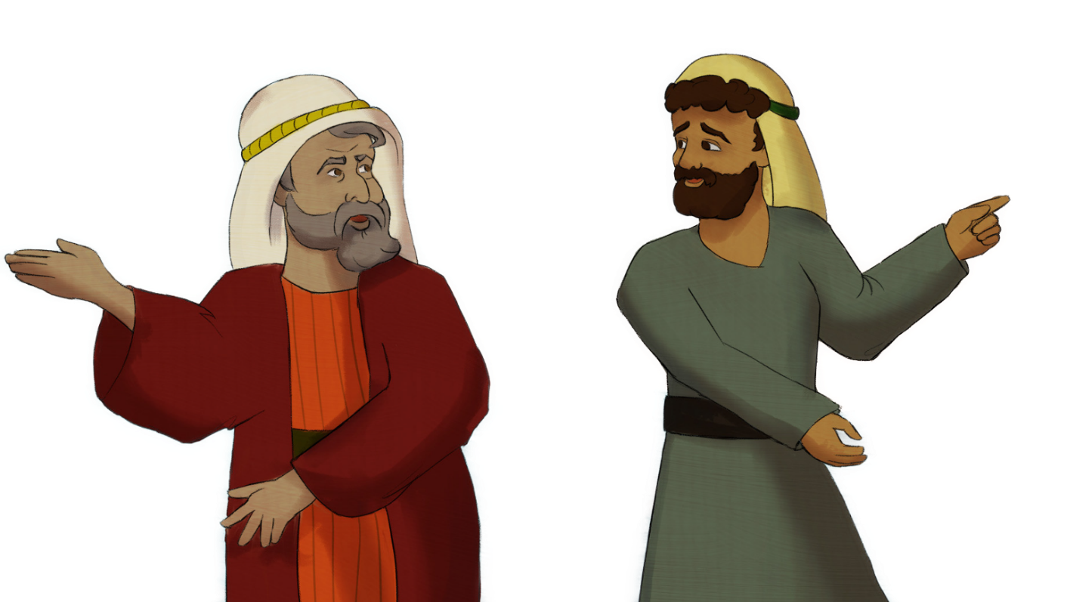
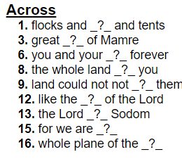
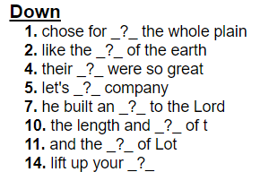
Family Activities
And I’ll do these. Remember the words and clues are from Genesis 13:5 – 18 (NIV). And help is available at https://tinyurl.com/47vurwcx along with other fun Family Activities.
OK … I’ll do these

Slide 21
Abram and Lot: Family Rights
October 20

