Slide 1
Abigail: Intervening Faith
June 23

Slide 2
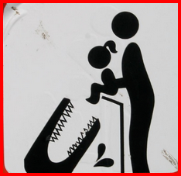
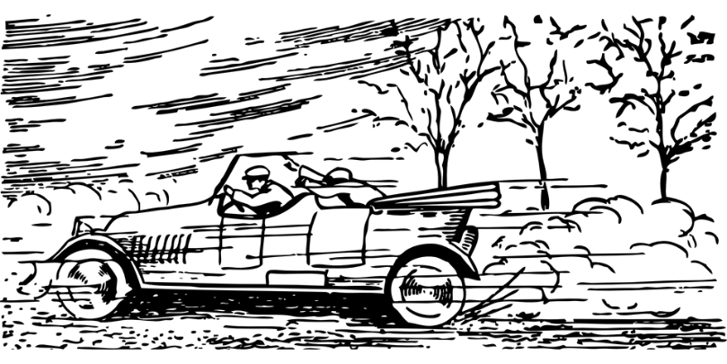
Think about it …
What are some instances where foolishness actually becomes dangerous or hazardous to one’s health?
Today we look at Nabal who acted foolishly and put his whole family at risk.
We also learn about how others stepped in and headed off disaster
As believers we Honor Christ by stepping in to help resolve conflict.

Slide 3
Listen for both foolish and wise action.
1 Samuel 25:1-3, 14 - 17 (NIV) Now Samuel died, and all Israel assembled and mourned for him; and they buried him at his home in Ramah. Then David moved down into the Desert of Maon. 2 A certain man in Maon, who had property there at Carmel, was very wealthy. He had a thousand goats and three thousand sheep, which he was shearing in Carmel. 3 His name was Nabal

Slide 4
Listen for both foolish and wise action.
and mean in his dealings … 14 One of the servants told Nabal's wife Abigail: "David sent messengers from the desert to give our master his greetings, but he hurled insults at them. 15 Yet these men were very good to us. They did not mistreat us, and the whole time we were out in the fields near them nothing was missing.

Slide 5
Listen for both foolish and wise action.
Night and day they were a wall around us all the time we were herding our sheep near them. 17 Now think it over and see what you can do, because disaster is hanging over our master and his whole household. He is such a wicked man that no one can talk to him.".

Slide 6
Be Trustworthy in Times of Need
Who was Nabal and what kind of person was he?
When a conflict arose between Nabal and David, who did one of Nabal’s servants approach?
Why might have he come to Abigail and not Nabal?
How did the servant assess the relationship he and others had with David and his men? What did he urge Abigail to do?

Slide 7
Be Trustworthy in Times of Need
How would you feel if you were asked to quickly fix a mess created by someone else? What thought would go through your head?
So, what kinds of things prevent us from acting to avoid the bad situation in a person’s life?
What might be some examples of bad situations people face that may require someone to step in to prevent the situation from getting worse?

Slide 8
Listen for Abigail’s swift action.
1 Samuel 25:23-28 (NIV) 23 When Abigail saw David, she quickly got off her donkey and bowed down before David with her face to the ground. 24 She fell at his feet and said: "My lord, let the blame be on me alone. Please let your servant speak to you; hear what your servant has to say. 25 May my lord pay no attention to that wicked man Nabal. He is just like his name--his name is Fool,

Slide 9
Listen for Abigail’s swift action.
and folly goes with him. But as for me, your servant, I did not see the men my master sent. 26 "Now since the LORD has kept you, my master, from bloodshed and from avenging yourself with your own hands, as surely as the LORD lives and as you live, may your enemies and all who intend to harm my master be like Nabal. 27 And let this gift,

Slide 10
Listen for Abigail’s swift action.
which your servant has brought to my master, be given to the men who follow you. 28 Please forgive your servant's offense, for the LORD will certainly make a lasting dynasty for my master, because he fights the LORD's battles. Let no wrongdoing be found in you as long as you live

Slide 11
Encourage Right Behavior
What was Abigail’s attitude when she went out to meet David?
How did Abigail evaluate her husband’s judgment?
Why did Abigail take responsibility for the insult to David?

Slide 12
Encourage Right Behavior
How can we know whether it is best to intervene in a conflict or to stay out?
What principles can we learn from Abigail’s approach to the problem?

Slide 13
Listen for David’s response.
1 Samuel 25:32-35 (NIV) David said to Abigail, "Praise be to the LORD, the God of Israel, who has sent you today to meet me. 33 May you be blessed for your good judgment and for keeping me from bloodshed this day and from avenging myself with my own hands. 34 Otherwise, as surely as the LORD,

Slide 14
Listen for David’s response.
the God of Israel, lives, who has kept me from harming you, if you had not come quickly to meet me, not one male belonging to Nabal would have been left alive by daybreak." 35 Then David accepted from her hand what she had brought him and said, "Go home in peace. I have heard your words and granted your request."

Slide 15
Keep a Christ-centered Perspective
For what did David praise the Lord?
So, how did David view the fact that Abigail came out to meet him?
Suppose you are in a situation more like David’s. Someone comes to you and asks you to change your actions. Why could that be a hard thing to do?

Slide 16
Keep a Christ-centered Perspective
What lessons can we learn from Abigail as we seek to make peace today?
How does resolving conflict honor Christ?

Slide 17
Lesson Summary
View Video

Slide 18
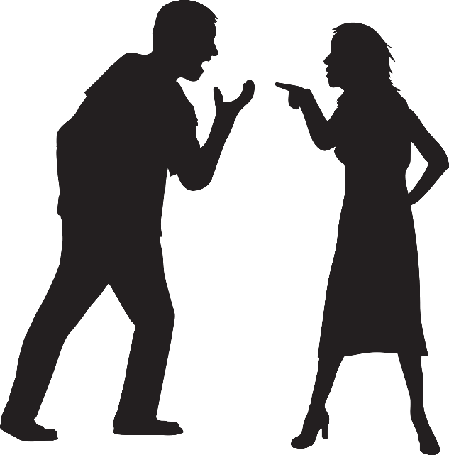
Application
Pray.
Pray for someone you know who is dealing with conflict.
Ask the Lord to intervene.

Slide 19
Application
Give permission.
Give someone permission to step in whenever you are on the verge of a bad decision.

Slide 20
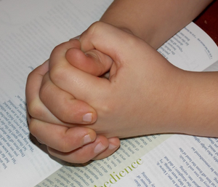
Application
Step in.
Is the Lord asking you to intervene for someone else?
Spend time reading Scripture that mentions unity in the body and pray for God to give you humility as you mediate.

Slide 21
Family Activities
We don’t want to miss anything on the Family Activities page. It’s great stuff!
https://tinyurl.com/y24k3l9e

Slide 22
Abigail: Intervening Faith
June 23

