Slide 1
Abigail: A Woman of Wisdom
August 27

Slide 2


Video Introduction
View Video

Slide 3



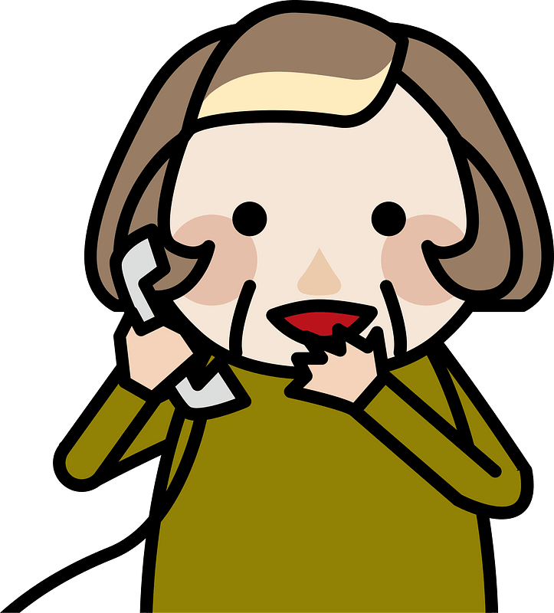

Remember that time?
When has someone helped you avoid a potential pitfall?
Some of these situations may have only caused an inconvenience.
  In other situations a wrong step may be physically or spiritually dangerous.
  Today we study someone who stepped in to keep a bad situation from getting worse.
Is this your wallet?
There’s a test tomorrow!

Slide 4
Listen for a warning given.
1 Samuel 25:14-17 (NIV) One of the servants told Nabal's wife Abigail: "David sent messengers from the desert to give our master his greetings, but he hurled insults at them. 15 Yet these men were very good to us. They did not mistreat us, and the whole time we were out in the fields near

Slide 5
Listen for a warning given.
them nothing was missing. 16 Night and day they were a wall around us all the time we were herding our sheep near them. 17 Now think it over and see what you can do, because disaster is hanging over our master and his whole household. He is such a wicked man that no one can talk to him."

Slide 6
Do What Is Right
Why do you think the servant sought out Abigail instead of confronting Nabal?
How did the servant assess the relationship he and others had with David and his men? What did he urge Abigail to do?
How would you feel if you were asked to quickly fix a mess created by someone else? What thought would go through your head?

Slide 7
Do What Is Right
Someone might accuse the servant of “tattling.” What’s the difference between tattling and giving someone information to keep a bad situation from becoming worse?
Tattling | Avoiding a Bad Situation

Slide 8
Do What Is Right
So, what kinds of things prevent us from acting to avoid the bad situation in a person’s life?
What might be some examples of bad situations people face that may require someone to step in to prevent the situation from getting worse?

Slide 9
Listen for an apology.
1 Samuel 25:23-28 (NIV) When Abigail saw David, she quickly got off her donkey and bowed down before David with her face to the ground. 24 She fell at his feet and said: "My lord, let the blame be on me alone. Please let your servant speak to you; hear what your servant has to say. 25 May my lord pay no attention to that wicked man Nabal.

Slide 10
Listen for an apology.
He is just like his name--his name is Fool, and folly goes with him. But as for me, your servant, I did not see the men my master sent. 26 "Now since the LORD has kept you, my master, from bloodshed and from avenging yourself with your own hands, as surely as the LORD lives and as you live, may your enemies and all who intend to

Slide 11
Listen for an apology.
harm my master be like Nabal. 27 And let this gift, which your servant has brought to my master, be given to the men who follow you. 28 Please forgive your servant's offense, for the LORD will certainly make a lasting dynasty for my master, because he fights the LORD's battles. Let no wrongdoing be found in you as long as you live.

Slide 12
Act Wisely
In what ways did Abigail show her respect for David?
Why did Abigail take responsibility for the insult to David?
How can we know whether it is best to intervene in a conflict or to stay out?

Slide 13
Act Wisely
Some might think Abigail was unsubmissive and rebellious when she did what Nabal refused to do. What was her reason for her actions?
What principles can we learn from Abigail’s approach to the problem?

Slide 14
Listen for a “thank you.”
1 Samuel 25:32-35 (NIV) David said to Abigail, "Praise be to the LORD, the God of Israel, who has sent you today to meet me. 33 May you be blessed for your good judgment and for keeping me from bloodshed this day and from avenging myself with my own hands. 34 Otherwise, as surely as the LORD, the God of

Slide 15
Listen for a “thank you.”
Israel, lives, who has kept me from harming you, if you had not come quickly to meet me, not one male belonging to Nabal would have been left alive by daybreak." 35 Then David accepted from her hand what she had brought him and said, "Go home in peace. I have heard your words and granted your request."

Slide 16
Thank the Lord for Wise Counsel
For what did David praise the Lord?
So how did David view the fact that Abigail came out to meet him?
Suppose you are in a situation more like David’s. Someone comes to you and asks you to change your actions. Why could that be a hard thing to do?

Slide 17
Thank the Lord for Wise Counsel
What lessons can we learn from Abigail as we seek to make peace today?
How does resolving conflict honor Christ?

Slide 18
Application
List.
  Make a list of areas where you need wisdom.
  Take those things to God in prayer, asking for His Holy Spirit’s guidance.

Slide 19
Application
Refine.
  Conduct an inventory of the sources that help you make decisions in life.
  Ask God for greater discernment in discriminating between them.
  Classify these sources by subject area (such as finances) and their degree of reliability.
  Then eliminate resources that could betray your judgment or lead you astray.

Slide 20
Application
Partner.
  Look for a godly mentor in one or more of the areas listed above.
  Schedule regular time together to grow in wisdom with God’s help.

Slide 21
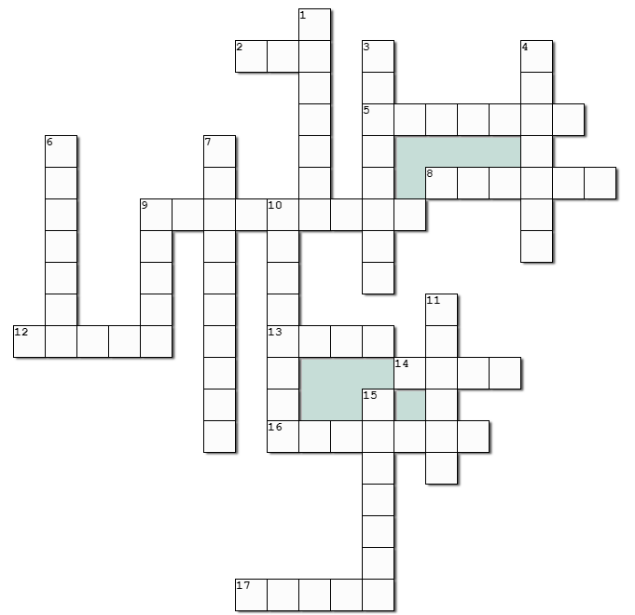

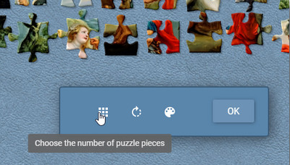
Family Activities
And an online jigsaw puzzle (choose your own number of pieces) at https://tinyurl.com/23h9nnsk
Help and more at https://tinyurl.com/5377w2wx

Slide 22
Abigail: A Woman of Wisdom
August 27

