Slide 1
Aaron and Hur
July 21

Slide 2
Video Introduction
View Video

Slide 3
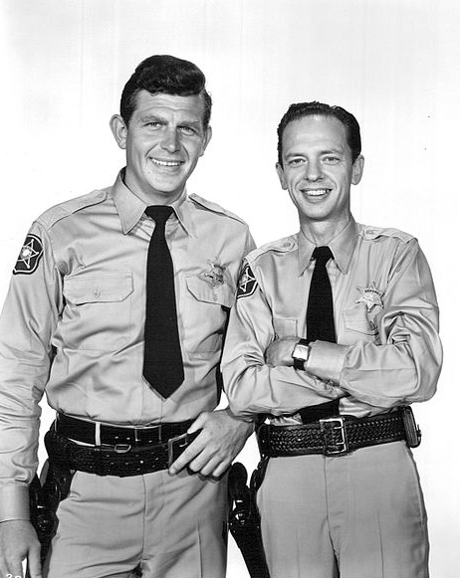
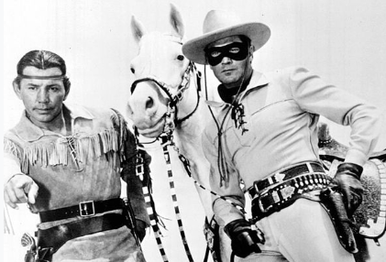
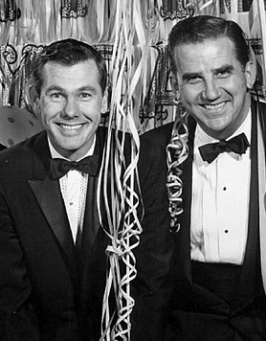
Just who were they?
Who are some of your favorite “sidekicks” from movies and TV shows?
Leaders don’t lead without the help of others.
Our examples were from fiction and TV shows
Today we look a help given by those in Bible history

Slide 4
Listen for appointments made.
Exodus 17:8-10 (NIV) The Amalekites came and attacked the Israelites at Rephidim. 9 Moses said to Joshua, "Choose some of our men and go out to fight the Amalekites. Tomorrow I will stand on top of the hill with the staff of God in my hands." 10 So Joshua fought the Amalekites as Moses had ordered, and Moses, Aaron and Hur went to the top of the hill.

Slide 5
Be Ready to Help
Consider the challenge the people of Israel faced in this setting.
Attacks from Amalekites
Turns out these were descendants of Esau
Israelites were descendants from his brother Jacob
Amalekites were nomadic raiders – they had learned to domesticate camels for swift hit and run attacks

Slide 6
Be Ready to Help
Who did Moses call upon to assist in resisting the Amalekites, and what do we know about them?
What challenge did Joshua have? What kind of courage did Joshua need to obey Moses?
What are some of the daily challenges you face?

Slide 7
Be Ready to Help
How do the challenges we deal with make it seem like we’re at war?
Moses had the “staff of God”. What do we have in our battles?
Who are some people you would want by your side when you face challenges?

Slide 8
Listen for how Moses needed help.
Exodus 17:11-13 (NIV) As long as Moses held up his hands, the Israelites were winning, but whenever he lowered his hands, the Amalekites were winning.12 When Moses' hands grew tired, they took a stone and

Slide 9
Listen for how Moses needed help.
put it under him and he sat on it. Aaron and Hur held his hands up--one on one side, one on the other--so that his hands remained steady till sunset. 13 So Joshua overcame the Amalekite army with the sword.

Slide 10
Do What You Can
What happened when Moses held up his hands?
Aaron and Hur had wisdom to help Moses in what way?

Slide 11
Do What You Can
The “staff of God” had previously been a symbol of God’s presence and power.
To initially reassure Moses, God turned it into a snake, then back to a walking staff
Did the same thing before Pharaoh
Moses used it when he held it out over the Red Sea and God parted the waters
Moses struck a rock with the staff and water came out of the rock

Slide 12
Do What You Can
When has someone “held your arms up” to help you accomplish a task?
In whose lives can you play the role of Aaron and Hur?
How might we offer physical support to our leaders when they are weary?

Slide 13
Listen for more help Moses needed.
Exodus 24:13-15 (NIV) Then Moses set out with Joshua his aide, and Moses went up on the mountain of God. 14 He said to the elders, "Wait here for us until we come back to you. Aaron and Hur are with you, and anyone involved in a dispute can go to them." 15 When Moses went up on the mountain, the cloud covered it,

Slide 14
Be Dependable
Moses returned to the mountain to receive the Ten Commandments etched in stone. Joshua accompanied him. What instructions did he give to the elders?
What other times elsewhere in Exodus do you see the growth of the relationship between Moses and Joshua?

Slide 15
Be Dependable
Why might Moses have had confidence in all three of these men?
What does it look like for someone to be dependable in their Christian walk? How will church leadership know to have confidence in church members for various ministries?
How can the church support Christian leaders?

Slide 16
Application
Be present.
Identify opportunities to encourage others.
Offering an encouraging word to your pastor or group leader.
Maybe help with something more tangible.
Let others know you are there for them.

Slide 17
Application
Offer thanks.
Look around for those who have helped you get where you are.
Write a thank you card to each one to let them know how important they’ve been in your Christian journey.

Slide 18
Application
Lighten a load.
Are there people in your life who always seem to have a burden to carry?
How can you be supportive and hold their arms up during these difficult days?
Look for an opportunity to lighten their load by taking on one of their tasks, even if just temporarily.

Slide 19
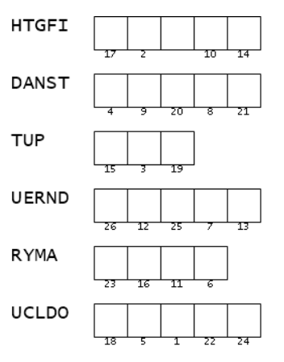
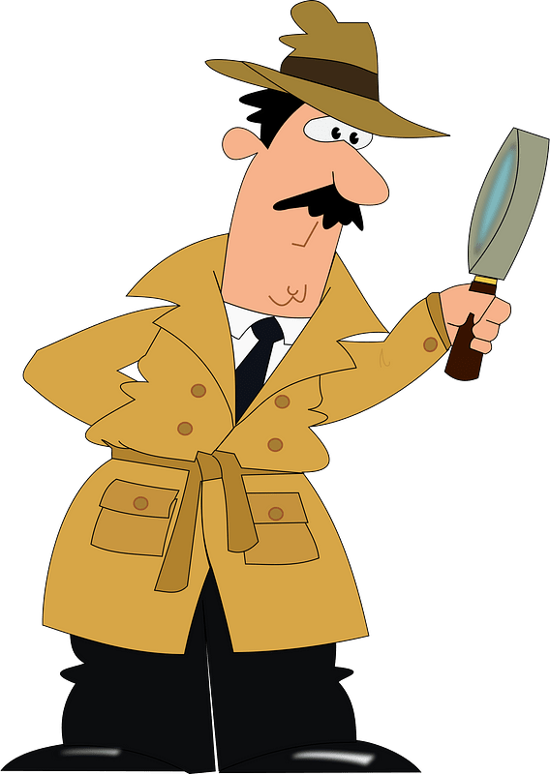
Family Activities
AH HA … One of the suspects is “RYMA”. Maybe she can tell us what the secret message is. I know this is important. Can you help us out? Other Fun Family Activities can be found at https://tinyurl.com/5n8h9jcn .

Slide 20
Aaron and Hur
July 21

