Slide 1
A Slower Pace
September 29

Slide 2
Introduction Video
View Video

Slide 3
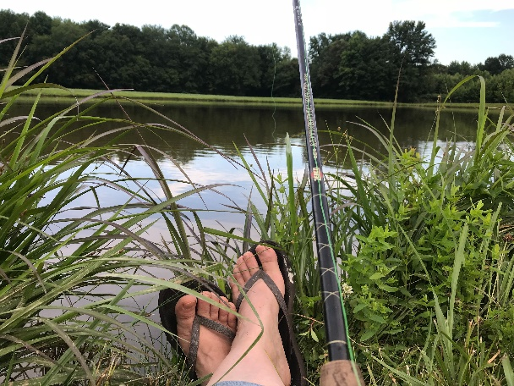
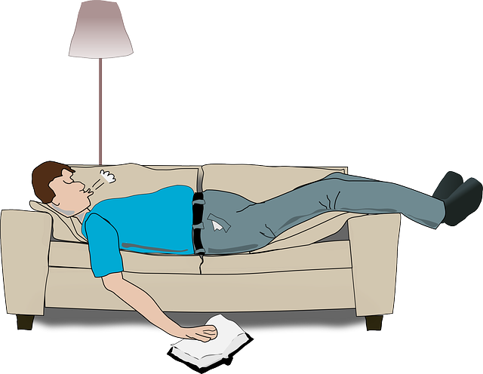
Admit it now …
What’s your favorite way to relax?
What is relaxing for one person may not be for another.
But we all need some times of relief from the daily grind.
Today we discover that rest is a gift from God.

Slide 4
Listen for who should rest.
Exodus 20:8-11 (NIV) "Remember the Sabbath day by keeping it holy. 9 Six days you shall labor and do all your work, 10 but the seventh day is a Sabbath to the LORD your God. On it you shall not do any work, neither you, nor your son or daughter, nor your manservant or maidservant,

Slide 5
Listen for who should rest.
nor your animals, nor the alien within your gates. 11 For in six days the LORD made the heavens and the earth, the sea, and all that is in them, but he rested on the seventh day. Therefore the LORD blessed the Sabbath day and made it holy

Slide 6
Day of Rest Commanded
How is the Sabbath to be honored?
What is the rationale for resting from work?
Why do we often struggle to slow down and take a break?
What distractions can keep us from a time of resting and reflecting on the Sabbath?

Slide 7
Day of Rest Commanded
What benefits of practicing a day of Sabbath rest resonate with you?
What positive actions can you take to honor the Lord’s day?

Slide 8
Listen for consequences.
Exodus 31:12-14 (NIV) Then the LORD said to Moses, 13 "Say to the Israelites, 'You must observe my Sabbaths. This will be a sign between me and you for the generations to come, so you may know that I am the LORD, who makes

Slide 9
Listen for consequences.
you holy. 14 "'Observe the Sabbath, because it is holy to you. Anyone who desecrates it must be put to death; whoever does any work on that day must be cut off from his people.

Slide 10
Holiness of a Day of Rest
Who is the ultimate authority behind the message given here?
What is the purpose for sabbath observance given in these verses?
Based on what these verses are saying, how important or significant is it to honor God on the Sabbath?

Slide 11
Holiness of a Day of Rest
What does it mean to keep a day “holy”?
What might need to change so that our Sabbath practices improve our relationship with God?
What are signs of people being addicted to work?

Slide 12
Holiness of a Day of Rest
What is the tension between working too much and resting too little?
How does rest provide us with new ways to grow as Christians?

Slide 13
Listen for a Sabbath/Creation connection.
Exodus 31:15-17 (NIV) For six days, work is to be done, but the seventh day is a Sabbath of rest, holy to the LORD. Whoever does any work on the Sabbath day must be put to death. 16 The Israelites are to observe the Sabbath,

Slide 14
Listen for a Sabbath/Creation connection.
celebrating it for the generations to come as a lasting covenant. 17 It will be a sign between me and the Israelites forever, for in six days the LORD made the heavens and the earth, and on the seventh day he abstained from work and rested.'"

Slide 15
Rest and Our Relationship with God
What is the purpose of sabbath suggested in these verses?
What happens to people who try to take on too many responsibilities?
If God is omnipotent – all powerful, we might conclude He wouldn’t need rest. So why did He rest?

Slide 16
Rest and Our Relationship with God
What difference does it make that God told His people to rest? Why dictate this way of life?
By the time of Jesus’ life on earth religious leaders of Israel had placed extreme boundaries on Sabbath observation … Jesus stated both implicitly and explicitly these were mistaken.
However … what reasonable boundaries we can adopt for ourselves to help us keep a Sabbath rest.

Slide 17
Application
Rest.
Take a day off from any work.
Rest your mind and body—and don’t convince yourself you are not being productive.
Proper rest will make you more productive.

Slide 18
Application
Refresh.
Spend time in prayer and worship, both by yourself and with others.
Let the things of God fill your mind and renew you.
Memorize Philippians 4:8: “Finally, brothers and sisters, whatever is true, whatever is noble, whatever is right, whatever is pure, whatever is lovely, whatever is admirable—if anything is excellent or praiseworthy—think about such things.”

Slide 19
Application
Reflect.
Use a journal and write down what God is teaching you.
Record your evaluation of the past day or week, because such reflection will spur you on to greater things.

Slide 20
Family Activities
We in the spy business call this a “one time pad.” Without the key, it’s impossible to decode. But … you’ve got the key. Don’t rest until you decrypt the message. Then you can rest up before you go to the Family Activities for other cool stuff. Use the secret QR code to find your way there if you get stuck.

Slide 21
A Slower Pace
September 29

