Slide 1
A Prayer of Thanksgiving
November 25

Slide 2
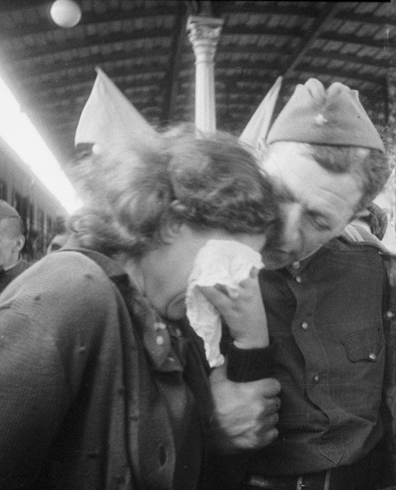
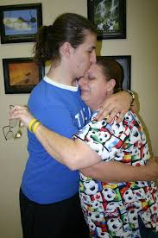
Remember the time …
When have you been overcome by gratitude?
We might not always be overcome, but we often receive blessings we didn’t expect
Certainly God demonstrates His grace on us daily as He provides our needs and more
Express gratitude and trust in the One who hears our prayers.

Slide 3
Listen for ways to praise God.
Psalm 138:1-2 (NIV) I will praise you, O LORD, with all my heart; before the "gods" I will sing your praise. 2 I will bow down toward your holy temple and will praise your name for your love and your faithfulness, for you have exalted above all things your name and your word.

Slide 4
Thankful for Love and Truth
What words indicate the depth of the praise David gave to the Lord?
What motivated David to write this song to God?
What do you think David meant when he said he praised the Lord “before the ‘gods’ ”?
In what circumstances today might we choose to worship the Lord before other "gods"?

Slide 5
Thankful for Love and Truth
Verse 2 in the KJV reads, I will worship toward thy holy temple, and praise thy name for thy lovingkindness and for thy truth: for thou hast magnified thy word above all thy name. What do the words “lovingkindness” and “truth” mean in relationship to God?
How has God displayed love and truth in your life recently?

Slide 6
Thankful for Love and Truth
Why do we often fail to give God thanks for what He has done?
How do the Psalmist’s words remind us to express our thanks to God?

Slide 7
Listen for reasons to praise God.
Psalm 138:3-6 (NIV) When I called, you answered me; you made me bold and stouthearted. 4 May all the kings of the earth praise you, O LORD, when they hear the words of your mouth. 5 May they sing of the ways of the LORD, for the glory of the LORD is great. 6 Though the LORD is on high, he looks upon the lowly, but the proud he knows from afar.

Slide 8
Thankful for God’s Provision
How had the Lord met David’s needs?
Whom did David want to join him in praise to God?
What might influence the kings or peoples of the earth to praise the Lord?
According to this passage, what things display God’s glory?

Slide 9
Listen for God’s protection.
Psalm 138:7-8 (NIV) Though I walk in the midst of trouble, you preserve my life; you stretch out your hand against the anger of my foes, with your right hand you save me. 8 The LORD will fulfill [his purpose] for me; your love, O LORD, endures forever-- do not abandon the works of your hands.

Slide 10
Thanking God for Protection
How does the Lord demonstrate His care for those He loves? List the assurances from the Lord that David claims in these verses.
What hope did David place in the Lord? On what are these assurances based?
How have you found God’s words and ways to be reliable?

Slide 11
Thanking God for Protection
When has God protected you without your awareness at the time?
How does a thankful spirit give you courage as you face challenges in life?
What’s happened recently in the life of our group to cause us to say, “God is faithful”?

Slide 12
Application
Be thankful.
Every day this week tell God something you are thankful for.

Slide 13
Application
Write out your thanks.
Make a list—a long list!—of all the reasons you have to be thankful.
Pray through the entire list and thank God for the different ways He has blessed and touched your life.

Slide 14
Application
Thank someone.
Write a handwritten note to someone for whom you’re thankful
Tell that person why you thank God for him or her.
Include a prayer of thanksgiving

Slide 15
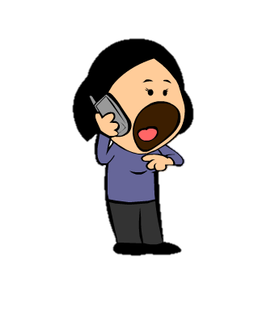
Family Activities
Yes … there’s a new set of Family activities … and there is a crossword puzzle. But I’ll tell you, there’s lots of other really interesting stuff that will grab the interest of the whole family. It’s at https://tinyurl.com/ybqjcraz

Slide 16
A Prayer of Thanksgiving
November 25

