Slide 1
A Prayer of Surrender
October 28

Slide 2
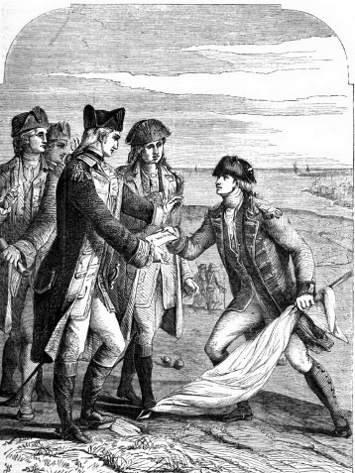
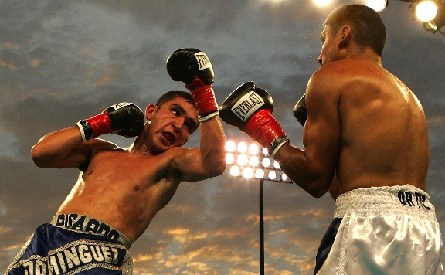
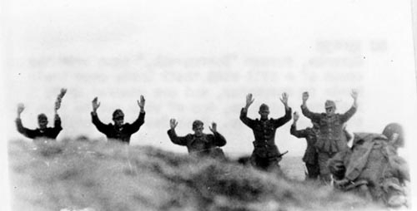
Think about it …
What are some ways where people in a fight or conflict with someone else might signify they wish to give up or surrender?
Today we want to talk about surrender in the context of prayer … surrender to God
  We consider how to approach prayer with humble submission to the will of God.

Slide 3

Listen for requests in this prayer.
Matt. 6:10 (NIV) … your kingdom come, your will be done, on earth as it is in heaven. …

Slide 4
Surrender and Submission to the Lord
What is the petition of this portion of the Lord’s Model Prayer?
How does this request continue the theme of honoring God that is at the heart of this section of the prayer?

Slide 5
Surrender and Submission to the Lord
What obstacles can keep us from surrendering our will to God’s will?
What does it mean and what would it be like for God’s will to be accomplished in earth, as it is in heaven?

Slide 6
Listen for how to come to God.
James 4:6-10 (NIV) But he gives us more grace. That is why Scripture says: "God opposes the proud but gives grace to the humble." 7 Submit yourselves, then, to God. Resist the devil, and he will flee from you. 8 Come near to God and he will come near to you.

Slide 7
Listen for how to come to God.
Wash your hands, you sinners, and purify your hearts, you double-minded.
9 Grieve, mourn and wail. Change your laughter to mourning and your joy to gloom. 10 Humble yourselves before the Lord, and he will lift you up.

Slide 8
Surrender to the
Lordship of Christ
What ten imperatives from James define and describe how to be in right relationship with God?
What three promises are attached to these imperatives?
Consider the words “He gives us more grace” and “gives grace to the humble.” What does this mean?

Slide 9
Surrender to the
Lordship of Christ
What is the relationship of grace to being reconciled to God?
How does “submitting to God” fit into this concept?
What is the relationship of being reconciled to God with being reconciled to others?

Slide 10
Surrender to the
Lordship of Christ
We are told to “resist the devil” … what are some synonyms of “resist?”
What are some ways in which we can resist (withstand, defy, oppose) the devil? Which of the previously listed imperatives apply here?

Slide 11
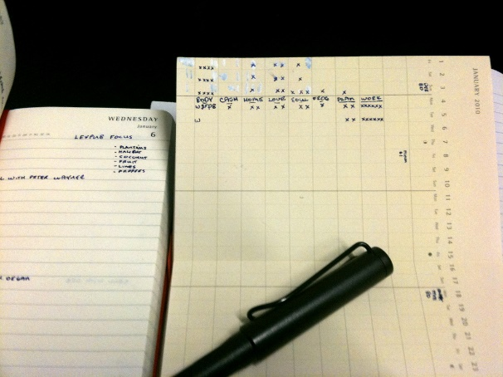
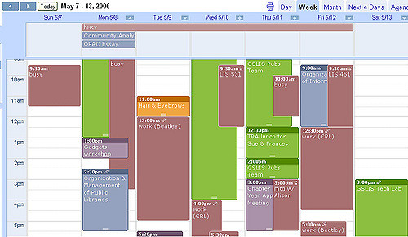
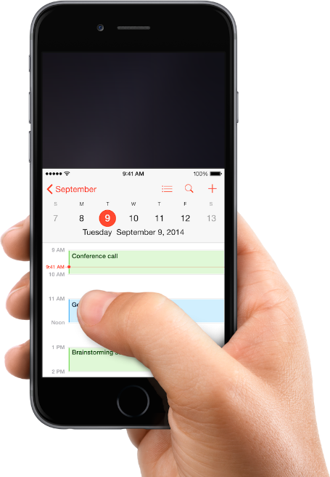
Consider …
What ways do we have to manage our time?
Listen for what James might say about our time fetish.

Slide 12

Listen for what James might say about our time fetish.
View the Video

Slide 13
Listen for what James might say about our time fetish.
James 4:13-17 (NIV) 13 Now listen, you who say, "Today or tomorrow we will go to this or that city, spend a year there, carry on business and make money." 14 Why, you do not even know what will happen tomorrow. What is your life? You are a mist that appears for a little

Slide 14
Listen for what James might say about our time fetish.
while and then vanishes. 15 Instead, you ought to say, "If it is the Lord's will, we will live and do this or that." 16 As it is, you boast and brag. All such boasting is evil. 17 Anyone, then, who knows the good he ought to do and doesn't do it, sins.

Slide 15
Surrender your Plans to God’s Plans
Whose attention did James want to get?
What are some mistakes we tend to make in planning for our future?
What imagery did James use to emphasize the brevity of life?

Slide 16
Surrender your Plans to God’s Plans
What kinds of events can so easily alter our carefully made plans?
What does he say we should do instead?
Note that James says that it is evil if we do not include God in our plans. List some ways to keep in submission to God as we pray.

Slide 17
Application
Evaluate.
  Evaluate the things you pray for.
  Consider if you are more focused on what you want or what God wants.

Slide 18
Application
Surrender.
  Ask God to reveal areas of your life that you have not surrendered to Him.

Slide 19
Application
Fast.
  One day a week, add fasting to your prayer life.
  This is to help you focus on God and break the power of “self”.

Slide 20
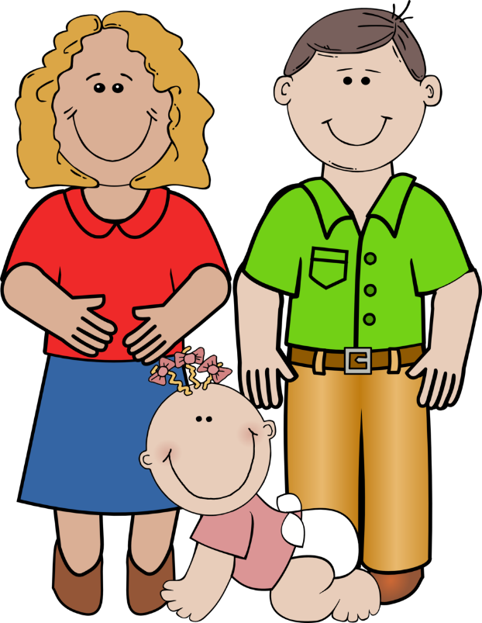
Family Activities
I just love that crossword puzzle … and the Video this week is thought provoking! Go to https://tinyurl.com/ybr53nqs
to see it all

Slide 21
A Prayer of Surrender
October 28

