Slide 1
A Mission without Boundaries
May 24

Slide 2


Video Introduction
View Video

Slide 3



What a trip …
Where are some places you’ve been that you will never forget?
Today we look at Paul and Barnabas sharing the Gospel.
Sharing the message of Christ is a privilege that could take you anywhere.

Slide 4
Listen for a literal “hands on” application.
Acts 13:1-3 (NIV) In the church at Antioch there were prophets and teachers: Barnabas, Simeon called Niger, Lucius of Cyrene, Manaen (who had been brought up with Herod the tetrarch) and Saul. 2 While they were worshiping the

Slide 5

Listen for a literal “hands on” application.
Lord and fasting, the Holy Spirit said, "Set apart for me Barnabas and Saul for the work to which I have called them." 3 So after they had fasted and prayed, they placed their hands on them and sent them off.

Slide 6
When God Calls … GO!
List words and phrases which suggest this is a good example of a church?
What indication do you see that the church leadership in Antioch was a diverse group?
What kinds of diversity would we see within our churches in today’s society?

Slide 7
When God Calls … GO!
How would that diversity influence the direction of ministries?
How does a person recognize a call to be a missionary?
In what context did the leaders or church receive instructions from the Holy Spirit?

Slide 8

When God Calls … GO!
Note some of the specifics:
Paul and Barnabas were called to a specific ministry
God did the calling
The church did the commissioning

Slide 9

When God Calls … GO!
God won’t send all of us to a foreign country, but where could he want us to go?

Slide 10
Listen for rejection.
Acts 13:44-47 (NIV) On the next Sabbath almost the whole city gathered to hear the word of the Lord. 45 When the Jews saw the crowds, they were filled with jealousy and talked abusively against what Paul was saying. 46 Then Paul and Barnabas answered them boldly: "We had to

Slide 11
Listen for rejection.
speak the word of God to you first. Since you reject it and do not consider yourselves worthy of eternal life, we now turn to the Gentiles. 47 For this is what the Lord has commanded us: "'I have made you a light for the Gentiles, that you may bring salvation to the ends of the earth.'"

Slide 12
Don’t Be Surprised by Rejection
Note what happened on the Sabbath after Paul first spoke in Perga.
Whole city gathered to hear the word of the Lord
Jews filled with jealousy
Jews talked abusively against Paul’s message

Slide 13
Don’t Be Surprised by Rejection
How did Paul and Barnabas assess the situation?
In what ways to Christians in some foreign countries experience rejection for their faith?
What great truth did Paul and Barnabas affirm about the nature and purpose of the Lord?
How should we handle rejection?

Slide 14
Listen for mixed responses.
Acts 13:48-52 (NIV) When the Gentiles heard this, they were glad and honored the word of the Lord; and all who were appointed for eternal life believed. 49 The word of the Lord spread through the whole region. 50 But the Jews incited the God-fearing women of high standing and

Slide 15
Listen for mixed responses.
the leading men of the city. They stirred up persecution against Paul and Barnabas, and expelled them from their region. 51 So they shook the dust from their feet in protest against them and went to Iconium. 52 And the disciples were filled with joy and with the Holy Spirit.

Slide 16
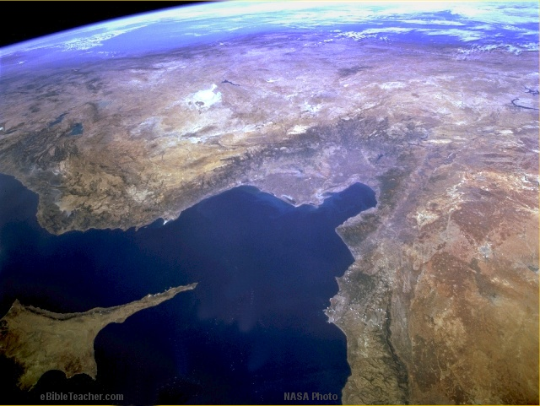
Paul-1st Missionary Journey
© EBibleTeacher.com
1st Missionary Journey
Acts 13 & 14
Modern Day Turkey
Antioch (Pisidian)
Iconium
Perga
Lystra
Attalia
Derbe
Antioch
Mediterranean Sea
Seleucia
Paphos
Salamas
Cyprus
Satellite Image - NASA
INDEX
Notes:
This shows the first missionary journey of Paul as described in Acts chapters 13 and 14.

Slide 17
Rejoice that the Gospel Is Embraced
List ways in which Gentiles respond to the declaration that the gospel was for them.
When the Gentiles heard this, they were glad and honored the word of the Lord; and all who were appointed for eternal life believed. The word of the Lord spread through the whole region

Slide 18
Rejoice that the Gospel Is Embraced
How did the Jewish opposition express itself?
But the Jews incited the God-fearing women of high standing and the leading men of the city. They stirred up persecution against Paul and Barnabas, and expelled them from their region.

Slide 19
Rejoice that the Gospel Is Embraced
How did Paul and Barnabas respond to the opposition?
So they shook the dust from their feet in protest against them and went to Iconium. And the disciples were filled with joy and with the Holy Spirit.

Slide 20
Rejoice that the Gospel Is Embraced
What was the overall feeling among those who followed Christ?
What does this passage teach us about persevering in the face of rejection?
What does this passage teach us about joy in the life of a Christian?

Slide 21
Application
Reflect.
In what ways could you be a greater part of the Great Commission that Jesus has called you to join, to make disciples of every nation?
Commit to pray for missionaries.
Generously support them, and be a part of sending them out.

Slide 22
Application
Rejoice.
Spend some time in prayer thanking God for His work in your life, in your church, and in our world.
Ask God to allow your heart and mind to be filled with joy in knowing Him and being a part of His work.
Pray that He will protect you from discouragement and negativity, even in the midst of difficulties or painful circumstances.

Slide 23
Application
Respond.
Do you sense God is calling you to be more than a mobilizer for overseas missions and that He may be calling you to go.
Tell Him of your willingness
Seek the counsel of one of your pastors or a mature believer to help you discern God’s leading.

Slide 24
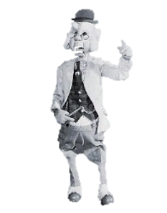

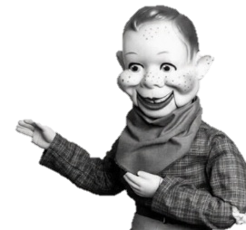
Family Activities
Gosh, howdy there, kids! It looks like that old rascal Phineas T. Bluster has been causing trouble again! Out of pure ornery meanness, he’s knocked letters right off our church sign—what a mess! We need your help putting things right. If you get stuck (or want the color page) go to https://tinyurl.com/afzuzjbr

Slide 25
A Mission without Boundaries
May 24

