Slide 1
A Life of Trust
March 20

Slide 2
Video Introduction
View Video

Slide 3
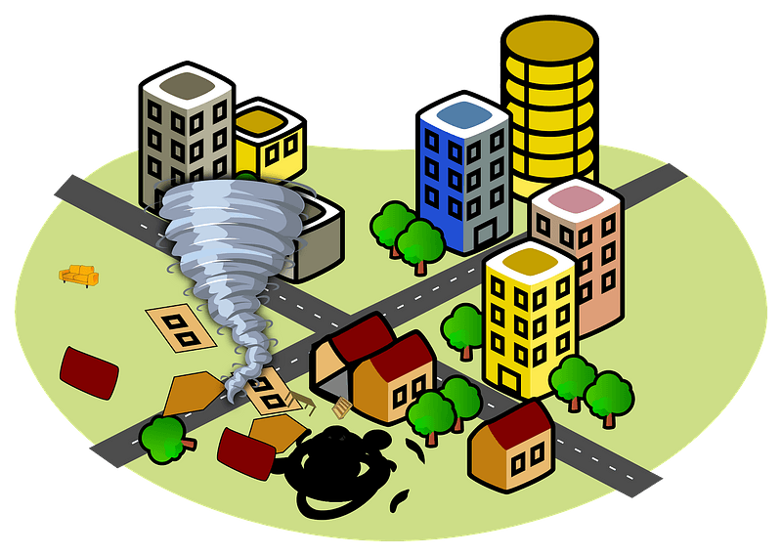
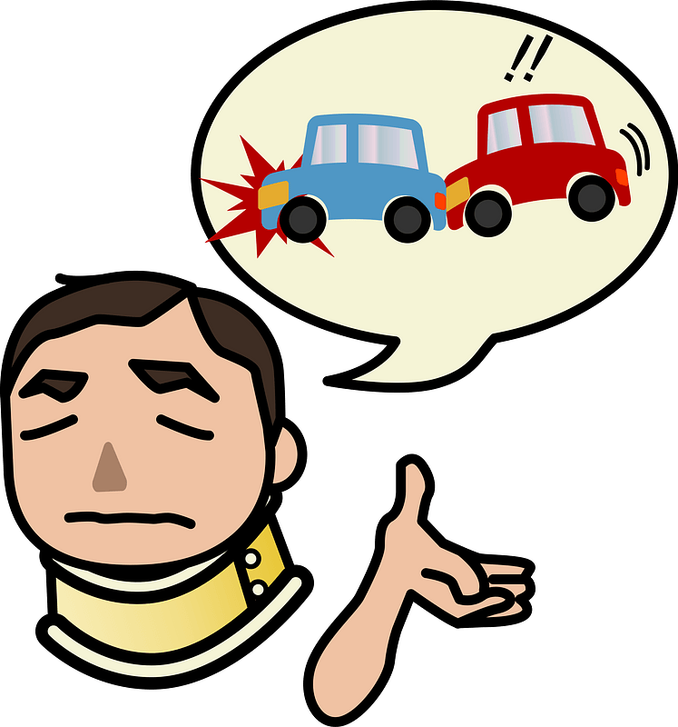
Remember that time …
When has your life taken an unexpected turn?
God is with us, no matter what life brings.
We can trust Jesus because He is The Way, The Truth, and The Life.

Slide 4
Listen for a promise and a prediction.
John 13:36 - 14:1 (NIV) Simon Peter asked him, "Lord, where are you going?" Jesus replied, "Where I am going, you cannot follow now, but you will follow later." 37 Peter asked, "Lord, why can't I follow you now? I will lay

Slide 5
Listen for a promise and a prediction.
down my life for you." 38 Then Jesus answered, "Will you really lay down your life for me? I tell you the truth, before the rooster crows, you will disown me three times! 14:1 "Do not let your hearts be troubled. Trust in God; trust also in me.

Slide 6
Trust God, Not Yourself
What are some reasons the disciples might have been troubled?
What corrective did Jesus offer for their troubled hearts?
What kinds of things trouble your heart?
What are some ways people deal with situations that trouble them?

Slide 7
Trust God, Not Yourself
How did Jesus want His disciples to respond to the troubling news of His departure?
Why is it sometimes hard to trust God with our problems?
What does it look like to trust Jesus when your heart is troubled?

Slide 8
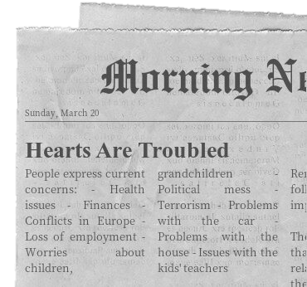
Trust God, Not Yourself
Look at our list of headline issues that trouble us today. How do Jesus’ reassurances speak to our worries?

Slide 9
Listen for where Jesus is going.
John 14:2-3 (NIV) In my Father's house are many rooms; if it were not so, I would have told you. I am going there to prepare a place for you. 3 And if I go and prepare a place for you, I will come back and take you to be with me that you also may be where I am.

Slide 10
Jesus’ Provision
Why do you suppose the disciples needed reassurance like this?
What kinds of preparations do we make for the future?
In what way is Jesus preparing you to be with Him?

Slide 11
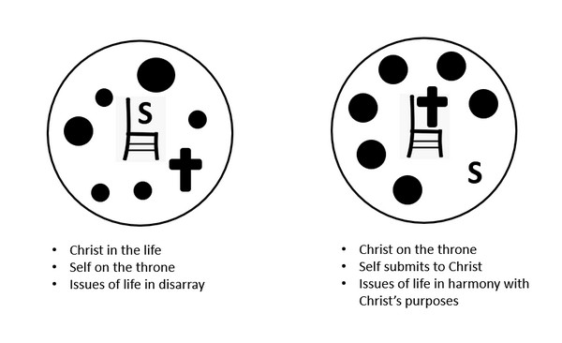
Jesus’ Provision
How are you preparing to be with Jesus?
Hebrews 12:2
Colossians 3:1
Colossians 3:2
1 Peter 2:9
1 Peter 3:15

Slide 12
Listen for the “I Am” statement.
John 14:4-6 (NIV) You know the way to the place where I am going." 5 Thomas said to him, "Lord, we don't know where you are going, so how can we know the way?" 6 Jesus answered, "I am the way and the truth and the life. No one comes to the Father except through me.

Slide 13
Trusting Jesus, the Only Way
In what ways does Thomas’ question indicate he (and the others) still did not understand what Jesus had been saying to them?

Slide 14
Trusting Jesus, the Only Way
Consider the “I Am” statement Jesus used to answer Thomas.
He is the only Way to have a right relationship to God.
What Jesus came to accomplish is the ultimate Truth for all time.
To know and believe in the Truth of Jesus is Life Eternal.

Slide 15
Trusting Jesus, the Only Way
What are some ways that people suggest that they can get to heaven?
Why does it bother people when they are told, “There is only one way to God”?
How can we answer someone who objects to this exclusiveness? They question how anyone could believe that a loving God would not accept everyone into heaven if they do their best to live right?

Slide 16
Application
Trust.
Think of an area of your life in which you tend to trust your own abilities.
How can you rely more on Jesus and less on yourself?

Slide 17
Application
List.
Make a list of times or events when you experienced the trustworthiness of Jesus.
Place the list where you can find it when your heart is troubled.

Slide 18
Application
Share.
Meet a friend or family member who does not share your spiritual beliefs about Jesus.
Pray for the opportunity to begin a conversation about Jesus as the only way to God.

Slide 19
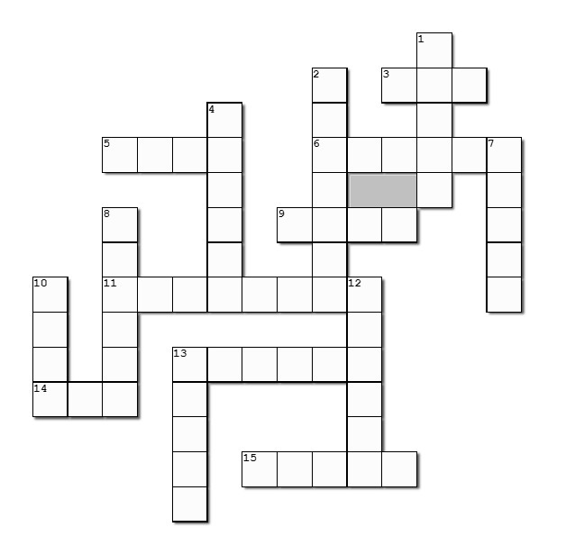
Family Activities
Humph! Well, I hope all you crossword fans are happy. And I TRUST you can find these words, even if you can’t find all the words in my puzzles. You’ll probably need some help. Humph! Go to https://tinyurl.com/yc3yphfw There IS a Word Search puzzle there. It’s worth two book reports if you do it.

Slide 20
A Life of Trust
March 20

