Slide 1
A Life of Persecution
April 3

Slide 2
Video Introduction
View Video

Slide 3
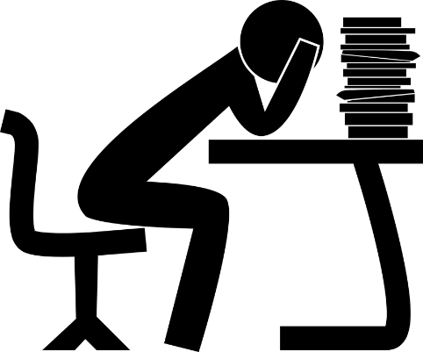
Remember that time …
When have you had to prepare for something you knew would be difficult?
Sometimes our difficulty can be mistreatment by others around us.
Living like Jesus means being treated as He was.

Slide 4
Listen for why you can be hated.
John 15:18-21 (NIV) "If the world hates you, keep in mind that it hated me first. 19 If you belonged to the world, it would love you as its own. As it is, you do not belong to the world, but I have chosen you out of the world. That is why the world hates you. 20 Remember the words

Slide 5
Listen for why you can be hated.
I spoke to you: 'No servant is greater than his master.' If they persecuted me, they will persecute you also. If they obeyed my teaching, they will obey yours also. 21 They will treat you this way because of my name, for they do not know the One who sent me.

Slide 6
Opposition from the World
Why could the disciples expect to be rejected by the world?
What words and phrases in these verses emphasize that true followers of Jesus will not live according to the standards of the world?
If you were one of Jesus’ twelve disciples, how would you have responded to His warning about the world’s hatred?

Slide 7
Opposition from the World
What is it about Jesus that many people find objectionable?
How does the world (in Western culture) today hate the followers of Jesus?
How about foreign cultures … how do they hate the followers of Jesus?

Slide 8
Listen for the response to Jesus’ Truth.
John 15:22-25 (NIV) If I had not come and spoken to them, they would not be guilty of sin. Now, however, they have no excuse for their sin. 23 He who hates me hates my Father as well. 24 If I had not done among them what

Slide 9
Listen for the response to Jesus’ Truth.
no one else did, they would not be guilty of sin. But now they have seen these miracles, and yet they have hated both me and my Father. 25 But this is to fulfill what is written in their Law: 'They hated me without reason.'

Slide 10
The World Rejects Jesus’ Truth
What effect did Jesus’ coming have on those of the world who opposed Him?
Why did they no longer have an excuse for their sin?
Why does the person who hates Jesus also hate God?

Slide 11
The World Rejects Jesus’ Truth
Note how those who knew the law contributed to the fulfillment of the law, albeit in a negative sense. Jesus quoted from Psalms they would know.
Psalm 35:19 (NIV) Let not those gloat over me who are my enemies without cause; let not those who hate me without reason maliciously wink the eye.
Psalm 69:4 (NIV) Those who hate me without reason outnumber the hairs of my head; many are my enemies without cause, those who seek to destroy me. I am forced to restore what I did not steal.

Slide 12
The World Rejects Jesus’ Truth
What are some biblical truths that people just don’t want to hear?
How is it both encouraging and discouraging to hear the warning Jesus gives here?
Discouraging | Encouraging

Slide 13
Listen for how Jesus is preparing the disciples.
John 16:1-4a (NIV) 1 "All this I have told you so that you will not go astray. 2 They will put you out of the synagogue; in fact, a time is coming when anyone who kills you will think he is offering

Slide 14
Listen for how Jesus is preparing the disciples.
a service to God. 3 They will do such things because they have not known the Father or me. 4 I have told you this, so that when the time comes you will remember that I warned you.

Slide 15
Help for A Steadfast Faith
Why was Jesus warning His disciples of what was to come?
What reasons might opponents of Jesus give to justify their actions (both then and now)?
What specific threats did Jesus identify?

Slide 16
Help for A Steadfast Faith
Jesus speaks about going “astray”. Other versions use the word “stumble”. What do you think it means to “stumble” in one’s faith or “go astray”?
What are some ways we can prepare for persecution?

Slide 17
Application
Thank.
Thank God for the freedom we have to worship Him.
Thank Him that believers in our country have not experienced persecution like other believers around the world.

Slide 18
Application
Pray.
Pray for the Christians who are being persecuted around the world.

Slide 19
Application
Partner.
Partner with your small group to identify a missionary serving in a place of Christian persecution.
As a group, make plans to support them financially. You can find help with this at imb.org.

Slide 20
Family Activities
Please help me … my word processor keeps substituting the wrong words. Can you fix this document? And you can go to https://tinyurl.com/59nnvdnf for other great activities.

Slide 21
A Life of Persecution
April 3

