Slide 1
A Life of Love
March 27

Slide 2

Video Introduction
View Video

Slide 3
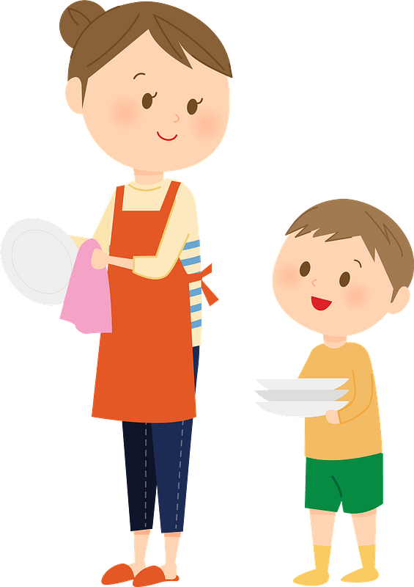
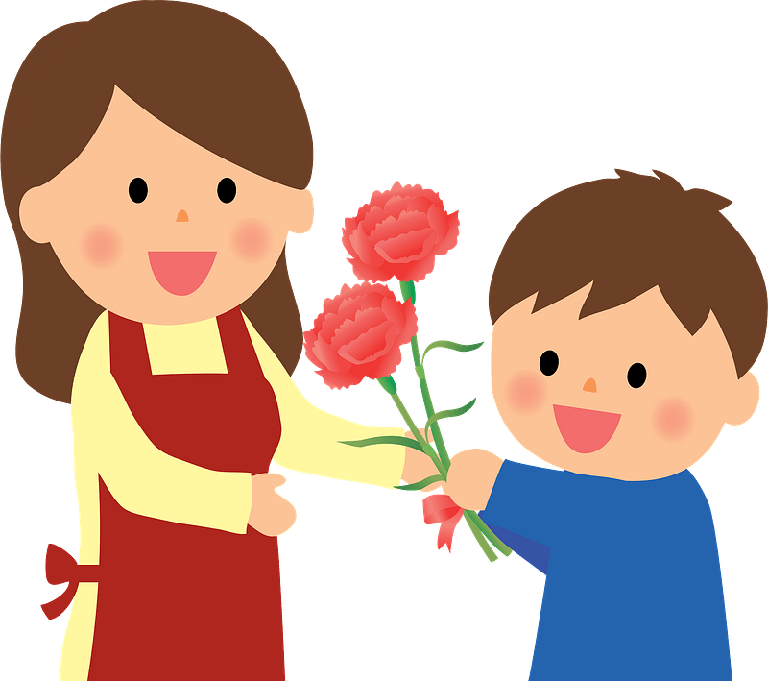

Think about it …
How do the people you love (whether close friends, spouse, or family members) know that you love them?
Jesus spoke to the issue of how to love.
  He said we should base every relationship on the unconditional love He has for us
  Remaining in Christ means our relationships are marked by love.

Slide 4

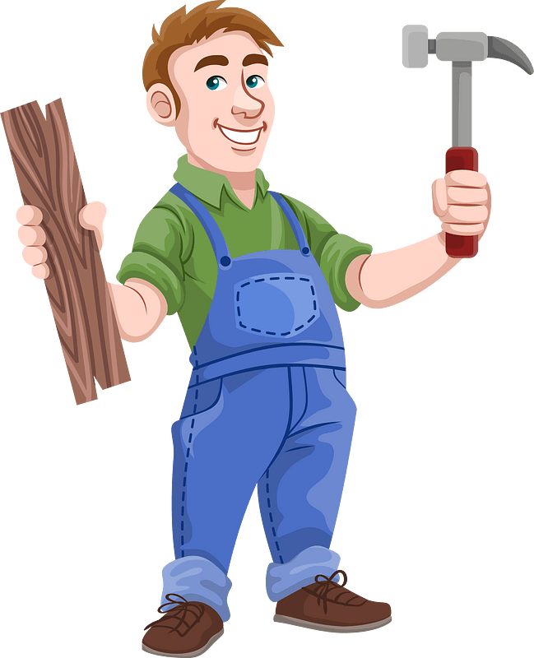
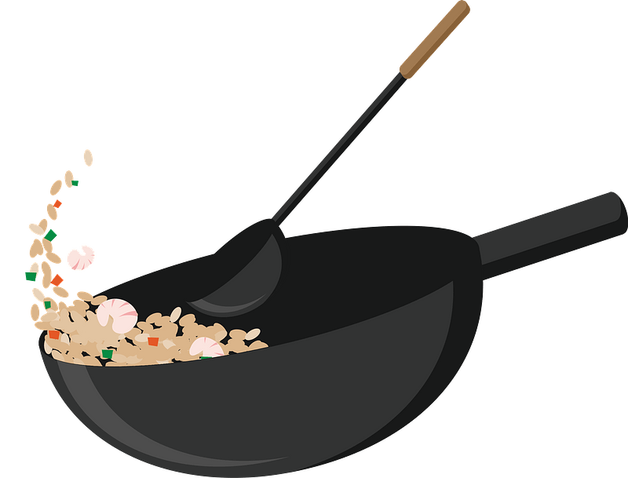
Remain in Jesus’ Love
What kind of skill have you learned by watching someone else repeatedly perform the skill?
How was this method of learning more effective than just reading a book about the skill?
Listen for how Jesus teaches us by His example.

Slide 5

Listen for how Jesus teaches us by His example.
John 15:9-11 (NIV) "As the Father has loved me, so have I loved you. Now remain in my love. 10 If you obey my commands, you will remain in my love, just as I have obeyed my Father's commands and remain in his love. 11 I have told you this so that my joy may be in you and that your joy may be complete.

Slide 6
Remain in Jesus’ Love
So, how does Christ teach us by example?
What appeal did Jesus make in these verses?
What will be the evidence that a person is abiding in Christ’s love?

Slide 7
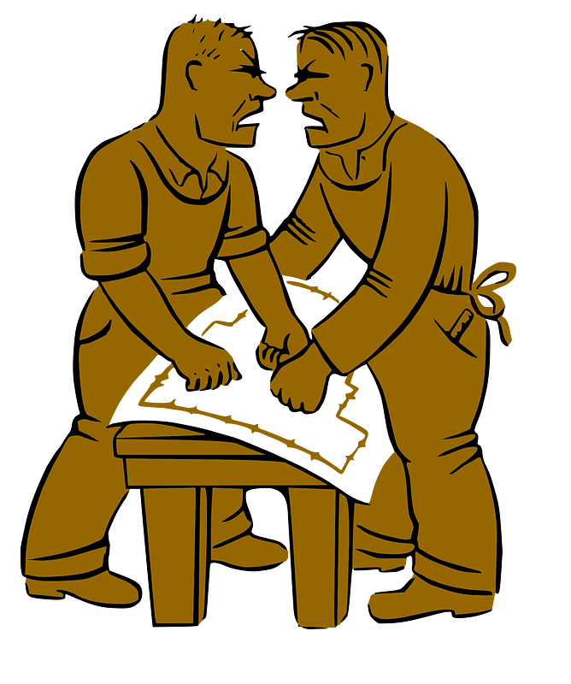
Remain in Jesus’ Love
Obedience is the requirement for abiding in Jesus’ love.
What do you think?
No … it is the result of abiding in His love.
Requirement | Result

Slide 8
Remain in Jesus’ Love
⇨ We should understand that obedience is the result of abiding or remaining in Jesus’ love.
⇨Obedience demonstrates our love for Jesus.
How do we sometimes miss the connection between love and obedience?
What does this passage tell us about God’s design for our class, our church?

Slide 9
Listen for a reminder to love.
John 15:12-14 (NIV) My command is this: Love each other as I have loved you. 13 Greater love has no one than this, that he lay down his life for his friends. 14 You are my friends if you do what I command.

Slide 10
Personal Sacrifice
According to Jesus, the greatest expression of love is to lay down one’s life for others. What does it mean for a person to “lay down his life”?
Of course, Jesus’ statement in verse 13 alludes to his coming death on the cross.
  Substitutionary death
  Took our punishment upon Himself
  Received the judgment for sin that was ours

Slide 11
Personal Sacrifice
What are some additional ways you have experienced the power of sacrificial love?
What opportunities do you have to “lay down your life” for others? What does it look like to love others the way Jesus loves us?

Slide 12
Listen for a change of status.
John 15:15-17 (NIV) I no longer call you servants, because a servant does not know his master's business. Instead, I have called you friends, for everything that I learned from my Father I have made known to you.

Slide 13
Listen for a change of status.
You did not choose me, but I chose you and appointed you to go and bear fruit--fruit that will last. Then the Father will give you whatever you ask in my name. 17 This is my command: Love each other.

Slide 14
Producing Spiritual Fruit
Note the contrasts Jesus makes between servants and friends.
Servants | Friends
Does not know master’s business Jesus no longer calls us servants | Great love demonstrated, laying down one’s life for a friend Do as God commands Jesus calls us “friends” Jesus made known all He learned from the Father to His friends

Slide 15
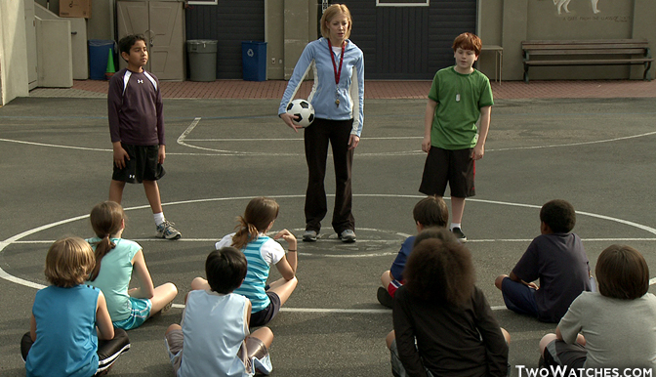
Producing Spiritual Fruit
Remember as a child when they would choose up sides for a game … were you ever the last one chosen? That meant, you weren’t even chosen, the person with last choice had to take you. How did you feel?

Slide 16
Picking Teams by Allan Ahlberg
When we pick teams in the playground,
Whatever the game might be,
There’s always somebody left till last
And usually it’s me.

Slide 17
Picking Teams by Allan Ahlberg
I stand there looking hopeful
And tapping myself on the chest,
But the captains pick the others first,
Starting, of course, with the best.

Slide 18
Picking Teams by Allan Ahlberg
Maybe if teams were sometimes picked
Starting with the worst,
Once in his life a boy like me
Could end up being first!

Slide 19
Producing Spiritual Fruit
It says here that God chose us (and not last) …
to be His friends! For what other purpose did God choose us?
Why is producing spiritual fruit an important part of our Christian life?
How should we respond to being called a friend of Jesus?

Slide 20
Application
Remember.
  Set aside time each day this week to remember Jesus’s love for you.
  Replay the gospel to yourself and abide in Jesus’s love.

Slide 21
Application
Love.
  Think of a fellow Christian you can love sacrificially this week.
  Maybe someone who has a physical need that you can love in a tangible way.
  What about someone who has an emotional need that you can listen to and pray for?

Slide 22
Application
Serve.
  What actions can you take this week to show love to someone in your life who does not know Jesus?
  How can you serve them in a way that helps them to see Jesus?

Slide 23

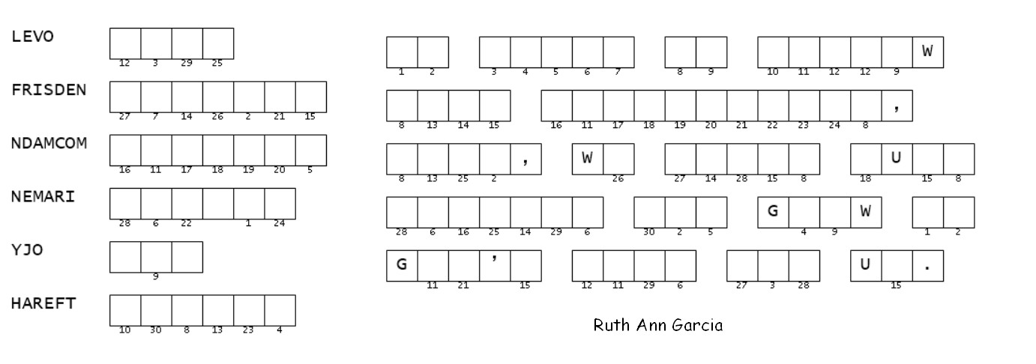
Family Activities
Well, humph! Seems like the Word Ninja has obfuscated another good quote. That boy needs help, and more than just the puzzle. So do your best. The key words are from our scripture passage. I venture to say some of you will need help. Humph! Go to https://tinyurl.com/2p995b7r . There’s other good stuff there also for the whole family.

Slide 24
A Life of Love
March 27

