Slide 1
A Life of Humble Service
March 6

Slide 2
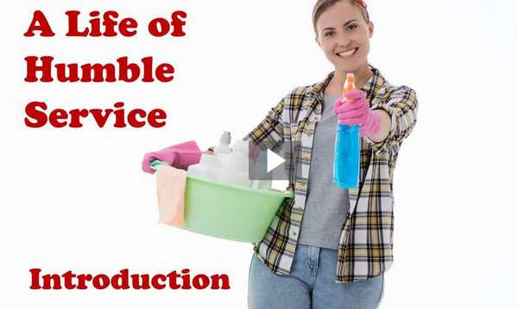
Video Introduction
View Video

Slide 3
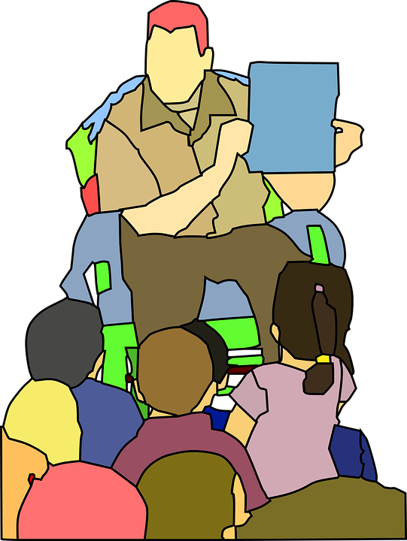
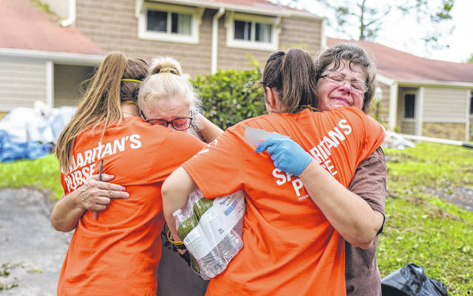
It was inspiring …
When have you seen someone go out of their way to serve others?
A faithful hardworking volunteer makes a statement by his or her actions.
We reflect Christ when we serve others with humility.

Slide 4
Listen for a contrast of position and action.
John 13:3-5 (NIV) Jesus knew that the Father had put all things under his power, and that he had come from God and was returning to God; 4 so he got up from the meal, took off his outer clothing,

Slide 5
Listen for a contrast of position and action.
and wrapped a towel around his waist. 5 After that, he poured water into a basin and began to wash his disciples' feet, drying them with the towel that was wrapped around him.

Slide 6
Jesus Models Humble Service
What background did Jesus know about Himself?
Consider the significance of those statements in understanding who Jesus is.
God the Son had a specific role in the creation
He was/is fully God and fully human,
He entered time and physical space as a human
He would leave as a physical human and return in Spirit form with Divine characteristics … omnipresence, omnipotence, omniscience

Slide 7
Jesus Models Humble Service
What cultural courtesy appears to have been ignored in Jesus’ gathering with the disciples?
How did Jesus model humble service?
What is the relevance of the three things Jesus knew about Himself, in the context of what He did?
⇨Humility is demonstrated through service but begins with attitude

Slide 8
Jesus Models Humble Service
Recall some of the conversations the disciples had recently had in Jesus’ presence …
Wanted to have positions immediately beside jesus’ throne when he began to reign
Argued about who was really the greatest disciple
In the midst of his teaching about the coming death and resurrection, they are quibbling about who is more important

Slide 9
Jesus Models Humble Service
When and why is it difficult for you to serve others like Jesus did?
What are some traits of humility that God would want us to possess and practice?
Consider Romans 12:3 (NIV) For by the grace given me I say to every one of you: Do not think of yourself more highly than you ought, but rather think of yourself with sober judgment, in accordance with the measure of faith God has given you.

Slide 10
Listen for Peter’s response.
John 13:6-10 (NIV) He came to Simon Peter, who said to him, "Lord, are you going to wash my feet?" 7 Jesus replied, "You do not realize now what I am doing, but later you will understand." 8 "No," said Peter, "you shall never wash my feet." Jesus answered, "Unless I wash you,

Slide 11
Listen for Peter’s response.
you have no part with me." 9 "Then, Lord," Simon Peter replied, "not just my feet but my hands and my head as well!" 10 Jesus answered, "A person who has had a bath needs only to wash his feet; his whole body is clean. And you are clean, though not every one of you."

Slide 12
Jesus Makes Us Clean
Why do you think Peter expressed shock?
When and why do you find it difficult to allow others to serve or help you in time of need?

Slide 13
Jesus Makes Us Clean
Note how Peter was struggling, uncomfortable with the lesson. Jesus was trying to teach all the disciples through this sequence of events …
The previous “who’s the greatest?” conversations
Revelations of the coming crucifixion and resurrection
The humble, servant task of foot washing

Slide 14
Jesus Makes Us Clean
In what ways does God work in our lives that make us uncomfortable, forces us to learn trust and obedience?

Slide 15
Listen for teaching about servanthood
John 13:14-16 (NIV) Now that I, your Lord and Teacher, have washed your feet, you also should wash one another's feet. 15 I have set you an example that you should do as I have done for you. 16 I tell you the truth, no servant is greater than his master, nor is a messenger greater than the one who sent him.

Slide 16
Jesus Calls Us to Humble Service
Note the two titles Jesus affirmed … Lord and Teacher. What is the significance of each?
Lord | Teacher

Slide 17
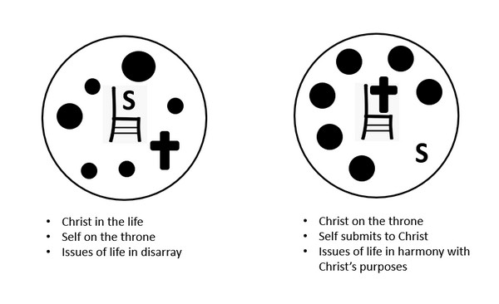
Jesus Calls Us to Humble Service
Ho do these thoughts fit in with the diagram from Campus Crusade we often use?

Slide 18
Jesus Calls Us to Humble Service
So, what is Jesus’ point after claiming these positions of authority?
What would be equivalent to washing other people’s feet for a Christ-follower today?
In what kinds of service can we be involved in our circle of acquaintances?

Slide 19
Application
Observe.
Pay attention to those who have the responsibility of serving you.
Create a list of the ways Jesus has sent others to serve you and thank Him for those people and ways.
Take the initiative

Slide 20
Application
Serve.
Ask God to put one person on your heart whom you can serve this week.

Slide 21
Application
Share.
Ask God to put one person on your heart who has not experienced the cleansing of Jesus.
Share with that person how Jesus has forgiven you.

Slide 22
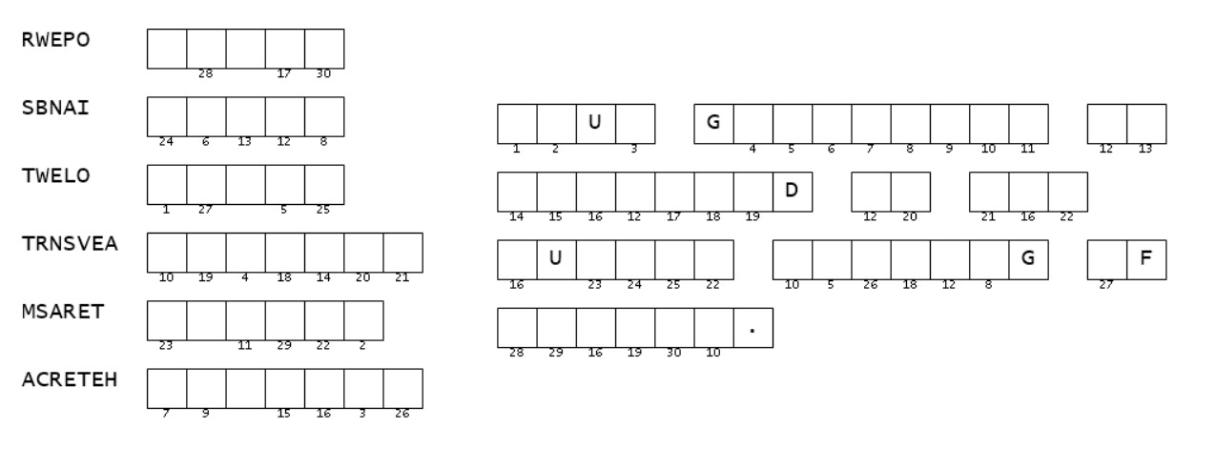
Family Activities
Aiee Cucaracha! These scrambled words scramble my brain. They come from our Bible passage today. But it’s worth the struggle to learn the message. If you need help, go to https://tinyurl.com/4sd38zm9 There’s other cool stuff for the whole family there also.

Slide 23
A Life of Humble Service
March 6

