Slide 1
A Cry for Justice
January 21

Slide 2
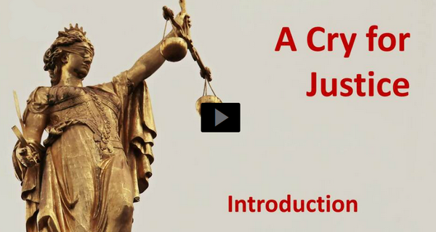
Video Introduction
View Video

Slide 3
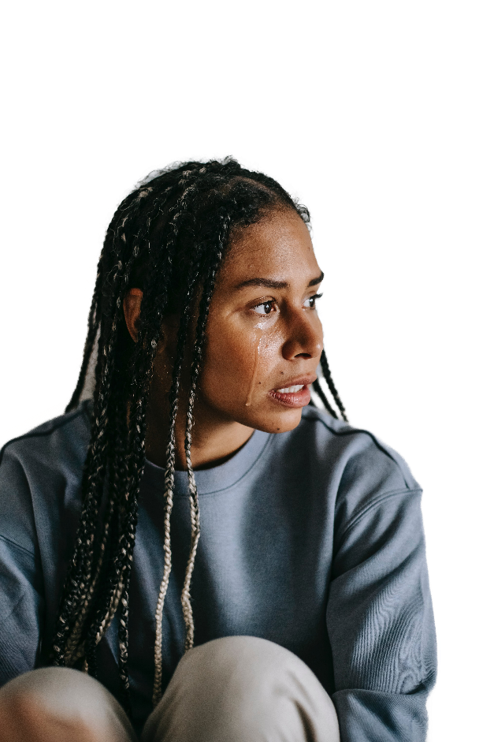
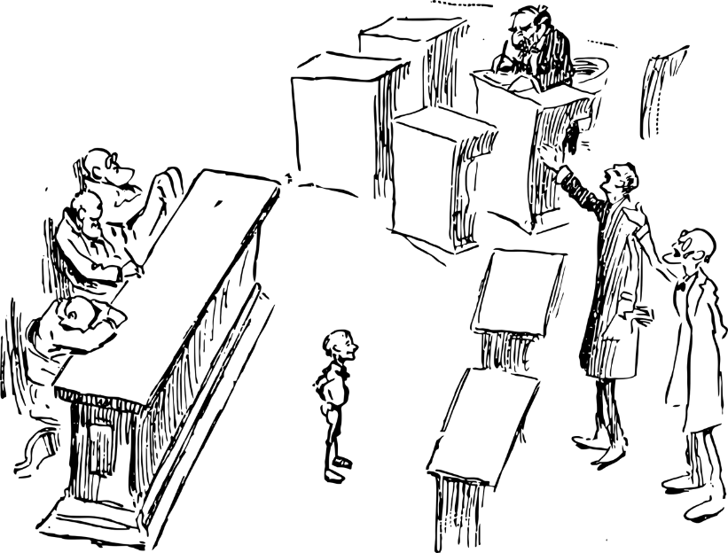
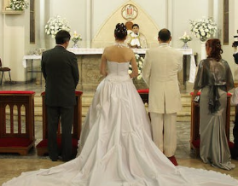
Think About It …
What would make you want to stand up for someone?
God calls us to defend, to stand up those who cannot defend themselves.
Join God in seeking justice, including justice for unborn children.

Slide 4
Listen for a cry of injustice.
Psalm 10:1-4 (NIV) Why, O LORD, do you stand far off? Why do you hide yourself in times of trouble? 2 In his arrogance the wicked man hunts down the weak, who are caught in the schemes he devises.

Slide 5
Listen for a cry of injustice.
He boasts of the cravings of his heart; he blesses the greedy and reviles the LORD. 4 In his pride the wicked does not seek him; in all his thoughts there is no room for God.

Slide 6
No Fear of God
What is the attitude of the wicked toward the Lord? How does the Psalmist describe the arrogance and pride of the wicked?
Why does that seem unjust?
Where do you see examples of injustice in our culture?

Slide 7
No Fear of God
When has it seemed God was far away in the face of injustice? Identify moments in your life when you've experienced the sentiments expressed in this Psalm?

Slide 8
No Fear of God
Bottom line …
What was true for the psalmist is still true today.
Even though we are trying to live faithfully for the Lord, we see ourselves being victimized by the wicked who refuse to think about God at all.

Slide 9
Listen for a request for God to work.
Psalm 10:12-15 (NIV) Arise, LORD! Lift up your hand, O God. Do not forget the helpless. 13 Why does the wicked man revile God? Why does he say to himself, "He won't call me to account"? 14 But you, O God, do see trouble

Slide 10
Listen for a request for God to work.
and grief; you consider it to take it in hand. The victim commits himself to you; you are the helper of the fatherless. 15 Break the arm of the wicked and evil man; call him to account for his wickedness that would not be found out.

Slide 11
Look to God for Justice
In verse 12, what appeal does the psalmist make to the Lord?
We see the flawed thinking of the wicked person.
He reviles God.
He believes he will get away with it, will not be called to account.

Slide 12
Look to God for Justice
What emotions and desperation are evident in the Psalmist's plea?
What confidence does the psalmist have that the Lord will act justly toward the humble of heart and toward the wicked and evil ones?

Slide 13
Look to God for Justice
What does the psalmist appeal for the Lord to do against the wicked?
Why is it wise to look to God for justice?

Slide 14
Look to God for Justice
Our faith should impact our response to injustice.
Anger and desire for vengeance do no good
Neither are they the response of faith.
Give up the anger and revenge, put it in God’s hands.
Remember that God sees and knows your problem.
He will remedy the problem in His time, in His way.
He is also working to redeem those who are acting unjustly.

Slide 15
Listen for hope expressed.
Psalm 10:16-18 (NIV) The LORD is King for ever and ever; the nations will perish from his land. 17 You hear, O LORD, the desire of the afflicted; you encourage them, and you listen to their cry, 18 defending the fatherless and the oppressed, in order that man, who is of the earth, may terrify no more.

Slide 16
God Overthrows Injustice
What claims does the psalmist make concerning the Lord?
What does the Lord do on behalf of the humble or those who suffer?
Therefore, with what attitude can we face whatever befalls us?

Slide 17
God Overthrows Injustice
How should we handle our frustration with unfairness or wrongdoing that goes unpunished?
What role can the church play in seeking justice?

Slide 18
God Overthrows Injustice
This Psalm inspires individuals or communities to address social issues today.
Know that God is in charge
He has BOTH the power and authority to work for the right
He hears our prayers
He defends the fatherless and oppressed
He will do away with the terror against injustice

Slide 19
Application
Pray.
Seek God’s protection for those who cannot fight for themselves.
Pray for them and for those who care for them and minister to them.

Slide 20
Application
Learn more.
Seek out a local Christian pregnancy center that is helping moms make choices that honor God and protect their babies.
Sign up for their mailing list and participate in opportunities they provide.

Slide 21
Application
Change some diapers.
Do you know a mom who is struggling?
Ask for ways you can help. Care for her little ones so she can run errands.
Enlist your Bible study group to provide for their needs.

Slide 22
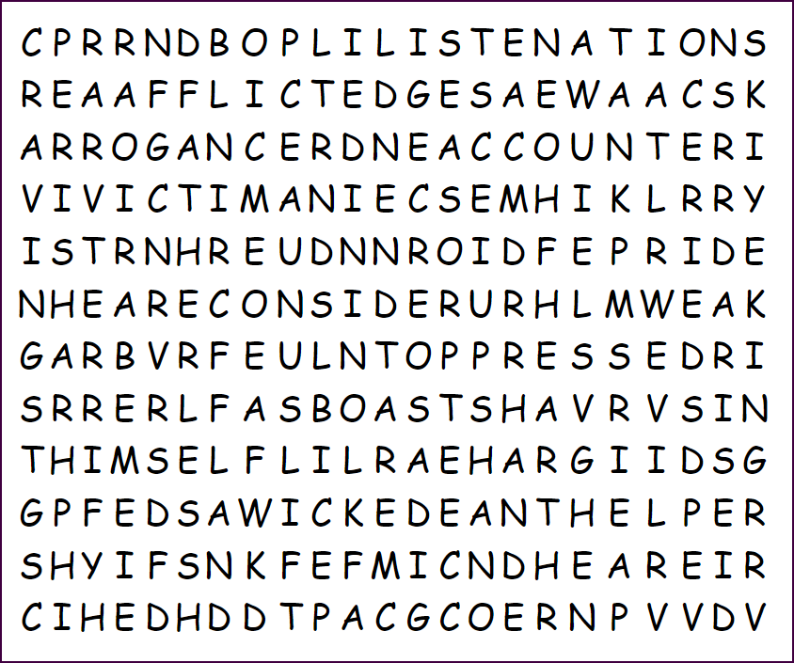
Family Activities
The Word Search Lady has cut us a break. No backwards words. Neither up, to the left, or upwards diagonal. Do your best to find as many words as possible from our Bible Study that you can. If you need hints, go to http://tinyurl.com/mr3zfdyc
Remember, there are other great family activities there also.

Slide 23
A Cry for Justice
January 21

