Slide 1
A Centered Life
Sept. 1

Slide 2
Introduction
View Introduction Video

Slide 3
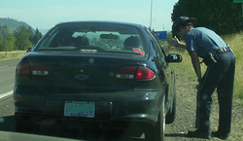
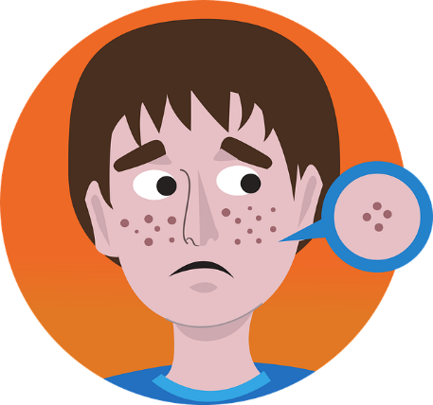
Remember when?
What are things you worried about as a teenager?
Even when we’re mature adults, some of those worries come back
Now we have additional needs and responsibilities to concern us
Today we consider the fact that when your life is centered in Christ, you find all you need.

Slide 4
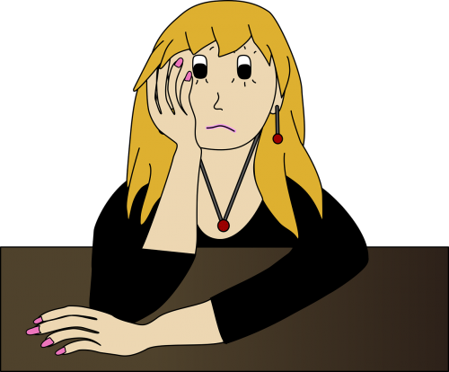
Think about this …
How would you define worry?
Listen for why not to worry

Slide 5
Listen for why not to worry.
Matthew 6:25-30 (NIV) "Therefore I tell you, do not worry about your life, what you will eat or drink; or about your body, what you will wear. Is not life more important than food, and the body more important than clothes? 26 Look at the birds of the air; they do not sow or reap or store away in barns, and yet your heavenly Father feeds them. Are you not much more valuable than they?

Slide 6
Listen for why not to worry.
Who of you by worrying can add a single hour to his life? 28 "And why do you worry about clothes? See how the lilies of the field grow. They do not labor or spin. 29 Yet I tell you that not even Solomon in all his splendor was dressed like one of these. 30 If that is how God clothes the grass of the field, which is here today and tomorrow is thrown into the fire, will he not much more clothe you, O you of little faith?

Slide 7
Don’t Worry
What things does Jesus say we tend to worry about?
What reasons then, does He give that we should not worry?
What elements of God’s creation did Jesus use to illustrate God’s reliability as a provider? Why?
Why do some of us worry about clothes more than others?

Slide 8
Don’t Worry
How do you think God feels about our society’s preoccupation with food?
What are some consequences of being enslaved to worry?
How do you know when you’ve crossed the line from reasonable concern to harmful worry?

Slide 9
Listen for who Jesus says does worry.
Matthew 6:31-32 (NIV) So do not worry, saying, 'What shall we eat?' or 'What shall we drink?' or 'What shall we wear?' 32 For the pagans run after all these things, and your heavenly Father knows that you need them.

Slide 10
Trust God
What are different translations of the word used for the people described in verse 32?
What are some ways people deal with worry in their lives?
What additional reasons did Jesus include for not worrying?

Slide 11
Trust God
Why do we sometimes have difficulty in trusting God to provide?
How would worry affect our witness?
How does praising God and giving Him glory keep you from worrying?

Slide 12
Listen for what is most important.
Matthew 6:33-34 (NIV) But seek first his kingdom and his righteousness, and all these things will be given to you as well. 34 Therefore do not worry about tomorrow, for tomorrow will worry about itself. Each day has enough trouble of its own.

Slide 13
Seek God’s Kingdom Above All
What is the summary truth Jesus declared?
How is an earthly kingdom different from God’s kingdom?
Earthly Kingdom | God’s Kingdom

Slide 14
Seek God’s Kingdom Above All
So, what does it mean for us to “seek first His kingdom”? How do we do that?
How do our priorities affect our worries?
How can we follow Jesus’ word not to worry about tomorrow yet still plan for the future?

Slide 15
Application
Confess.
To overcome worry, confess the areas where you struggle to trust God.
Admit your struggles with life-long worry and allow God to begin working in you.

Slide 16
Application
Memorize.
Hold strongly to the promises of God by memorizing Matthew 6:33:
“But seek first his kingdom and his righteousness, and all these things will be given to you as well.”
Continually remind yourself of God’s promise to provide.

Slide 17
Application
Share.
Find someone you trust and share the things that cause you to worry and the areas of your life where you lack a trust in God.
Invite this friend to pray with you and for you.

Slide 18
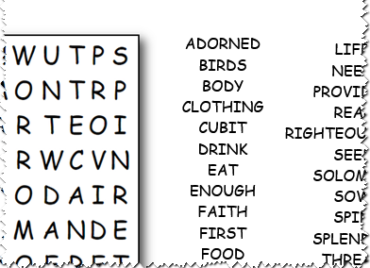
Family Activities
Oh, NOOooooo …
It’s the Word Search Lady. Quick, do the puzzle and get on to the other, friendlier Family Activities at https://tinyurl.com/y2gdt9os

Slide 19
A Centered Life
Sept. 1

