Slide 1
We Pray for One Another
August 2

Slide 2
Video Introduction
View Video

Slide 3
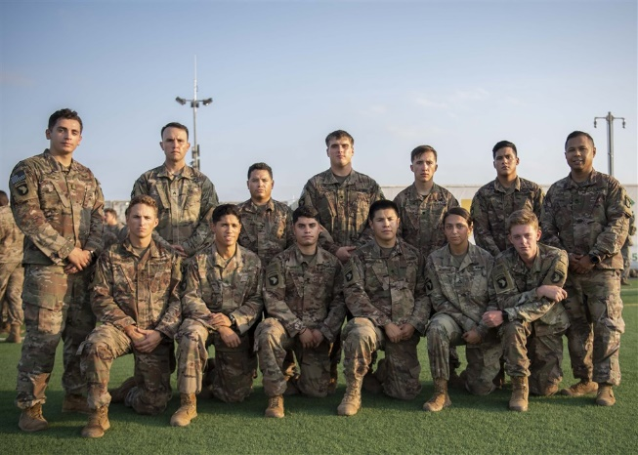
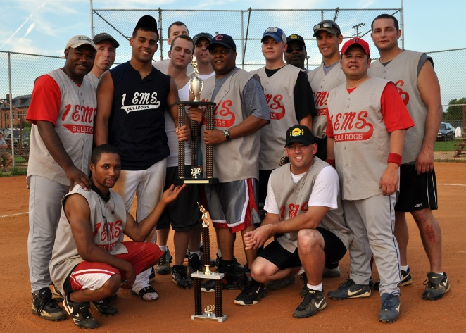
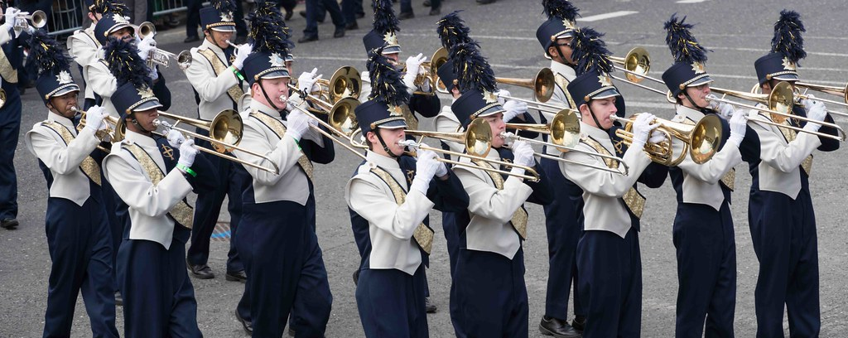
Think about it …
When have you really enjoyed being a part of a group?
Our relationships are strengthened when we do fun things together as a group.
Our own lives are enriched when we pray as a group.
More important, the Church is strengthened as we pray.

Slide 4
Listen for Paul’s prayer request.
Ephesians 3:14-17a (NIV) For this reason I kneel before the Father, 15 from whom his whole family in heaven and on earth derives its name. 16 I pray that out of his glorious riches he may strengthen you with power through his Spirit in your inner being, 17 so that Christ may dwell in your hearts through faith.

Slide 5
Pray for Christ’s Power and Presence
What indicates the earnestness and urgency of Paul’s prayer?
According to these verses, to whom is God the Father?
So, what was Paul’s request?
When have you experienced something that was obviously an answer to prayer?

Slide 6
Pray for Christ’s Power and Presence
What is the source and the means by which the believers could be strengthened?
Why might these early Christian believers need God’s strength in church life?

Slide 7
Pray for Christ’s Power and Presence
Why do we need God’s strength at work in our lives and churches?
Note the resource Paul mentions from which God will provide strength … out of his glorious riches. In what ways should that effect how we pray?

Slide 8
Listen for references to love.
Ephesians 3:17b-19 (NIV) And I pray that you, being rooted and established in love, 18 may have power, together with all the saints, to grasp how wide and long and high and deep is the love of Christ, 19 and to know this love that surpasses knowledge--that you may be filled to the measure of all the fullness of God.

Slide 9
Pray to Know God’s Love
Paul speaks of being “rooted and grounded in love.” What do you think he had in mind?
What does Paul want his readers to comprehend?
What does it mean to “know” the love of Christ?

Slide 10
Pray to Know God’s Love
What facets of God’s love are the most amazing to you? How does knowing you are loved by God give you confidence and assurance?
How is it possible to “be filled to the measure of all fullness of God”? God is infinite. What is Paul trying to communicate here?

Slide 11
Listen for extent of God’s power.
Ephesians 3:20-21 (NIV) Now to him who is able to do immeasurably more than all we ask or imagine, according to his power that is at work within us, 21 to him be glory in the church and in Christ Jesus throughout all generations, for ever and ever! Amen.

Slide 12
Pray God is Glorified
What does Paul affirm about the ability of God to respond to our requests or even our thoughts?
How does Paul describe God’s abilities in this passage?
“Glory” describes God’s splendor. To glorify is to
Admire
Point out good in
Act so others see that good

Slide 13
Pray God is Glorified
What words or phrases does Paul use to glorify God, to describe His splendor?
Why do you think praising/glorifying God should be such an important part of our prayers? What are some reasons that God deserves our praise?
How might ending your prayer time with a doxology like Paul’s here, build your faith?

Slide 14
Application
Confess.
Realign your prayer life in a more God-centered, others-focused direction.
Confess to God the ways you’ve prayed in self-centered ways.

Slide 15
Application
Pray.
If you’re not in a regular discipline of prayer, begin now.
Keep a journal of your prayer requests to ensure you are also praying for the spiritual and physical needs of others.

Slide 16
Application
Pray together.
The best way to grow in praying together in Christ’s church is by praying together in Christ’s church!
Commit to a regular time to meet and pray with one or two other believers from your Bible study group.

Slide 17
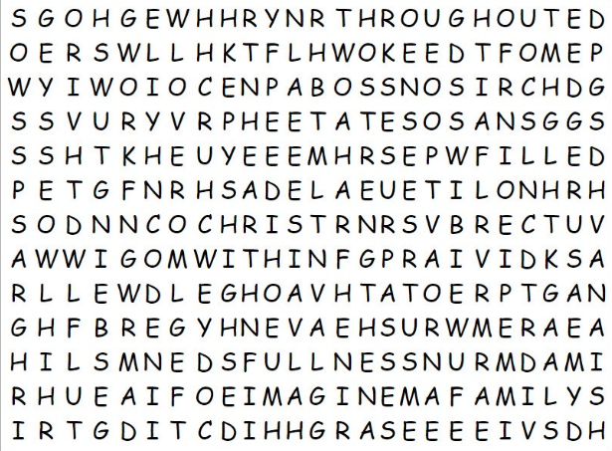
Family Activities
They told me this was a Word Search. I can see letters, but the words are hard to find. That Word Search Lady told me there’s help and other “instructive” activities at https://tinyurl.com/y4bu29vp

Slide 18
We Pray for One Another
August 2

