Slide 1
The Pitfall of Injustice
February 6

Slide 2
Video Introduction
View Video

Slide 3
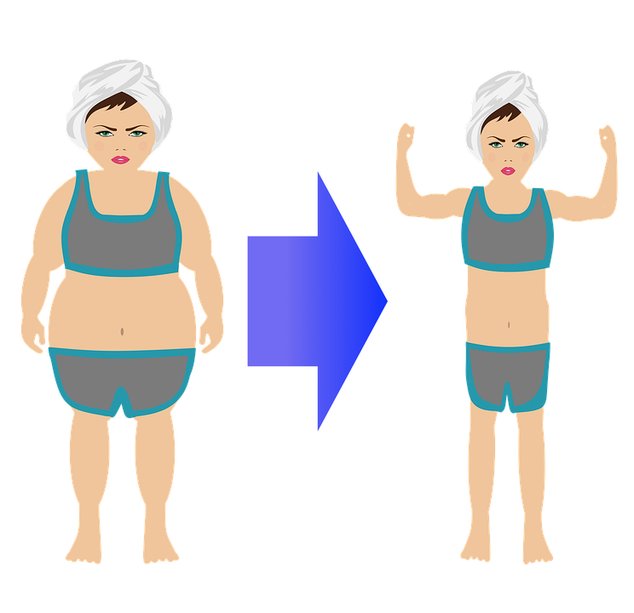
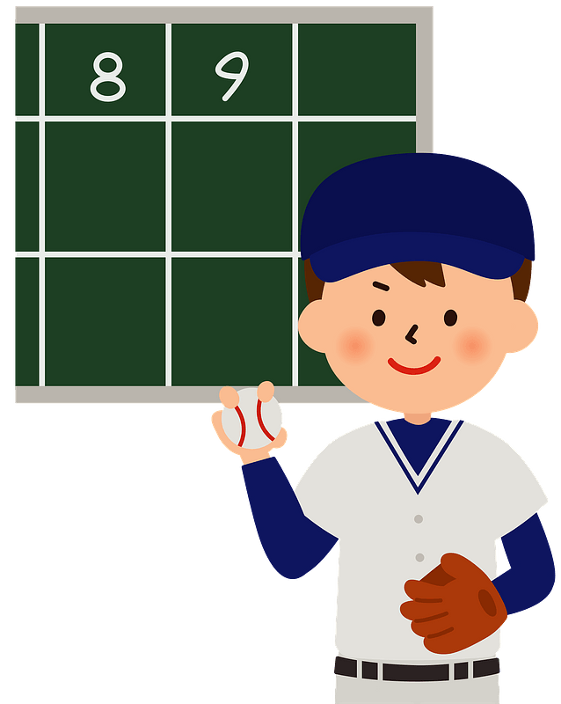
It was amazing …
When have you seen someone simply refuse to quit?
Today we continue with the study of Joseph.
He was treated unjustly by his brothers, then by his employer.
We will see that he pressed forward in spite of injustice.

Slide 4
Listen for Joseph’s new job.
Genesis 39:21-23 (NIV) the LORD was with him; he showed him kindness and granted him favor in the eyes of the prison warden. 22 So the warden put Joseph in charge of all those held in the prison,

Slide 5
Listen for Joseph’s new job.
and he was made responsible for all that was done there. 23 The warden paid no attention to anything under Joseph's care, because the LORD was with Joseph and gave him success in whatever he did.

Slide 6
Stay the Course
In what ways does this episode parallel Joseph’s rise to success in Potiphar’s house?
What evidence suggests that Joseph made diligent effort even in dark circumstances?
What might cause you to question God due to your circumstances?
What is your first reaction when someone acts unjustly towards you?

Slide 7
Stay the Course
Why do our circumstances affect our view of God’s love and loyalty to us?
He is sold as a slave and becomes second in the household of Potiphar. He is thrown in prison and is put in charge of the prisoners. What does this tell us about Joseph?

Slide 8
Stay the Course
Ultimately, to what was Joseph’s success to be attributed ?
So, how do we remain faithful when we find ourselves where we didn’t expect to be?

Slide 9
Listen for two dreamers.
Genesis 40:4-8 (NIV) The captain of the guard assigned them to Joseph, and he attended them. After they had been in custody for some time, 5 each of the two men--the cupbearer and the baker of the king of Egypt, who were being held in prison--had a dream the same night, and each dream had a meaning of its own. 6 When Joseph came to them

Slide 10
Listen for two dreamers.
the next morning, he saw that they were dejected. 7 So he asked Pharaoh's officials who were in custody with him in his master's house, "Why are your faces so sad today?" 8 "We both had dreams," they answered, "but there is no one to interpret them." Then Joseph said to them, "Do not interpretations belong to God? Tell me your dreams."

Slide 11
Don’t Take It Out on Others
In addition to being in prison, what else caused two new prisoners to be troubled?
What words or actions suggest Joseph was sensitive to and concerned about their well-being?
What did Joseph say about dreams?

Slide 12
Don’t Take It Out on Others
How might Joseph have begun to recognize that he was in prison for a purpose?
What are some ways we can demonstrate God’s concern to others, especially when we are struggling with some life event?

Slide 13
Listen for who is forgetful.
Genesis 40:20-23 (NIV) Now the third day was Pharaoh's birthday, and he gave a feast for all his officials. He lifted up the heads of the chief cupbearer and the chief baker in the presence of his officials: 21 He restored the chief cupbearer

Slide 14
Listen for who is forgetful.
to his position, so that he once again put the cup into Pharaoh's hand, 22 but he hanged the chief baker, just as Joseph had said to them in his interpretation. 23 The chief cupbearer, however, did not remember Joseph; he forgot him.

Slide 15
Don’t Get Discouraged
What happened at Pharaoh’s birthday party?
What did the chief cupbearer not do?
Why?
Why did Joseph have good reason to be disappointed?

Slide 16
Don’t Get Discouraged
How can we manage disappointment, anger, resentment, and sadness when we have not been treated fairly or let down by others?
How can we be encouraged to keep doing what God has gifted us to do, even when you receive little or no credit for it?

Slide 17
Application
Pray.
Pray for patience.
Patience is a Fruit of the Holy Spirit at work in your life.
Pay attention to situations this week where you tend to lose your patience.
Ask the Holy Spirit to help you endure patiently in these moments.

Slide 18
Application
Write.
Write an inspiring Bible verse on a sticky note and attach it to your computer.
Every time you’re tempted to whine about your circumstances, pray that verse.

Slide 19
Application
Read.
Read through a great devotional book this month, like Experiencing God or The Pursuit of God.
Draw from the well of others.

Slide 20
Family Activities
This just in … coded messages from Kiantsermal. We need your assistance. These are important communications! Technical help available at https://tinyurl.com/2p98a7za

Slide 21
The Pitfall of Injustice
February 6

