Slide 1
Sure of Salvation
October 10

Slide 2
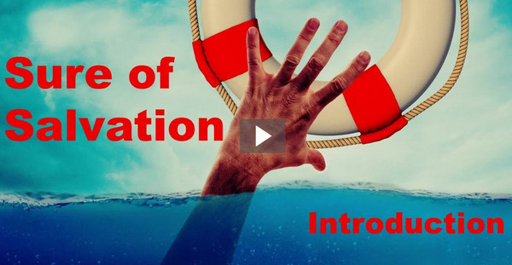
Video Introduction
View Video

Slide 3
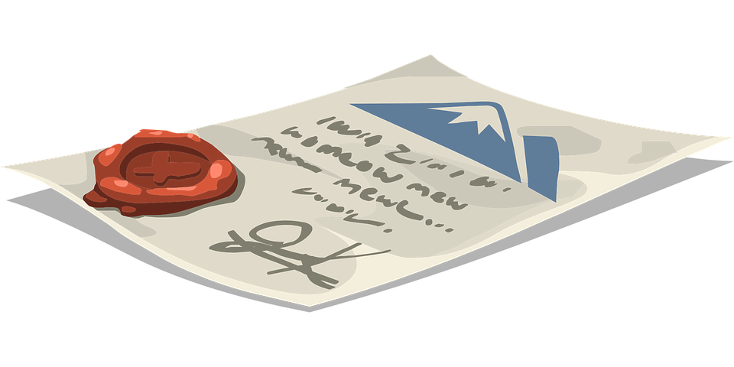
It actually happened ?
When have you had a warranty that really paid off?
You always wonder if the warranty will actually pay off or the company will weasel out.
Contrast that with God’s promises
We can be sure God saves us when we trust in Christ.

Slide 4
Listen for how to be born of God.
1 John 5:1-5 (NIV) Everyone who believes that Jesus is the Christ is born of God, and everyone who loves the father loves his child as well. 2 This is how we know that we love the children of God: by loving God and carrying out his commands. 3 This is love for God: to

Slide 5
Listen for how to be born of God.
obey his commands. And his commands are not burdensome, 4 for everyone born of God overcomes the world. This is the victory that has overcome the world, even our faith. 5 Who is it that overcomes the world? Only he who believes that Jesus is the Son of God.

Slide 6
Jesus is the Christ
What is key to being born of God?
What is the relationship of being born of God, believing in Jesus as the Christ, loving others, and loving God?
How do believers demonstrate their love for God?
Verse 3 says loving God will be displayed by obedience of God’s commands. What are some commands of God with which you struggle with obeying?

Slide 7
Jesus is the Christ
How then can John say that God’s commands are not burdensome?
What makes a person willing to give to or to love sacrificially the people they know?
What makes a person willing to love sacrificially someone you don’t know personally?

Slide 8
Listen for the importance of God’s Word.
1 John 5:11-13 (NIV) And this is the testimony: God has given us eternal life, and this life is in his Son. 12 He who has the Son has life; he who does not have the Son of God does not have life. 13 I write these things to you who believe in the name of the Son of God so that you may know that you have eternal life.

Slide 9
God’s Word Says So
Why did John write this letter?
What does it mean to believe on the name of the Son of God?
What assurance did John want his readers to have that moved him to write to them?

Slide 10
God’s Word Says So
What does it mean to have “life through the Son?”
Why is it sometimes hard for people to believe faith in Jesus is enough for salvation?
What aspect of eternal life is most exciting for you?

Slide 11
Listen for one more reason of assurance.
1 John 5:18-21 (NIV) We know that anyone born of God does not continue to sin; the one who was born of God keeps him safe, and the evil one cannot harm him. 19 We know that we are children of God, and that the whole world is under the control of the evil one.

Slide 12
Listen for one more reason of assurance.
We know also that the Son of God has come and has given us understanding, so that we may know him who is true. And we are in him who is true--even in his Son Jesus Christ. He is the true God and eternal life. 21 Dear children, keep yourselves from idols.

Slide 13
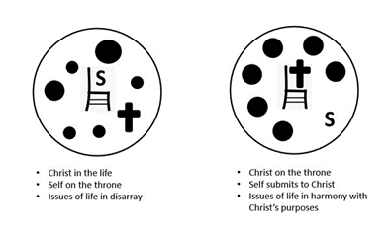
My Life Has Been Changed
What are the various claims about Jesus made in these verses?
By whom is the believer’s salvation secured?
Why can a believer refrain from a lifestyle of sin?
From the NLT2 We know that God’s children do not make a practice of sinning, for God’s Son holds them securely, and the evil one cannot touch them.

Slide 14
My Life Has Been Changed
How has your life changed since you first encountered Christ?
How does verse 21 fit into John’s overall message?
How can we guard ourselves from idols?

Slide 15
Application
Evaluate your life.
Does your life reflect the triad of assurance: faith, love, obedience?
If you say yes, but not as well as it should, what changes need to be made in your life to better reflect these salvation qualities?

Slide 16
Application
Align your life.
Have you started taking steps in your life to be a faithful witness?
Practice sharing your testimony.
Download the Life on Mission app (namb.net) on your phone, learn the presentation, and be prepared to share.

Slide 17
Application
Make a difference in someone’s life.
Make an intentional effort to lead someone to faith in Christ this week.
Set up a coffee or lunch meeting.
Make it a priority to share the gospel. Remember, it’s not your job to save them, but God does want you to share.
Trust Him for the results.

Slide 18
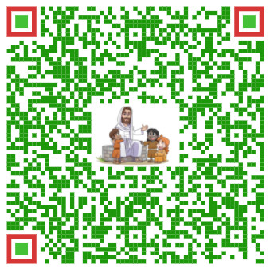
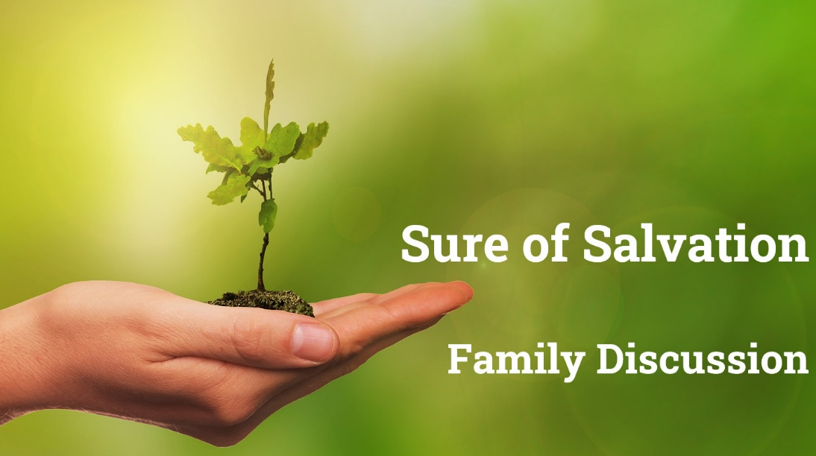
Family Discussion Video

Slide 19
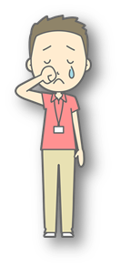
Family Activities
I was so frightened … the letters came down with a horrible clatter. Windows were broken 2 blocks away. Can you help us put them back correctly?
Need Help or want the crossword? https://tinyurl.com/5b33pzc4

Slide 20
Sure of Salvation
October 10

