Slide 1
Serve Even When Discouraged
August 22

Slide 2
Video Introduction
View Video

Slide 3
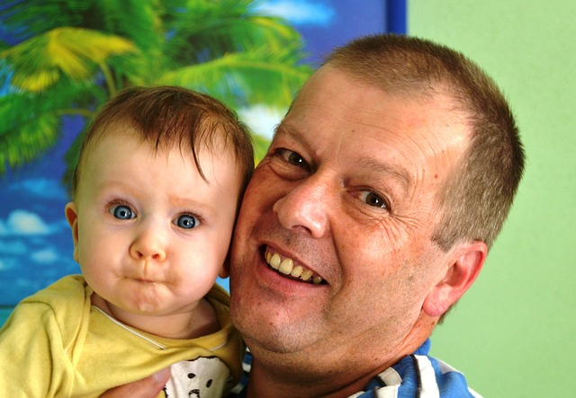
Think About It …
Who or what can most always cheer you up?
Sometimes our discouragement affects our spiritual lives.
Today we look at Elijah’s time of discouragement.
God told him and tells us, don’t let discouragement keep you from serving.

Slide 4
Listen for response to a threat.
1 Kings 19:1-5 (NIV) Now Ahab told Jezebel everything Elijah had done and how he had killed all the prophets with the sword. 2 So Jezebel sent a messenger to Elijah to say, "May the gods deal with me, be it ever so severely, if by this time tomorrow I do not make your life like that of one of them." 3 Elijah was afraid and ran for his life.

Slide 5
Listen for response to a threat.
When he came to Beersheba in Judah, he left his servant there, 4 while he himself went a day's journey into the desert. He came to a broom tree, sat down under it and prayed that he might die. "I have had enough, LORD," he said. "Take my life; I am no better than my ancestors." 5 Then he lay down under the tree and fell asleep.

Slide 6
Never Give Up
Who are named here as Elijah’s enemies?
What did Jezebel say that frightened Elijah?
Describe his attitude toward what was happening to him and the solution he had for escaping it.
What are some situations where you could feel like you just want to give up?

Slide 7
Never Give Up
Why do you think it is difficult to remember God’s power and faithfulness in the midst of discouragement?
Realize this …
Spiritual victory is often followed by trouble and danger
Even godly people can be tired, afraid, and distressed

Slide 8
Never Give Up
Elijah is off into the wilderness. How could this be symbolic of his state of mind?
How can isolation be detrimental when you are discouraged?

Slide 9
Listen for how God speaks.
1 Kings 19:11-14 (NIV) The LORD said, "Go out and stand on the mountain in the presence of the LORD, for the LORD is about to pass by." Then a great and powerful wind tore the mountains apart and shattered the rocks before the LORD, but the LORD was not in the wind. After the wind there was an earthquake, but the LORD was not in the earthquake.

Slide 10
Listen for how God speaks.
After the earthquake came a fire, but the LORD was not in the fire. And after the fire came a gentle whisper. 13 When Elijah heard it, he pulled his cloak over his face and went out and stood at the mouth of the cave. Then a voice said to him, "What are you doing here, Elijah?"

Slide 11
Listen for how God speaks.
He replied, "I have been very zealous for the LORD God Almighty. The Israelites have rejected your covenant, broken down your altars, and put your prophets to death with the sword. I am the only one left, and now they are trying to kill me too."

Slide 12
Be Attentive to The Lord’s Presence
When God asks, “what are you doing here?” what points does Elijah make?
Why do you think Elijah believed he was the only prophet of God left alive?
What events does Elijah experience that turn out not to be God’s communication?
What do we normally do when someone whispers? What did Elijah do?

Slide 13
Be Attentive to The Lord’s Presence
What do you think Elijah could learn about God through the great wind, the earthquake, and the fire?
How does God speak specifically to us today?
What encouragement has God recently spoken to you through one of these ways?

Slide 14
Listen for tasks given to Elijah.
Kings 19:15-18 (NIV) The LORD said to him, "Go back the way you came, and go to the Desert of Damascus. When you get there, anoint Hazael king over Aram. 16 Also, anoint Jehu son of Nimshi king over Israel, and anoint Elisha son of Shaphat from Abel Meholah to succeed you as prophet.

Slide 15
Listen for tasks given to Elijah.
Jehu will put to death any who escape the sword of Hazael, and Elisha will put to death any who escape the sword of Jehu. 18 Yet I reserve seven thousand in Israel--all whose knees have not bowed down to Baal and all whose mouths have not kissed him."

Slide 16
Press On!
What specific tasks does God have for a worn-out prophet?
Why would assignment of specific ministries be an encouragement to someone who feels at the end of their rope?
How would news of the 7000 faithful be an encouragement?
Consider that our personal obedience to the Lord is an encouragement to other believers!

Slide 17
Press On!
What kinds of things make us feel sorry for ourselves?
How does God give a sense of purpose and direction in these situations?

Slide 18
Application
Pray.
Revise your prayers this week from “God, change my situation.”
Change them to “God, change my perspective.”

Slide 19
Application
Thank.
Thank someone who has encouraged you by their perseverance to serve God through discouraging circumstances.
Commit yourself to be that example for one person you know.

Slide 20
Application
Recommit.
Recommit yourself to a God-given task you’ve been ready to quit.
Make your recommitment public.

Slide 21
Family Activities
So, our young operative in the Republic of Kiarab needs your help to decode this message. If you run into difficulty, get assistance from the QR code below. Additional Family intrigues will also be found there.

Slide 22
Serve Even When Discouraged
August 22

