Slide 1
Our Commitment to Christ
October 25

Slide 2
Video Introduction
View Video

Slide 3
Be honest, now …
What is something you committed to, but you wish you hadn’t?
Some commitments are worth it, some maybe not so much.
Committing your life to Jesus is totally worth it.
We are challenged to commit our whole life in trust and obedience to Christ.

Slide 4
Listen for what aggravated Jesus.
Mark 10:13-16 (NIV) People were bringing little children to Jesus to have him touch them, but the disciples rebuked them. 14 When Jesus saw this, he was indignant. He said to them, "Let the little children come to me, and do not hinder them,

Slide 5
Listen for what aggravated Jesus.
for the kingdom of God belongs to such as these. 15 I tell you the truth, anyone who will not receive the kingdom of God like a little child will never enter it." 16 And he took the children in his arms, put his hands on them and blessed them.

Slide 6
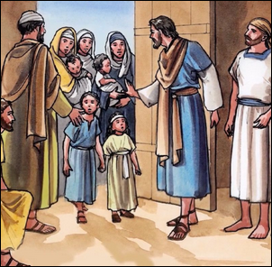
Childlike Faith
What is the tender picture presented in these verses?
How was that scene distorted? What kinds of things do you think the disciples might have said?

Slide 7
Childlike Faith
Contrast how the disciples felt about children and how Jesus felt.
Why do you think that Jesus is described as being displeased or indignant?
What truth did Jesus teach through the children about kingdom citizenship?
Disciples Attitude | Jesus’ Attitude

Slide 8
Childlike Faith
What does it look like to receive the kingdom of God like a little child?
How can we have the same attitude toward God that children had toward Jesus?

Slide 9
Listen for a bold claim.
Mark 10:17-20 (NIV) As Jesus started on his way, a man ran up to him and fell on his knees before him. "Good teacher," he asked, "what must I do to inherit eternal life?" 18 "Why do you call me good?" Jesus answered. "No one is good--except God alone.

Slide 10
Listen for a bold claim.
You know the commandments: 'Do not murder, do not commit adultery, do not steal, do not give false testimony, do not defraud, honor your father and mother.'" 20 "Teacher," he declared, "all these I have kept since I was a boy.".

Slide 11
Strive for Obedience
What words or statements support the understanding that the man who came to Jesus was a decent man making a sincere inquiry of Jesus?
What was the man seeking who came to Jesus?
Where is the flaw in his question?
What was the first part of Jesus’ explanation of the way to inherit eternal life?

Slide 12
Strive for Obedience
Why do you think Jesus quizzed the man about his commitment to the commandments?
What does the rich man’s answer to Jesus tell us about his spiritual state?
What might be significant about the fact that Jesus had not yet addressed the first four commandments … those which deal with our relationship with God?

Slide 13
Listen for why the man goes away sad.
Mark 10:21-22 (NIV) Jesus looked at him and loved him. "One thing you lack," he said. "Go, sell everything you have and give to the poor, and you will have treasure in heaven. Then come, follow me." 22 At this the man's face fell. He went away sad, because he had great wealth.

Slide 14
Follow Jesus Wholeheartedly
What further requirement did Jesus pose?
Why do you think Jesus called for the man to sell his possessions and give to the poor?
How can wealth interfere with a person’s Christian faith?
What other kinds of things can become substitutes for God in our lives? What might Jesus ask us to set aside?

Slide 15
Follow Jesus Wholeheartedly
So, how do you think God does want us to use the material wealth He has given us?
How can we prevent ourselves from allowing wealth to interfere with our faith?

Slide 16
Application
Trust.
If you’ve been trying to be good and moral in order to gain a good standing with God, acknowledge the futility of it.
Trust Christ and be obedient to His Word as a response to His grace in your life.

Slide 17
Application
Examine.
Examine your heart and see if, like the rich young ruler, you have things that sit on the throne of your heart other than the Person of Christ.
Maybe it’s money, power, comfort, control, safety, approval, or recognition.
Ask Him to reveal those things to you and give Him His rightful place on the throne of your life.

Slide 18
Application
Renew.
If you’ve lost your first love for Christ and are not coming to Him on a daily basis like a little child, rekindle that relationship with Him.
Write down some of the ways or things that have kept you from a childlike faith in God and ask Him to help you return to that place again.

Slide 19
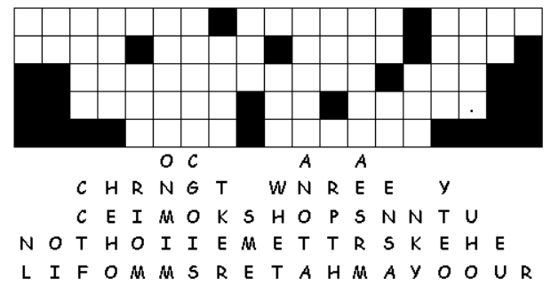
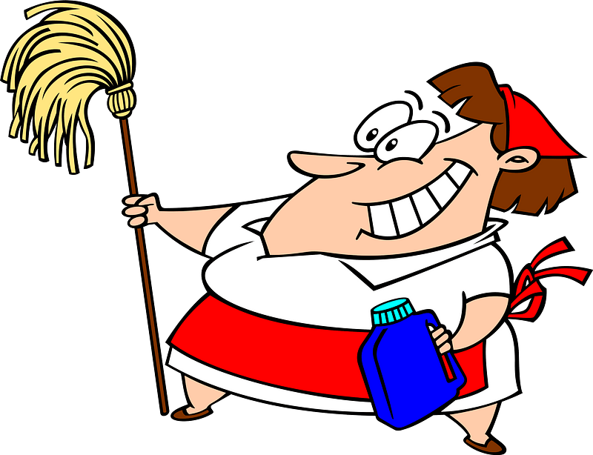
Family Activities
Just look at all those letters. We’ve got to fix that. I’m sure there’s an important message there. And there’s more good stuff at https://tinyurl.com/y6xs666k . Don’t know about that 666! But your family will like what you find on that web page!

Slide 20
Our Commitment to Christ
October 25

