Slide 1
Nehemiah Persist
August 5

Slide 2
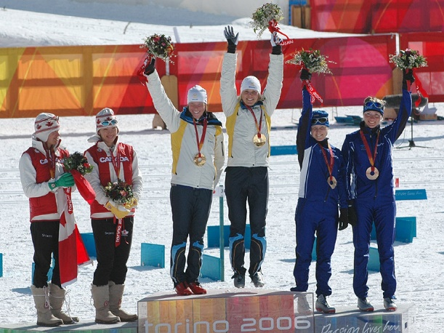
Think About It …
Why do you think some people get upset when they see others succeed?
Today we look at how Nehemiah’s beginning success upset some local leaders
Nehemiah faced opposition.
Doing God’s often brings out detractors and opposition even today

Slide 3
Listen for ridicule.
Nehemiah 4:1-3 (NIV) When Sanballat heard that we were rebuilding the wall, he became angry and was greatly incensed. He ridiculed the Jews, 2 and in the presence of his associates and the army of Samaria, he said, "What are those feeble Jews doing? Will they restore their wall?

Slide 4
Listen for ridicule.
Will they offer sacrifices? Will they finish in a day? Can they bring the stones back to life from those heaps of rubble--burned as they are?" 3 Tobiah the Ammonite, who was at his side, said, "What they are building--if even a fox climbed up on it, he would break down their wall of stones!"

Slide 5
Ridicule and Opposition
Who were the opponents who spoke out against the Jews and their efforts to rebuild and fortify the city?
What tactics did they use?
List some of the negative comments.
What did Sanballat and the others hope to accomplish by their ridicule?

Slide 6
Ridicule and Opposition
Why does involvement in God’s work sometimes incite opposition?
To what area of life today do Nehemiah’s words speak?
What kinds of events, opposition, or setbacks most discourage you?
How should we respond to negative events or criticism from others?

Slide 7
Listen for Nehemiah’s response.
Nehemiah 4:6-9 (NIV) So we rebuilt the wall till all of it reached half its height, for the people worked with all their heart. 7 But when Sanballat, Tobiah, the Arabs, the Ammonites and the men of Ashdod heard that the repairs to Jerusalem's walls

Slide 8
Listen for Nehemiah’s response.
had gone ahead and that the gaps were being closed, they were very angry. 8 They all plotted together to come and fight against Jerusalem and stir up trouble against it. 9 But we prayed to our God and posted a guard day and night to meet this threat.

Slide 9
Prayerfully Do God’s Task
What did Israel’s enemies do when they heard of Israel’s success in rebuilding Jerusalem’s walls? In what ways did the opposition to their efforts to build the wall increase?
How did Nehemiah and the Jews respond to the evil plotting of their enemies?
What was one of the keys to success for Nehemiah and the people?

Slide 10
Prayerfully Do God’s Task
How can we maintain our focus on God’s work in the face of opposition? How does God want us to deal with discouragement?
What practical steps could you take the next time you feel opposition from others for doing what is right?

Slide 11
Listen for a challenge.
Nehemiah 4:14-18 (NIV) After I looked things over, I stood up and said to the nobles, the officials and the rest of the people, "Don't be afraid of them. Remember the Lord, who is great and awesome, and fight for your brothers, your sons and your daughters, your wives and your homes."

Slide 12
Listen for a challenge.
When our enemies heard that we were aware of their plot and that God had frustrated it, we all returned to the wall, each to his own work. 16 From that day on, half of my men did the work, while the other half were equipped with spears, shields, bows and armor.

Slide 13
Listen for a challenge.
The officers posted themselves behind all the people of Judah 17 who were building the wall. Those who carried materials did their work with one hand and held a weapon in the other, 18 and each of the builders wore his sword at his side as he worked. But the man who sounded the trumpet stayed with me.

Slide 14
Work with Vigilance
What did Nehemiah do to encourage the Israelites and protect them from their enemies?
What security plan did Nehemiah set in place that would allow the work to continue?
What does it look like for us to work with one hand and resist opposition with the other?

Slide 15
Work with Vigilance
How does remembering the Lord help us persist in our current struggles?
How can we support each other when one of us is experiencing opposition and adversity?

Slide 16
Application
Serve.
If you are not regularly involved in service or ministry to others, find a place to make a difference.
Consider where you can help “build the wall.”
Talk to your pastor or other Christians for input on an area where you can serve.

Slide 17
Application
Search.
See how others deal with opposition as they serve Christ.
Go to https://www.opendoorsusa.org/ and research Christian persecution across the globe.
Pray for persecuted peoples.

Slide 18
Application
Share.
One way to “confront” someone who opposes you is to lovingly serve that person.
Without big fanfare, find a way to express and share the love of Christ through your actions.

Slide 19
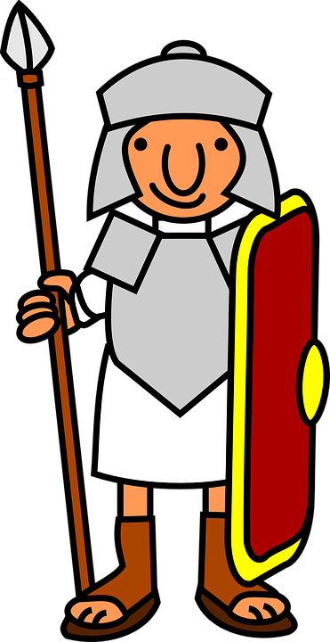
Family Activities
Check out the Family Activities web site at https://tinyurl.com/y7zbn3un
Try some of the fun activities which help build strong Christian families.

Slide 20
Nehemiah Persist
August 5

