Slide 1
Joy in Place of Fear
January 8

Slide 2
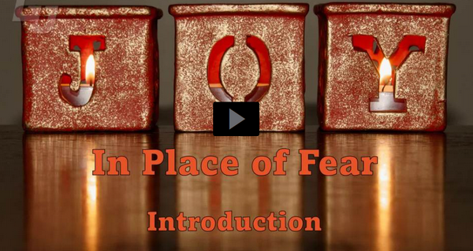
Video Introduction
View Video

Slide 3
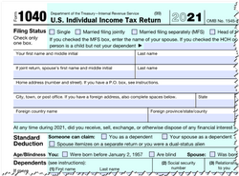
Remember that time …
When have you said, “I’m glad that’s behind me”?
Someday all our fears will be left behind!
Fear will be a thing of the past in God’s eternal kingdom

Slide 4
Listen for renewal.
Zephaniah 3:9-13 (NIV) "Then will I purify the lips of the peoples, that all of them may call on the name of the LORD and serve him shoulder to shoulder. 10 From beyond the rivers of Cush my worshipers, my scattered people, will bring me offerings. 11 On that day you will

Slide 5
Listen for renewal.
not be put to shame for all the wrongs you have done to me, because I will remove from this city those who rejoice in their pride. Never again will you be haughty on my holy hill. 12 But I will leave within you the meek

Slide 6
Listen for renewal.
and humble, who trust in the name of the LORD. 13 The remnant of Israel will do no wrong; they will speak no lies, nor will deceit be found in their mouths. They will eat and lie down and no one will make them afraid."

Slide 7
Humble Yourself before God
Note the words and phrases that describe the unity of God’s people.
God will purify His people’s lips – purify their speech
All God’s people can call on His name and serve Him together
Believers from all nations will bring Him offerings

Slide 8
Humble Yourself before God
Verse 11 says, “On that day you will not be put to shame for all the wrongs you have done …” What will the Lord do to eliminate that shame?
How do the faithful remnant behave?
Why will they have no need to be afraid?
How does embracing God’s purpose set your mind at ease about the future?

Slide 9
Humble Yourself before God
What kinds of fears hinder believers experiencing the joy God intends for us?
Based on this passage, what should the believer do to conquer these kinds of fears?

Slide 10
Humble Yourself before God
Consider John 15:11-16 (NIV) I have told you this so that my joy may be in you and that your joy may be complete.
According to this verse …
God’s joy is in you
Your joy is complete
In what ways does this happen? How is God’s joy manifested in you? How is it made complete?

Slide 11
Listen for returning to joy.
Zephaniah 3:14-17 (NIV) Sing, O Daughter of Zion; shout aloud, O Israel! Be glad and rejoice with all your heart, O Daughter of Jerusalem! 15 The LORD has taken away your punishment, he has turned back your enemy. The LORD, the King of Israel, is with you; never again will

Slide 12
Listen for returning to joy.
you fear any harm. 16 On that day they will say to Jerusalem, "Do not fear, O Zion; do not let your hands hang limp. 17 The LORD your God is with you, he is mighty to save. He will take great delight in you, he will quiet you with his love, he will rejoice over you with singing."

Slide 13
God’s Presence throughout Harm
What words and phrases express what the people are encouraged to do in verses 14 and 16?
What are some reasons for singing and rejoicing?
What does the Lord promise about Himself in relationship to His people? Why can the Lord’s people face fear with strength?

Slide 14
God’s Presence throughout Harm
Note: God rejoices over you with singing
Not because of your merits
Not because you’ve been a good person
Not because you’ve avoided being a bad person
But … because He loves you … God Is Love
He rejoices that you have placed your trust in Him

Slide 15
God’s Presence throughout Harm
How does God’s presence with you help you not be afraid?

Slide 16
Listen for promises of hope.
Zephaniah 3:18-20 (NIV) "The sorrows for the appointed feasts I will remove from you; they are a burden and a reproach to you. 19 At that time I will deal with all who oppressed you; I will rescue the lame and gather those who have been scattered. I will give them praise and honor

Slide 17
Listen for promises of hope.
in every land where they were put to shame. 20 At that time I will gather you; at that time I will bring you home. I will give you honor and praise among all the peoples of the earth when I restore your fortunes before your very eyes," says the LORD.

Slide 18
Eternally Restored in God’s Kingdom
What additional actions of the Lord are described in these verses?
What do you think it means “before your very eyes”?

Slide 19
Eternally Restored in God’s Kingdom
The people of God will be vindicated. Why does the glory truly belong to God?
How can knowledge of God’s eternal kingdom, God’s eternal rule and authority impact our lives now?

Slide 20
Application
Anticipate.
Reflect on Zephaniah 3 and Revelation 21–22.
Thank God for the ways His heavenly kingdom will be unlike our current world.

Slide 21
Application
Memorize.
Keep being reminded of the joy we have in Christ.
Memorize Psalm 16:11: “You reveal the path of life to me; in your presence is abundant joy; at your right hand are eternal pleasures.”

Slide 22
Application
Witness.
Share the gospel with someone.
We are surrounded by those who don’t have the assurance of a joy-filled future in Christ.
Ask God to reveal to you who that person is and pray for the opportunity to share Christ’s love and what He has done for him or her.

Slide 23
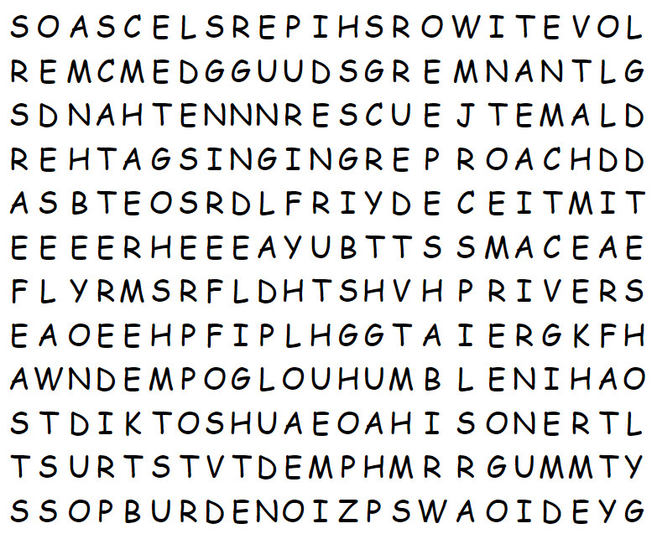
Family Activities
I love these word searches. Here’s one of the words already. If you get stuck, go to https://tinyurl.com/ytat2ynrv . You’ll also find great Family Activities there. I have it on good authority your teacher especially enjoys the color page.

Slide 24
Joy in Place of Fear
January 8

