Slide 1
God With Us
December 5

Slide 2
Video Introduction
View Video

Slide 3
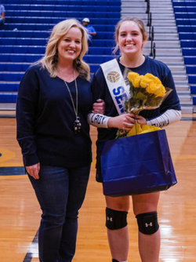
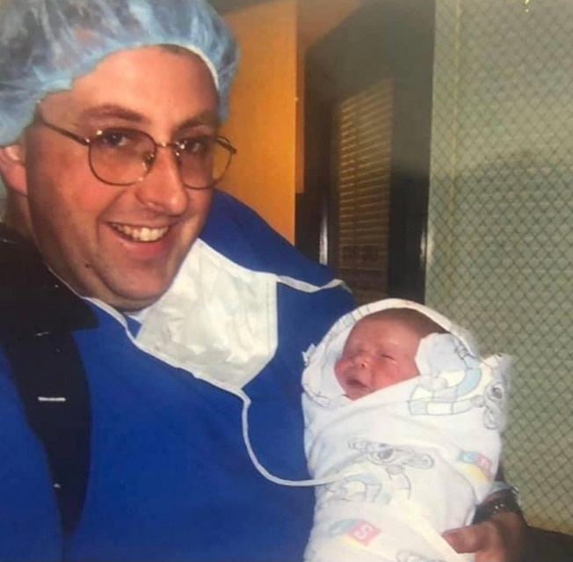
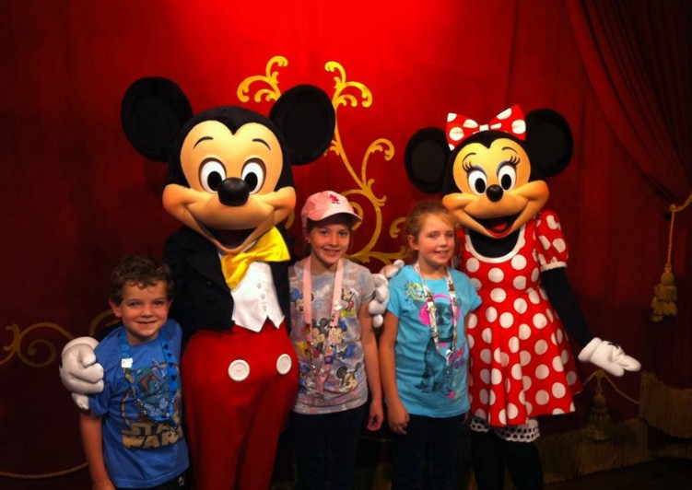
It was special …
When has someone’s presence been the ultimate present for you?
We enjoy and appreciate the presence of someone meaningful in our lives.
Today we study the very presence of the Son of God coming to earth as a human.
Jesus is Immanuel—God with us

Slide 4
Listen for a prediction.
Isaiah 7:10-14 (NIV) Again the LORD spoke to Ahaz, 11 "Ask the LORD your God for a sign, whether in the deepest depths or in the highest heights." 12 But Ahaz said, "I will not ask; I will not put the LORD to the test." 13 Then Isaiah said,

Slide 5
Listen for a prediction.
"Hear now, you house of David! Is it not enough to try the patience of men? Will you try the patience of my God also? 14 Therefore the Lord himself will give you a sign: The virgin will be with child and will give birth to a son, and will call him Immanuel.

Slide 6
Virgin Birth Foretold
King Ahaz was facing an invasion. What did God invite Ahaz to do in order to be reassured?
How did Ahaz respond to the invitation to ask God for a sign?
Why do you think Ahaz might not want to have a sign from God?
What sign was promised by God, even though Ahaz had not asked?

Slide 7
Virgin Birth Foretold
What do you think was the intent of the sign?
What is the meaning and message behind calling the child Immanuel?
Immanuel impacts you personally
Matt. 1 declares Jesus also fulfilled the promise
Son of God entered time and space – rescued us from the curse of sin
Holy Spirit of God present in our lives

Slide 8
Virgin Birth Foretold
What are some ways God invites us to trust in Immanuel, God with Us?

Slide 9
Listen for how God fulfilled the prophecy.
Matthew 1:18-19 (NIV) This is how the birth of Jesus Christ came about: His mother Mary was pledged to be married to Joseph, but before they came together, she was found to be with child through the Holy Spirit. 19 Because Joseph her husband was a righteous man and did not want to expose her to public disgrace, he had in mind to divorce her quietly.

Slide 10
God’s Promise Fulfilled
What plans did Joseph and Mary have in place that they had to be willing to adjust to conform to God’s plan?
What fears do you think Joseph initially had, hearing this news about his bride-to-be?

Slide 11
God’s Promise Fulfilled
Joseph’s options in their culture
Marry her and live with rumors and talk
Make a big deal of the divorce, let people know “It was NOT me”
Quietly end things without major drama.
What positive character qualities did Joseph demonstrate?

Slide 12
God’s Promise Fulfilled
Why do you think God chose this sequence of events surrounding the birth of the Messiah? Why not wait until Mary and Joseph were married – much less embarrassing?

Slide 13
Listen for how Joseph demonstrated faith.
Matthew 1:20-25 (NIV) But after he had considered this, an angel of the Lord appeared to him in a dream and said, "Joseph son of David, do not be afraid to take Mary home as your wife, because what is conceived in her is from the Holy Spirit. 21 She will give birth to a son, and you are to give him the name Jesus,

Slide 14
Listen for how Joseph demonstrated faith.
because he will save his people from their sins." 22 All this took place to fulfill what the Lord had said through the prophet: 23 "The virgin will be with child and will give birth to a son, and they will call him Immanuel"--which means,

Slide 15
Listen for how Joseph demonstrated faith.
"God with us." 24 When Joseph woke up, he did what the angel of the Lord had commanded him and took Mary home as his wife. 25 But he had no union with her until she gave birth to a son. And he gave him the name Jesus.

Slide 16
Our Faith Grounded in God With Us
What facts in the angel’s message indicated the child to be born to Mary was extraordinary?
What benefits would humankind receive through the birth of this child?
How did Joseph respond to his dream?
What do these verses teach us about Joseph?

Slide 17
Our Faith Grounded in God With Us
Joseph responded positively to the angel’s declarations … why do we sometimes fear God working through us in unique or unexpected ways?
What do we know about the rest of the story that Joseph did not know of the future.
How might God’s Christmas plan influence your plans in the days ahead?

Slide 18
Application
Sing to Him.
Look up the lyrics to “O Come, O Come Emmanuel.”
As you listen to the song, consider how Jesus’ presence makes all the difference.

Slide 19
Application
Sit with Him.
Set aside time each day this week to enjoy God’s presence.
Turn off your phone and find a quiet spot to contemplate the depths of God’s love for you.

Slide 20
Application
Share about Him.
The virgin birth seems impossible and unbelievable to many people today.
Look for opportunities to discuss the wonder of the virgin birth with others who might not know Christ.
Emphasize that this points to the unbelievably wonderful truth of our reconciliation with God, which is impossible without Christ.

Slide 21
Family Activities
Pshaw! Someone stole the clues … and the numbers didn’t print in the squares. Well, you do have the words. Ignore the book report assignment for my sister. Concentrate on this. The words tell the story. There’s help and more cool stuff at https://tinyurl.com/pyf2jvfc
Humph!

Slide 22
God With Us
December 5

