Slide 1
God Deserves Our Thanks
November 26

Slide 2
Video Introduction
View Video

Slide 3
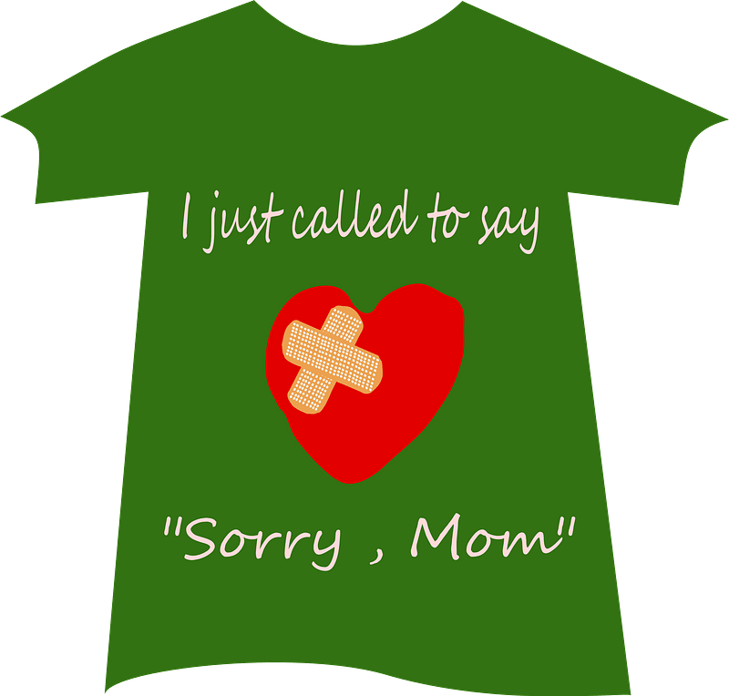
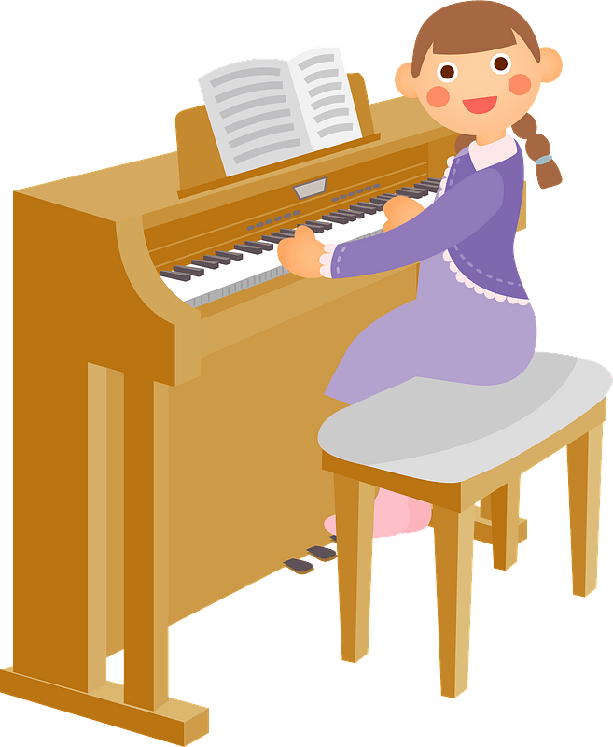
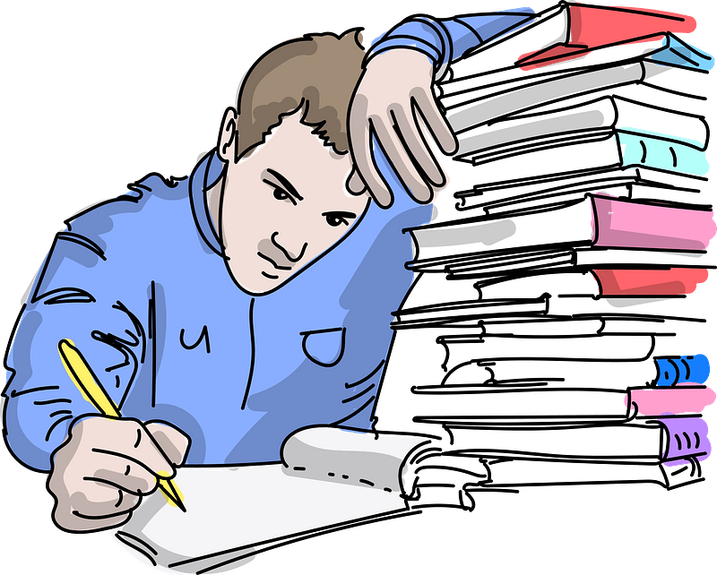
Ah .. Memories …
What are some good habits your parents sought to instill in you?
To say “Thank you” was, no doubt, one of the habits you learned.
Today we consider that we have so much to thank God for.

Slide 4
Listen for commitments to be made to God.
Psalm 65:1-4 (NIV) Praise awaits you, O God, in Zion; to you our vows will be fulfilled. 2 O you who hear prayer, to you all men will come. 3 When we were overwhelmed by sins, you forgave our transgressions. 4 Blessed are those you choose and bring near to live in your courts! We are filled with the good things of your house, of your holy temple.

Slide 5
God’s Forgiveness
What kind of commitments to God does David write about?
Consider what God does with our sin:
Removes our sins as far as the east is from the west
Puts our sins “behind his back”
Remembers them no more
Casts our sins into the depth of the sea

Slide 6
God’s Forgiveness
If left on our own, what would our sins do to us? How would it overwhelm us?
What kinds of iniquities do you think overwhelmed David, the author?
Why does sin (our iniquities) tend to overwhelm us?
How does it feel when you are convinced of God’s (or someone else’s) forgiveness?

Slide 7
God’s Forgiveness
How does praising God for His forgiveness change our lives?
How does the lack of praise for Him affect our lives?
What ways can we make thanks for God’s forgiveness part our holiday celebration?

Slide 8
Listen for God’s greatness.
Psalm 65:5-8 (NIV) You answer us with awesome deeds of righteousness, O God our Savior, the hope of all the ends of the earth and of the farthest seas, 6 who formed the mountains by your power, having armed yourself with

Slide 9
Listen for God’s greatness.
strength, 7 who stilled the roaring of the seas, the roaring of their waves, and the turmoil of the nations. 8 Those living far away fear your wonders; where morning dawns and evening fades you call forth songs of joy.

Slide 10
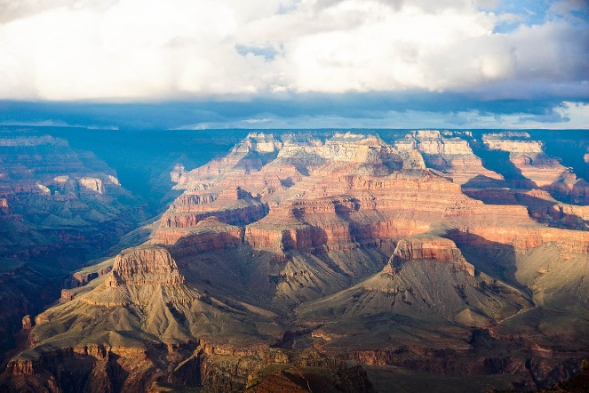
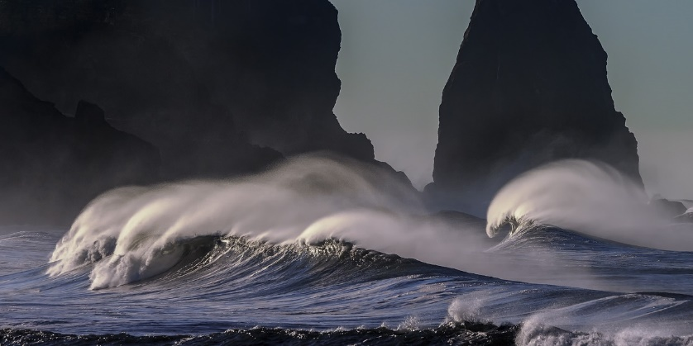
God’s Power and Authority
What word pictures does the writer use to describe of the greatness of God?
What examples of some of these things can you remember seeing?

Slide 11
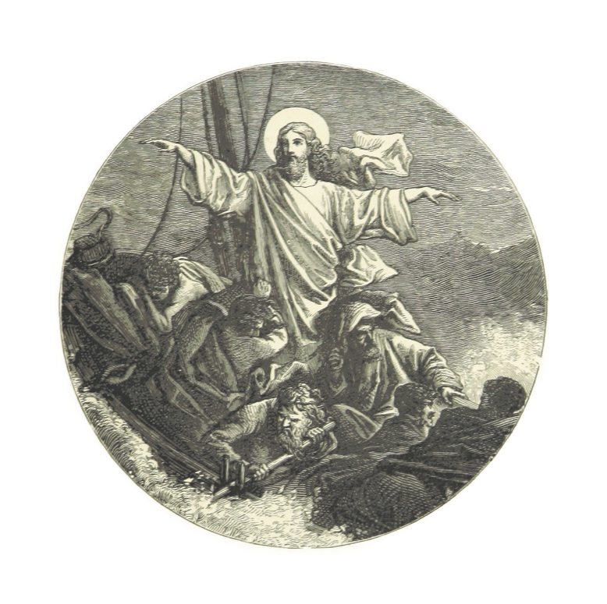
God’s Power and Authority
How do these things cause us to praise the Lord?
David talks of God calming storms … Jesus did this … what kinds of “storms” in your life has God calmed?

Slide 12
Listen for how God provides.
Psalm 65:9-13 (NIV) You care for the land and water it; you enrich it abundantly. The streams of God are filled with water to provide the people with grain, for so you have ordained it. 10 You drench its furrows and level its ridges; you soften it with showers and bless its crops.

Slide 13
Listen for how God provides.
You crown the year with your bounty, and your carts overflow with abundance. 12 The grasslands of the desert overflow; the hills are clothed with gladness. 13 The meadows are covered with flocks and the valleys are mantled with grain; they shout for joy and sing.

Slide 14
God’s Provision
What words and phrases in this passage describe God’s blessings?
If God brings rain to bless the earth, what does He bring to bless our lives?
Why do some people not see God’s bounty?

Slide 15
God’s Provision
How does remembering God’s guidance and provision in the past encourage you for the future (or in times when you are experiencing famine, drought, or poverty)?

Slide 16
Application
Personal reflection.
Take some time to get specific about why you must be grateful.
Evaluate the blessings you might often take for granted and thank God for them one by one.

Slide 17
Application
Intentional encouragement.
Some of the greatest gifts in our lives are the people with whom God has surrounded us.
Prayerfully consider someone who could use encouragement.
Go out of your way to tell them why you are thankful God has placed them in your life.

Slide 18
Application
Family discussion.
Amid all the holiday busyness, carve out time to list why your family should be thankful.
Use this time as family, relatives, or friends have gathered to discuss the reasons we have to thank God.
Use this discussion to combat any endangering consumerism that tempts us during the holiday season.

Slide 19
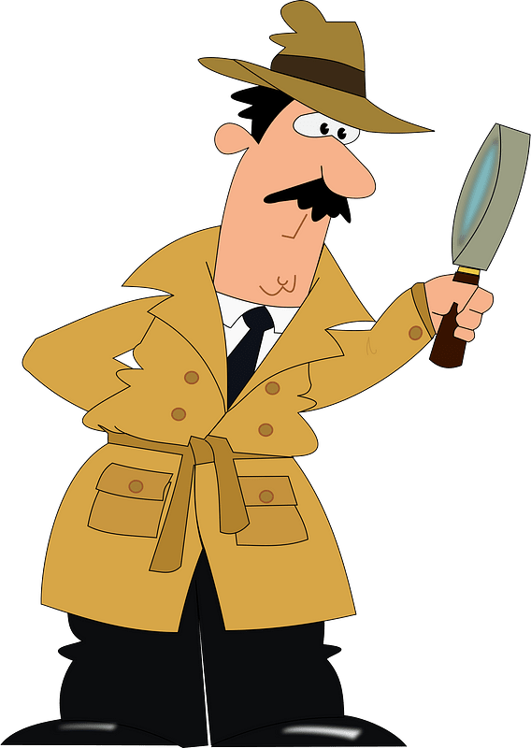
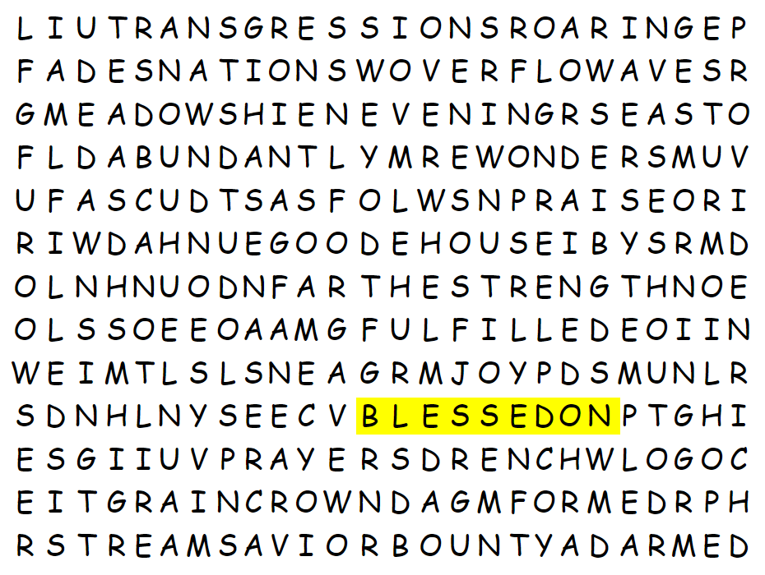
Family Activities
What’s this “BLESSEDON” word? Who is this Don fellow, anyway. You can do better. Maybe I’ll do the crossword at https://tinyurl.com/y3r5nhmu

Slide 20
God Deserves Our Thanks
November 26

