Slide 1
Does It Honor God?
February 19

Slide 2
Video Introduction
View Video

Slide 3
Admit it, now …
What is the greatest honor you or someone you know has received?
We occasionally receive glory and fame for our accomplishments.
Ultimately God is the One who deserves glory for His love for us.
God’s voice always leads us to glorify Him and accomplish His purposes.

Slide 4
Listen for an offer of eternal life.
John 17:1-3 (NIV) After Jesus said this, he looked toward heaven and prayed: "Father, the time has come. Glorify your Son, that your Son may glorify you. 2 For you granted him authority

Slide 5
Listen for an offer of eternal life.
over all people that he might give eternal life to all those you have given him. 3 Now this is eternal life: that they may know you, the only true God, and Jesus Christ, whom you have sent

Slide 6
Share Eternal Life
To what was Jesus referring with the phrase “the hour is come”?
Jesus asks of the Father
Glorify Your Son
So that Your Son will glorify You
Why do you think this prayer was said out loud for the disciples to hear?

Slide 7
Share Eternal Life
For what reasons do we turn to God in prayer? About what sort of things do we usually pray?
Contrast with the example of prayer Jesus gives in this passage.
Jesus worshiped, gave glory to God the Father
He prayed for spiritual needs of His disciples
He noted attributes of God the Father – power, authority, eternality, God is a personal God who can be known by us

Slide 8
Share Eternal Life
What does Jesus' statement about "the only true God" imply?
What is the nature and the source of eternal life?
What does it mean to glorify God in our lives? How can we bring glory to God? What are some everyday things we can do to glorify God?

Slide 9
Listen for how Jesus’ work on earth is completed.
John 17:4-5 (NIV) I have brought you glory on earth by completing the work you gave me to do. 5 And now, Father, glorify me in your presence with the glory I had with you before the world began.

Slide 10
Continue the Work Jesus Gave Us
What are some synonyms for “glory” (noun) and for “glorify” (verb)?
How did God the Father glorify Jesus when He was on the earth?
What could Jesus confidently say He had accomplished by His life and ministry on earth? How did Jesus bring God glory on earth?
Noun – “Glory” | Verb – “Glorify”

Slide 11
Continue the Work Jesus Gave Us
What are some examples of work God has called us to complete?
What are some sacrifices Christians are called to make to do the Lord’s work?

Slide 12
Listen for how Jesus prays for the disciples.
John 17:6-9 (NIV) "I have revealed you to those whom you gave me out of the world. They were yours; you gave them to me and they have obeyed your word. 7 Now they know that everything you have given me comes from you. 8 For I gave them

Slide 13
Listen for how Jesus prays for the disciples.
the words you gave me and they accepted them. They knew with certainty that I came from you, and they believed that you sent me. 9 I pray for them. I am not praying for the world, but for those you have given me, for they are yours.

Slide 14
Pray and Disciple Others
What are some words and phrases used to describe the men of whom Jesus spoke in verse 6?
How had these men, the disciples responded to Jesus’ teachings? What did they believe?
What are the qualities of someone who does a great job of discipling others?

Slide 15
Pray and Disciple Others
For whom did Jesus particularly pray in this instance?
Note: this does not mean Jesus did not (and we should not) pray for non-believers.
We too are charged to pray for others – for one another, for fellow believers
In this setting His prayer was specifically on behalf of His disciples
At the same time, we know we are praying in God’s will to pray for the salvation of those who need Jesus in their lives.
2 Peter 3:9 “The Lord is … not willing that any should perish, but that all should come to repentance.”

Slide 16
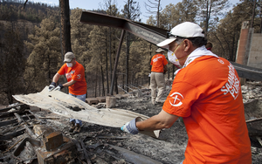
Pray and Disciple Others
Whether great or small, public or private, what might the Lord be calling us to do in His service whereby you bring Him glory?

Slide 17
Application
List.
Make a list of things you know God has told you to do.
Mark an F beside each one you have finished.
Mark a U beside those yet unfinished.
Then pray and ask God for direction in completing those things.

Slide 18
Application
Intercede.
Pray for others.
Pray for them by name, asking God to work in their lives in a way that brings glory to God.

Slide 19
Application
Disciple.
You can honor God as you disciple and lead others to a deeper walk with Christ.
Ask God to lead you to an individual you can disciple.
Let God use you for His glory in the life of another.

Slide 20
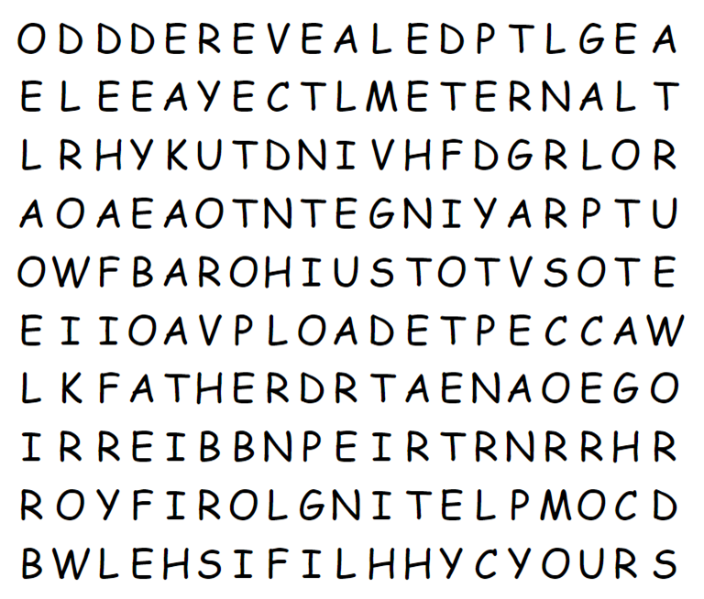
Family Activities
Aiee cucarocha ! The Word Search Lady says to tell you, “Humph!” I can see some words in there, but not the ones on her list. But you can do it! And if you get stuck, go to https://tinyurl.com/mh29yuwp If you would rather do the color page or the crossword, that’s where they are.

Slide 21
Does It Honor God?
February 19

