Slide 1
Confidence in the Midst of Conflict
October 31

Slide 2
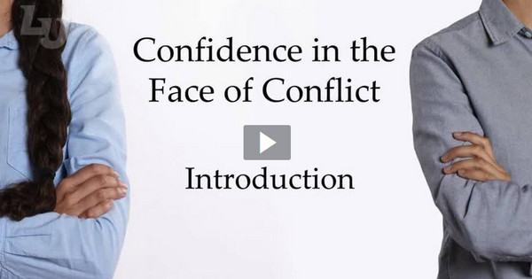
Video Introduction
View Video

Slide 3
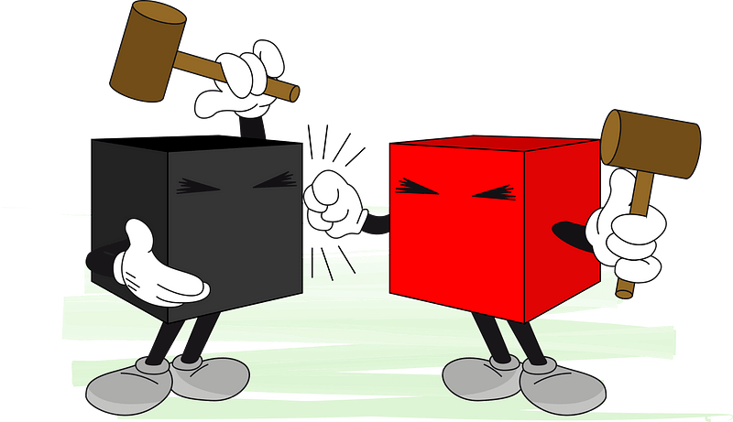
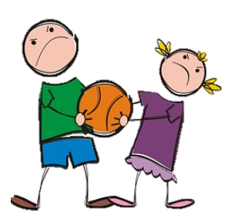
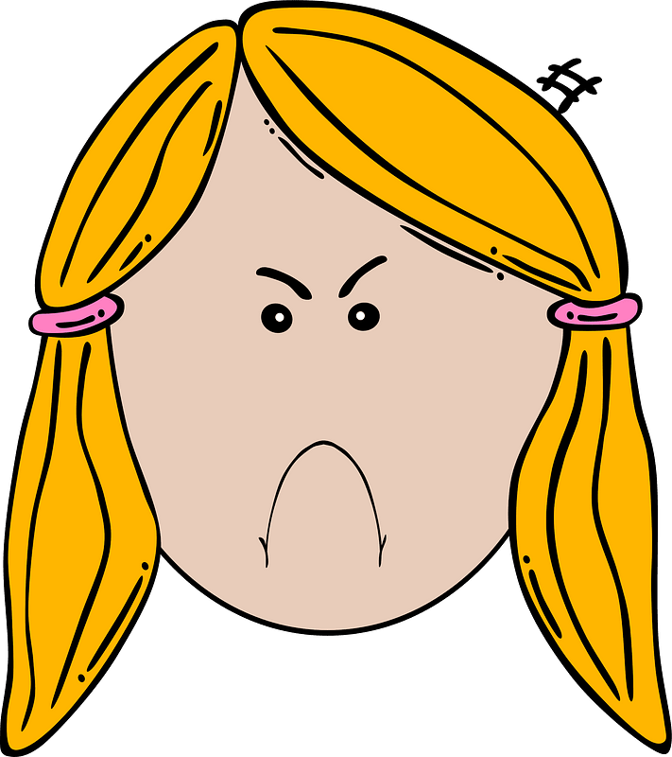
What happened?
What’s the smallest thing you’ve seen someone fight about?
Sometimes people really get out of sorts whether the issue was large or small.
Relationships can be hurt or even broken.
Today we study how we should trust God when conflict disrupts your relationships.
What did you call me?
My turn!
My turn!

Slide 4
Listen for the issue of the conflict.
Genesis 13:5-8 (NIV) Now Lot, who was moving about with Abram, also had flocks and herds and tents. 6 But the land could not support them while they stayed together, for their possessions were so great that they were not able to stay together. 7 And quarreling arose between

Slide 5
Listen for the issue of the conflict.
Abram's herdsmen and the herdsmen of Lot. The Canaanites and Perizzites were also living in the land at that time. 8 So Abram said to Lot, "Let's not have any quarreling between you and me, or between your herdsmen and mine, for we are brothers.

Slide 6
Conflict Between Friends
What were some of the details of the strife that developed?
What was at least one reason Abram cited for Lot and him to avoid quarrelling and strife?
What are some things that make conflict worse in our culture?
What are some ways that people today deal with conflict?

Slide 7
Conflict Between Friends
Why is it sometimes hard to get along with family members and other people you love?
When might a disagreement be a good thing?
⇨Consider the way musicians play different notes,
but when played together, they sound beautiful
it’s called harmony.
Our interactions with others who are different can also result in harmony.

Slide 8
Conflict Between Friends
Why do you think someone who “called on the name of the Lord” encountered problems such as described here?
What are some early steps we can take to avoid or reduce conflict?

Slide 9
Listen for Abram’s solution.
Genesis 13:9-11 (NIV) Is not the whole land before you? Let's part company. If you go to the left, I'll go to the right; if you go to the right, I'll go to the left." 10 Lot looked up and saw that the whole plain of the Jordan was well watered,

Slide 10
Listen for Abram’s solution.
like the garden of the LORD, like the land of Egypt, toward Zoar. (This was before the LORD destroyed Sodom and Gomorrah.) 11 So Lot chose for himself the whole plain of the Jordan and set out toward the east. The two men parted company:

Slide 11
Put Others First
What solution did Abram propose for settling the dispute between his and Lot’s herdsman and preventing any breach between the two of them?
Why do you think Abram suggested the solution he did? Why didn’t he exert his authority as the senior family member?
What choice did Lot make and what apparently influenced his decision?

Slide 12
Put Others First
What lessons can be learned from the way Abram resolved his conflict with Lot?
What would people have said about or to Abram if they’d watched this drama play out?
What criticisms might we take if we seek godly solutions?

Slide 13
Listen for God’s response to Abram.
Genesis 13:14-18 (NIV) The LORD said to Abram after Lot had parted from him, "Lift up your eyes from where you are and look north and south, east and west. 15 All the land that you see I will give to you and your offspring forever. 16 I will make your offspring like the dust of the earth,

Slide 14
Listen for God’s response to Abram.
so that if anyone could count the dust, then your offspring could be counted. 17 Go, walk through the length and breadth of the land, for I am giving it to you." 18 So Abram moved his tents and went to live near the great trees of Mamre at Hebron, where he built an altar to the LORD.

Slide 15
Trust God’s Faithful Promises
What signs of Abram’s trust in the Lord are seen in these verses?
What did God say in response to Abram’s actions?
Why do you think God chose this time to restate His promise to Abram?

Slide 16
Trust God’s Faithful Promises
Many of these tensions are a normal part of life, but when tensions escalate …
Can lead to alienation
Can result in abuse
Consider situations in our family lives where there is conflict …
Newly (or long time) married couple argue about money
Parents of willful teens argue in front of kids about discipline
Parent treats one child as least/most favorite
Siblings fight over inheritance

Slide 17
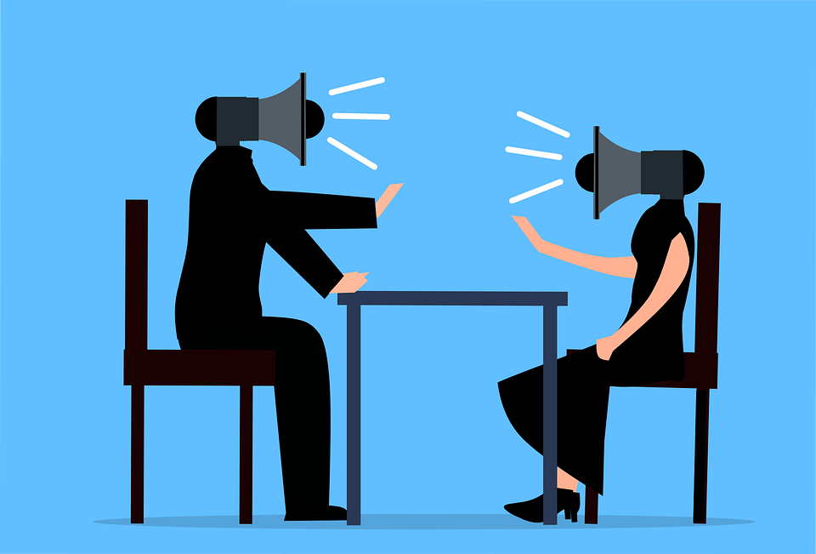
Trust God’s Faithful Promises
How can relying on God influence these kinds of situations?

Slide 18
Application
Pray.
As an act of worship, lift up those whom you might have relational tension with right now.
Also as you pray, a tension from your past might come to the forefront of your mind; pray for those people as well.

Slide 19
Application
Check your pride.
In comparison to Jesus, what is the level of your humility?
Go to God and ask Him to reveal where your pride might be getting the best of you.
Remember pride knocks you down; humility lifts you up.

Slide 20
Application
Reconcile.
What imaginary conversation have you been having with a person whom you know you need to have a real conversation with?
Pick up the phone, set up the meeting, and have the difficult conversation.

Slide 21
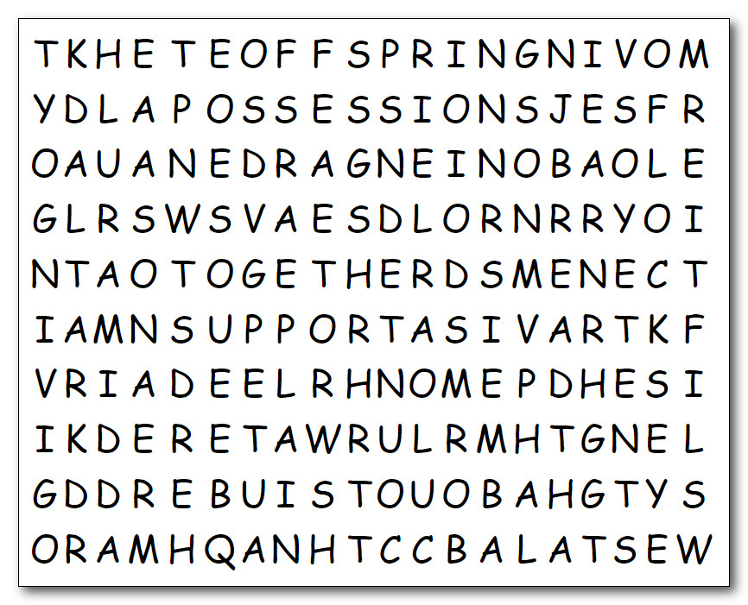
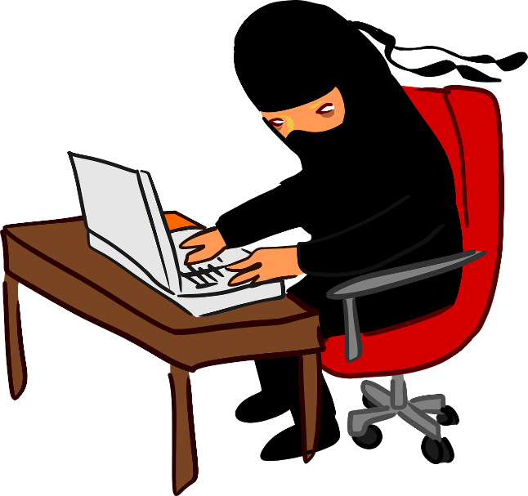
Family Activities
Ah .. The Word Ninja needs your help. I’m busy with book reports for the Word Search Lady. Can you find the words for me? I’m told there is help and other challenging word puzzles at https://tinyurl.com/8w4me5xu I’m confident you can overcome this conflict.

Slide 22
Family Discussion
That Word Ninja fellow didn’t mention an important new feature connected to these lessons. Family Discussion videos. Check it out at https://tinyurl.com/8w4me5xu

Slide 23
Confidence in the Midst of Conflict
October 31

