Slide 1
A Daily Pursuit
September 8

Slide 2
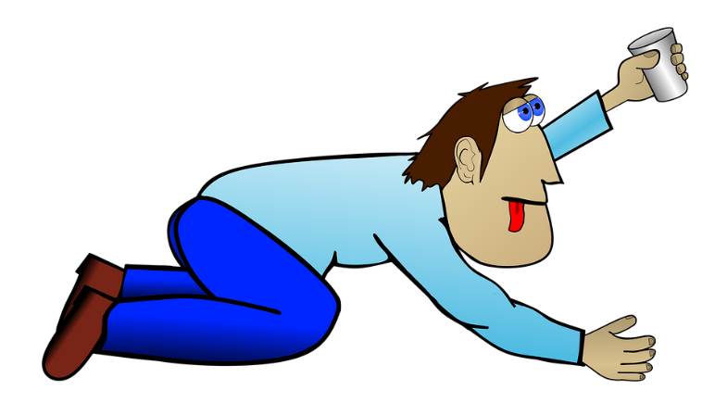
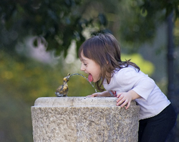
Remember the time?
When has the taste of water felt especially good?
Sometimes we become spiritually dehydrated.
We need spiritual refreshing
We can deepen our relationship with God by spending time with Him every day.

Slide 3
Listen for a repeated command.
Philippians 4:4-5 (NIV) Rejoice in the Lord always. I will say it again: Rejoice! 5 Let your gentleness be evident to all. The Lord is near.

Slide 4
Begin with Praise
Paul was writing from a jail cell. What kinds of things could he have communicated?
Instead of this, what are Paul’s comments and exhortations.
What is your initial reaction to the command to rejoice?
So, what type of things would causes you to rejoice?

Slide 5
Begin with Praise
Count Your Blessings
When upon life’s billows you are tempest-tossed, When you are discouraged, thinking all is lost, Count your many blessings, name them one by one, And it will surprise you what the Lord has done.
Refrain: Count your blessings, name them one by one, Count your blessings, see what God has done! Count your blessings, name them one by one, And it will surprise you what the Lord has done.
How then can we rejoice when things are not going well?
What would the motivation “the Lord is near” have to do with rejoicing and gentleness?

Slide 6
Begin with Praise
How do these concepts relate to our emphasis on spending time with the Lord daily?
If you were more thankful, joyful, and gentle, how might your family and friends be affected?

Slide 7
Listen for the alternative to worry.
Philippians 4:6-7 (NIV) Do not be anxious about anything, but in everything, by prayer and petition, with thanksgiving, present your requests to God. 7 And the peace of God, which transcends all understanding, will guard your hearts and your minds in Christ Jesus.

Slide 8
Praying Brings Peace
What is the remedy for anxiety Paul commends to his readers?
Paul says to pray instead of worrying. How does talking to God work better than worrying?
What outcome results from such praying?

Slide 9
Praying Brings Peace
What differentiates the peace God gives and peace as we might usually think of it?
Why is the peace that God gives beyond understanding?
Man’s Peace | God’s Peace

Slide 10
Listen for what to focus on.
Philippians 4:8-9 (NIV) Finally, brothers, whatever is true, whatever is noble, whatever is right, whatever is pure, whatever is lovely, whatever is admirable--if anything is excellent or praiseworthy--think about such things. 9 Whatever you have learned or received or heard from me, or seen in me--put it into practice. And the God of peace will be with you.

Slide 11
Dwell on the Right Things
What are the qualities of wholesome thoughts? What are their opposites?
Wholesome Thoughts | Opposites

Slide 12
Dwell on the Right Things
How does thinking on these things affect the way we act.
How can we practice the things Paul taught in the passage? How do you keep your focus on godly thinking that leads to godly living?
In addition to these qualities Paul taught about, he also modeled them before those around him. Who in our lives needs to see us model these qualities?

Slide 13
Application Video
View Video

Slide 14
Application
Praise daily.
Begin your day—every day—with praise.
Instead of focusing on your aches and pains, praise God.
Praise puts the day ahead of you into perspective.

Slide 15
Application
Pray daily.
Set aside time every day for uninterrupted prayer where you give God your full attention.
At this stage of your life, you can control your schedule. Prayer is a daily decision.
Pray about your day and pray for the challenges others are facing.
Let the peace of God rule your heart as you leave these needs in His hands.

Slide 16
Application
Read daily.
Get into God’s Word daily.
Choose a Bible reading plan, and/or use this book as a guide for your daily focus in God’s Word.
Partner with others in your group to support and encourage each other in your daily prayer and reading.

Slide 17
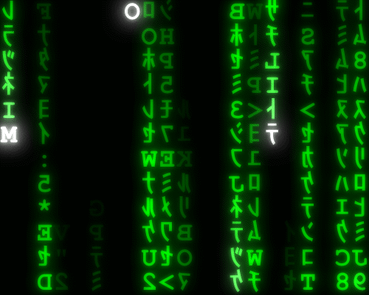
Family Activities
Yup … it’s happening again … falling letters. You’ll need to put them back in place. If you’d rather do the Crossword, go to https://tinyurl.com/yyomgtdg

Slide 18
A Daily Pursuit
September 8

